Slide 1
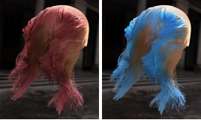

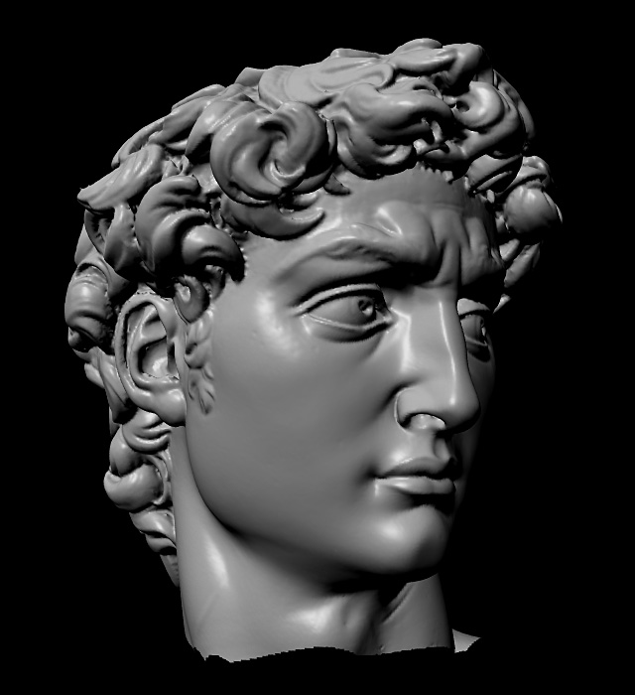
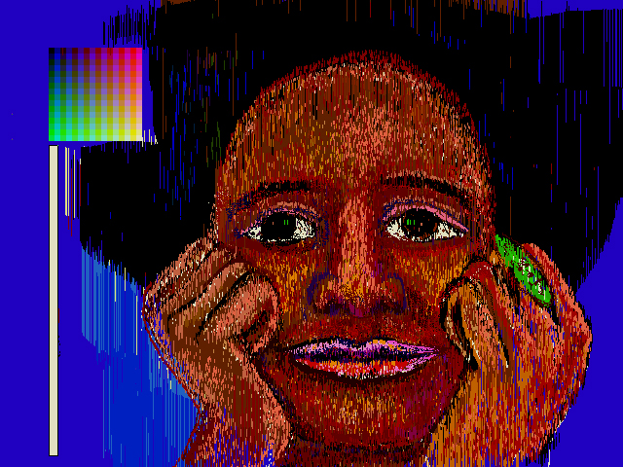
Advanced Computer Graphics
CSE 163 [Spring 2018], Lecture 4
Ravi Ramamoorthi
http://www.cs.ucsd.edu/~ravir

Slide 2
To Do
Assignment 1, Due Apr 27.
  Please START EARLY
  This lecture completes all the material you need

Slide 3
Outline
Implementation of digital filters
  Discrete convolution in spatial domain
  Basic image-processing operations
  Antialiased shift and resize

Slide 4
Discrete Convolution
Previously: Convolution as mult in freq domain
  But need to convert digital image to and from to use that
  Useful in some cases, but not for small filters
Previously seen: Sinc as ideal low-pass filter
  But has infinite spatial extent, exhibits spatial ringing
  In general, use frequency ideas, but consider implementation issues as well
Instead, use simple discrete convolution filters e.g.
  Pixel gets sum of nearby pixels weighted by filter/mask
2 | 0 | -7
5 | 4 | 9
1 | -6 | -2

Slide 5
Implementing Discrete Convolution
Fill in each pixel new image convolving with old
  Not really possible to implement it in place
  More efficient for smaller kernels/filters f
Normalization
  If you don’t want overall brightness change, entries of filter must sum to 1. You may need to normalize by dividing
Integer arithmetic
  Simpler and more efficient
  In general, normalization outside, round to nearest int

Slide 6
Outline
Implementation of digital filters
  Discrete convolution in spatial domain
  Basic image-processing operations
  Antialiased shift and resize

Slide 7
Basic Image Processing (Assn 3.4)
Blur
Sharpen
Edge Detection
All implemented using convolution with different filters

Slide 8
Blurring
Used for softening appearance
Convolve with gaussian filter
  Same as mult. by gaussian in freq. domain, so reduces high-frequency content
  Greater the spatial width, smaller the Fourier width, more blurring occurs and vice versa
How to find blurring filter?

Slide 9
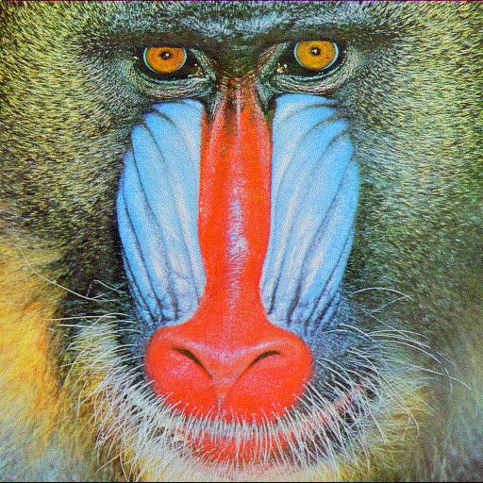
Blurring

Slide 10

Blurring

Slide 11

Blurring

Slide 12

Blurring

Slide 13

Blurring

Slide 14
Blurring Filter
In general, for symmetry f(u,v) = f(u) f(v)
  You might want to have some fun with asymmetric filters
We will use a Gaussian blur
  Blur width sigma depends on kernel size n (3,5,7,11,13,19)
Spatial
Frequency

Slide 15
Discrete Filtering, Normalization
Gaussian is infinite
  In practice, finite filter of size n (much less energy beyond 2 sigma or 3 sigma).
  Must renormalize so entries add up to 1
Simple practical approach
  Take smallest values as 1 to scale others, round to integers
  Normalize. E.g. for n = 3, sigma = ½

Slide 16
Basic Image Processing
Blur
Sharpen
Edge Detection
All implemented using convolution with different filters

Slide 17
Sharpening Filter
Unlike blur, want to accentuate high frequencies
Take differences with nearby pixels (rather than avg)

Slide 18
Blurring

Slide 19
Blurring

Slide 20

Blurring

Slide 21
Basic Image Processing
Blur
Sharpen
Edge Detection
All implemented using convolution with different filters

Slide 22
Edge Detection
Complicated topic: subject of many PhD theses
  Including newest work at UCSD, Marr Prize ICCV 15
Here, we present one approach (Sobel edge detector)
Step 1: Convolution with gradient (Sobel) filter
  Edges occur where image gradients are large
  Separately for horizontal and vertical directions
Step 2: Magnitude of gradient
  Norm of horizontal and vertical gradients
Step 3: Thresholding
  Threshold to detect edges

Slide 23
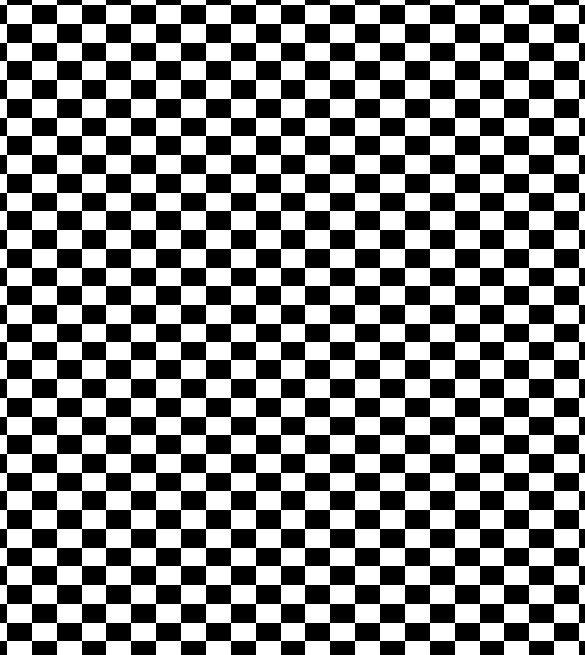
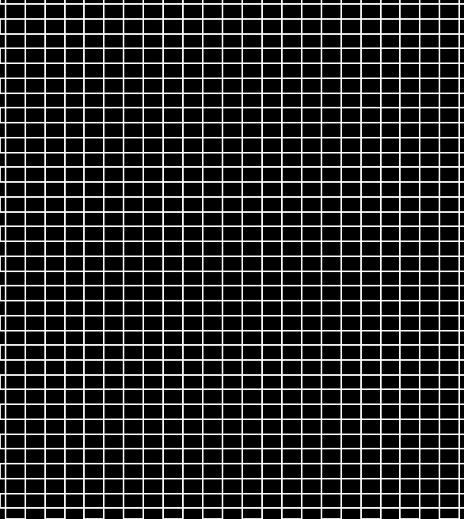
Edge Detection

Slide 24
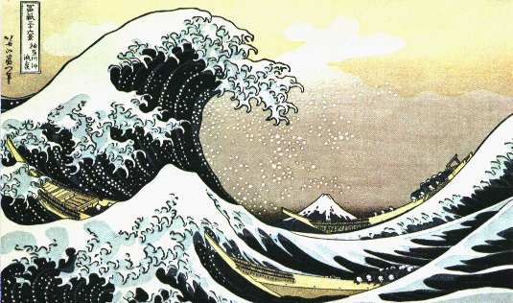
Edge Detection

Slide 25
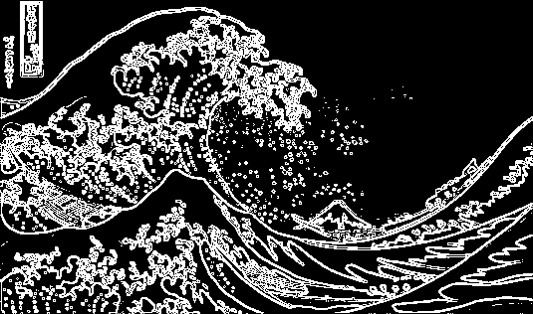
Edge Detection

Slide 26
Details
Step 1: Convolution with gradient (Sobel) filter
  Edges occur where image gradients are large
  Separately for horizontal and vertical directions
Step 2: Magnitude of gradient
  Norm of horizontal and vertical gradients
Step 3: Thresholding

Slide 27
Outline
Implementation of digital filters
  Discrete convolution in spatial domain
  Basic image-processing operations
  Antialiased shift and resize (Assn 3.5, brief)

Slide 28
Antialiased Shift
Shift image based on (fractional) s_{x} and s_{y}
  Check for integers, treat separately
  Otherwise convolve/resample with kernel/filter h:
  In this part, no discrete kernel or mask; continuous

Slide 29
Antialiased Scale Magnification
Magnify image (scale s or γ > 1)
  Interpolate between orig. samples to evaluate frac vals
  Do so by convolving/resampling with kernel/filter:
  Treat the two image dimensions independently (diff scales)

Slide 30


Antialiased Scale Minification
checkerboard.bmp 300x300: point sample
checkerboard.bmp 300x300: Mitchell

Slide 31
Antialiased Scale Minification
Minify (reduce size of) image
  Similar in some ways to mipmapping for texture maps
  We use fat pixels of size 1/γ, with new size γ*orig size (γ is scale factor < 1).
  Each fat pixel must integrate over corresponding region in original image using the filter kernel.

Slide 32
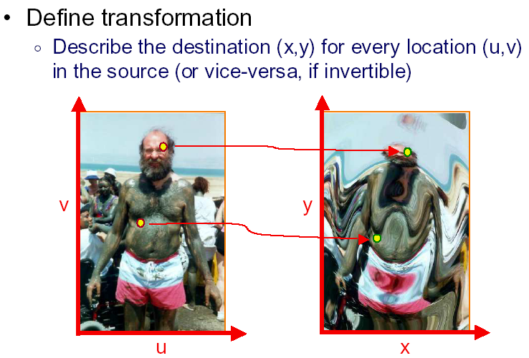
Bonus and Details: Image Warping
Slides courtesy Tom Funkhouser

Slide 33
A note on notation
This segment uses (u,v) for warped location in the source image (or old coordinates) and (u', v') for integer coordinates, and (x,y) for new coordinates
Most of the homework assignment uses (x,y) for old integer coordinates and (a,b) for new coordinates. The warped location is not written explicitly, but is implicit in the evaluation of the filter

Slide 34
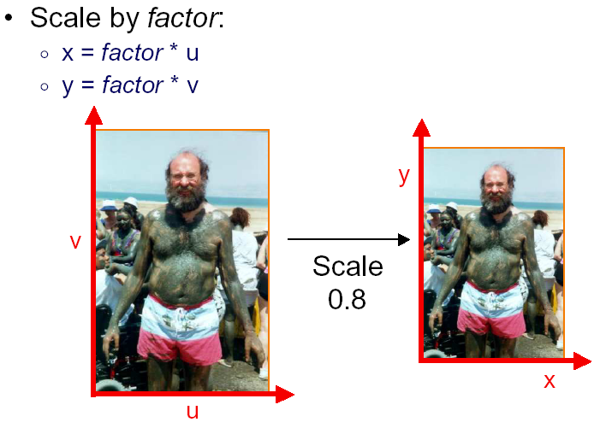
Example Mappings

Slide 35
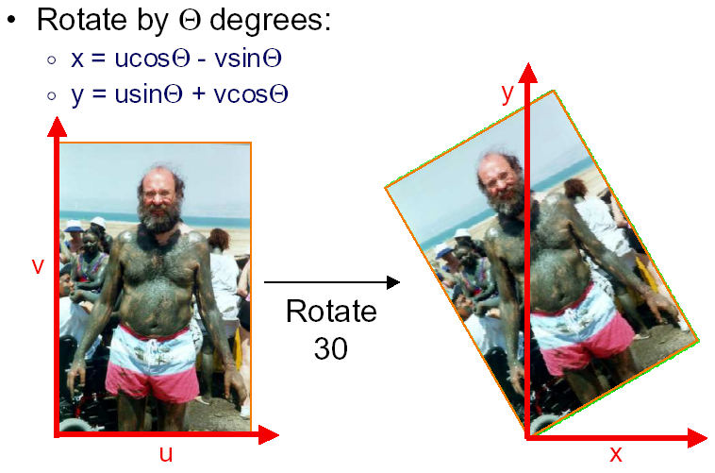
Example Mappings

Slide 36
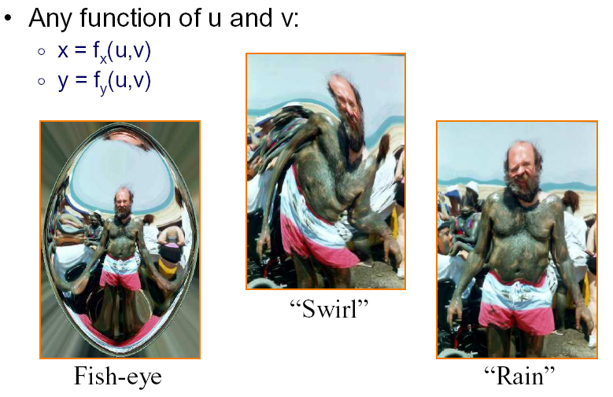
Example Mappings

Slide 37
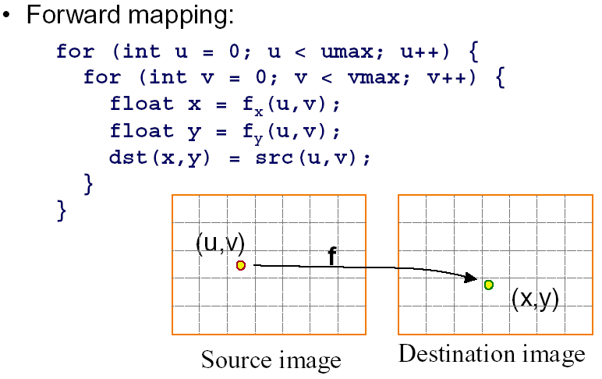
Forward Warping/Mapping
Iterate over source, sending pixels to destination

Slide 38
Forward Warping: Problems
Iterate over source, sending pixels to destination
Same source pixel map to multiple dest pixels
Some dest pixels have no corresponding source
Holes in reconstruction
Must splat etc.

Slide 39
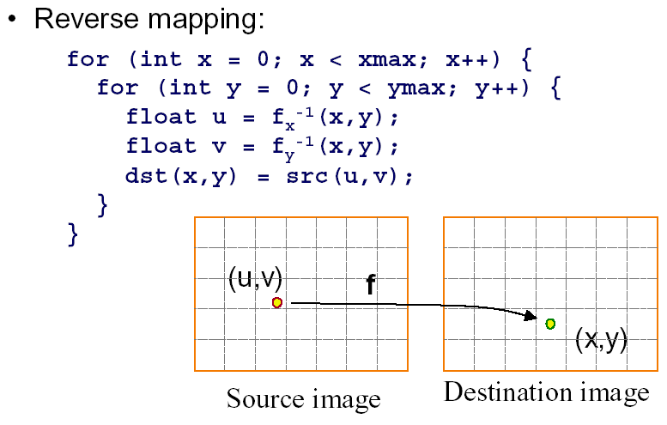
Inverse Warping/Mapping
Iterate destination, finding pixels from source

Slide 40
Inverse Warping/Mapping
Iterate over dest, finding pixels from source
Non-integer evaluation source image, resample
May oversample source
But no holes
Simpler, better than forward mapping

Slide 41
Filtering or Resampling
Compute weighted sum of pixel neighborhood
  Weights are normalized values of kernel function
  Equivalent to convolution at samples with kernel
  Find good (normalized) filters h using earlier ideas
s=0 ;
for (u ' = u-width ; u ' <= u+width; u ' ++)
for (v' = v-width ; v ' <= v+width; v ' ++)
s += h (u ' - u, v' - v) src (u ' , v ') ;
(u,v)
width=2

Slide 42
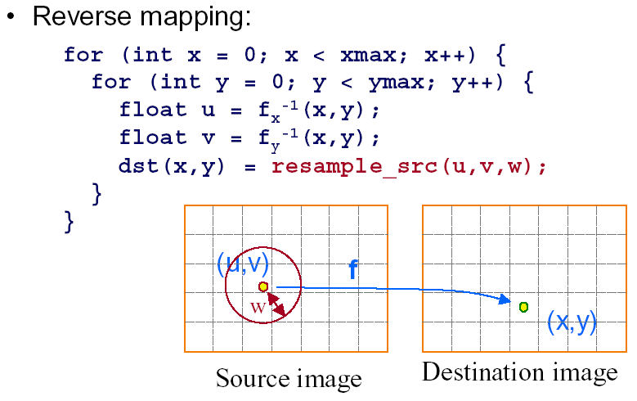
Inverse Warping/Mapping
Iterate destination, finding pixels from source
Filter is really square
with width w, not circle

Slide 43
Filters for Assignment
Implement 3 filters (for anti-aliased shift, resize)
  Nearest neighbor or point sampling
  Hat filter (linear or triangle)
  Mitchell cubic filter (form in assigments). This is a good finite filter that approximates ideal sinc without ringing or infinite width. Alternative is gaussian
Construct 2D filters by multiplying 1D filters

Slide 44
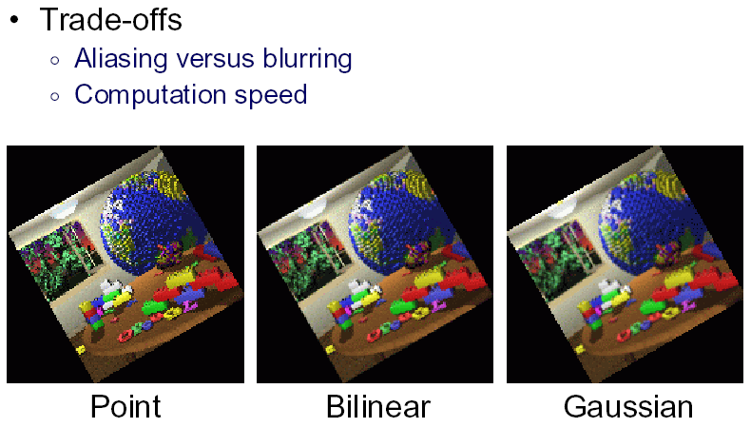
Filtering Methods Comparison

