Slide 1
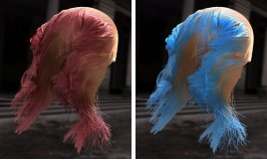

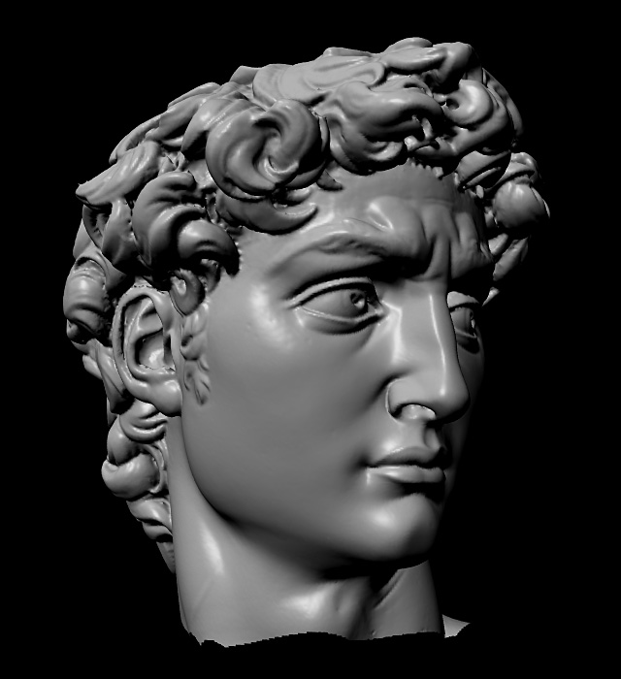
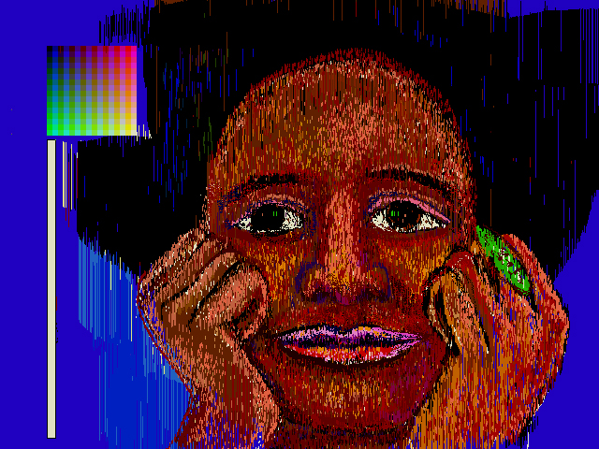
Advanced Computer Graphics
CSE 163 [Spring 2018], Lecture 10
Ravi Ramamoorthi
http://www.cs.ucsd.edu/~ravir

Slide 2
To Do
Assignment 2 due May 18
  Should already be well on way.
  Contact us for difficulties etc.
  This lecture is a “bonus”: more advanced topic that is closer to the research frontier

Slide 3
Subdivision
Was a very hot topic in computer graphics
Brief survey lecture, quickly discuss ideas
Detailed study quite sophisticated
  See some of materials from readings
Advantages
  Simple (only need subdivision rule)
  Local (only look at nearby vertices)
  Arbitrary topology (since only local)
  No seams (unlike joining spline patches)

Slide 4

Video: Geri’s Game (outside link)

Slide 5
Outline
Basic Subdivision Schemes
Analysis of Continuity
Exact and Efficient Evaluation (Stam 98)

Slide 6
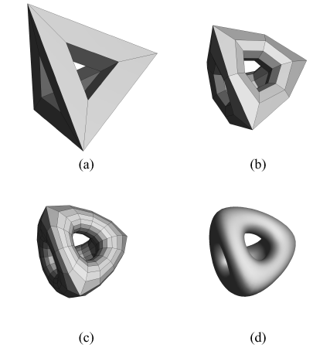
Subdivision Surfaces
Coarse mesh & subdivision rule
  Smooth surface = limit of sequence of refinements
[Zorin & Schröder]

Slide 7
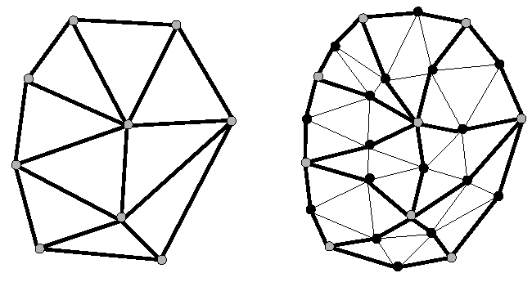
Key Questions
How to refine mesh?
Where to place new vertices?
  Provable properties about limit surface
[Zorin & Schröder]

Slide 8
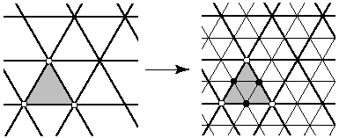
Loop Subdivision Scheme
How refine mesh?
  Refine each triangle into 4 triangles by
  splitting each edge and connecting new vertices
[Zorin & Schröder]

Slide 9
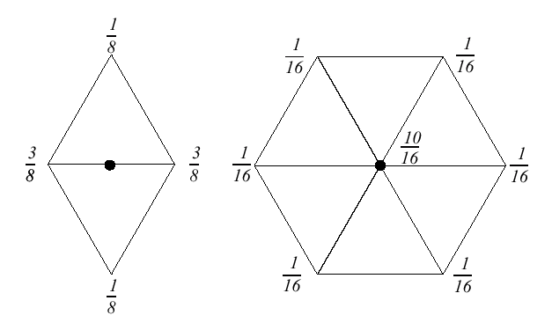
Loop Subdivision Scheme
Where to place new vertices?
  Choose locations for new vertices as weighted average of original vertices in local neighborhood
[Zorin & Schröder]

Slide 10
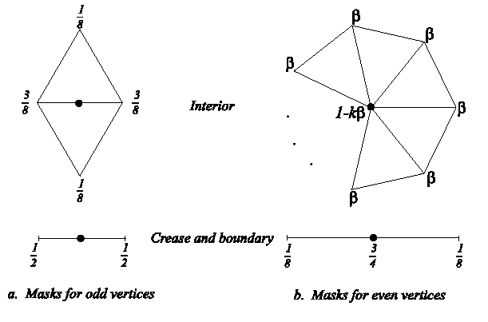
Loop Subdivision Scheme
Where to place new vertices?
  Rules for extraordinary vertices and boundaries:
[Zorin & Schröder]

Slide 11
Loop Subdivision Scheme
Choose β by analyzing continuity of limit surface
  Original Loop
  Warren

Slide 12
Butterfly Subdivision
Interpolating subdivision: larger neighborhood
¹/₈
⁻¹/₁₆
⁻¹/₁₆
¹/₂
¹/₂
⁻¹/₁₆
¹/₈
⁻¹/₁₆

Slide 13
Modified Butterfly Subdivision
Need special weights near extraordinary vertices
  For n = 3, weights are ⁵/₁₂, ⁻¹/₁₂, ⁻¹/₁₂
  For n = 4, weights are 3/8, 0, -1/8, 0
  For n ≥ 5, weights are
  Weight of extraordinary vertex = 1 - Σ other weights

Slide 14
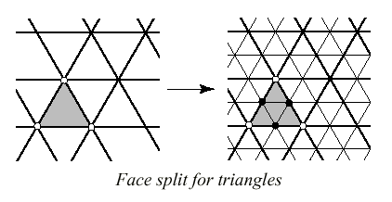
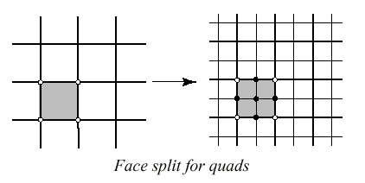

A Variety of Subdivision Schemes
Triangles vs. Quads
Interpolating vs. approximating
[Zorin & Schröder]

Slide 15
More Exotic Methods
Kobbelt’s subdivision:

Slide 16
More Exotic Methods
Kobbelt’s subdivision:
Number of faces triples per iteration:
gives finer control over polygon count

Slide 17
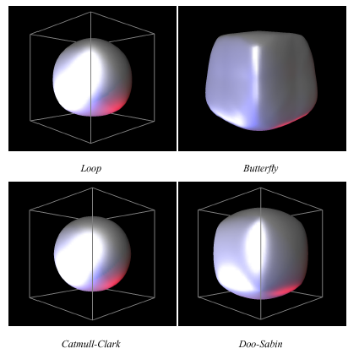
Subdivision Schemes
[Zorin & Schröder]

Slide 18
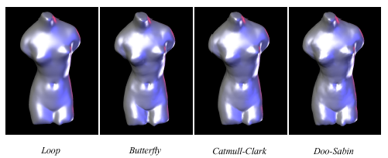
Subdivision Schemes
[Zorin & Schröder]

Slide 19
Outline
Basic Subdivision Schemes
Analysis of Continuity
Exact and Efficient Evaluation (Stam 98)

Slide 20
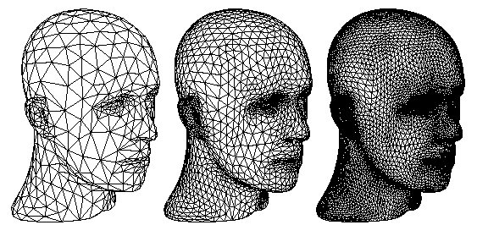
Analyzing Subdivision Schemes
Limit surface has provable smoothness properties
[Zorin & Schröder]

Slide 21
Analyzing Subdivision Schemes
Start with curves: 4-point interpolating scheme
⁹/₁₆
⁹/₁₆
⁻¹/₁₆
⁻¹/₁₆
(old points left where they are)

Slide 22
4-Point Scheme
What is the support?
Step i:
v₋₂
v₋₁
v₀
v₁
v₂
Step i+1:
v₋₂
v₋₁
v₀
v₁
v₂
So, 5 new points depend on 5 old points

Slide 23
Subdivision Matrix
How are vertices in neighborhood refined?
(with vertex renumbering like in last slide)

Slide 24
Subdivision Matrix
How are vertices in neighborhood refined?
(with vertex renumbering like in last slide)
After n rounds:

Slide 25
Convergence Criterion
Expand in eigenvectors of S:
Criterion I: |λ_{i}| ≤ 1

Slide 26
Convergence Criterion
What if all eigenvalues of S are < 1?
  All points converge to 0 with repeated subdivision
Criterion II: λ₀ = 1

Slide 27
Translation Invariance
For any translation t, want:
Criterion III: e₀ = 1, all other |λ_{i}| < 1

Slide 28
Smoothness Criterion
Plug back in:
Dominated by largest λ_{i}
Case 1: |λ₁| > |λ₂|
  Group of 5 points gets shorter
  All points approach multiples of e₁ ➔ on a straight line
  Smooth!

Slide 29
Smoothness Criterion
Case 2: |λ₁| = |λ₂|
  Points can be anywhere in space spanned by e₁, e₂
  No longer have smoothness guarantee
Criterion IV: Smooth iff λ₀ = 1 > |λ₁| > |λ_{i}|

Slide 30
Continuity and Smoothness
So, what about 4-point scheme?
  Eigenvalues = 1, ¹/₂ , ¹/₄ , ¹/₄ , ¹/₈
  e₀ = 1
  Stable ✓
  Translation invariant ✓
  Smooth ✓

Slide 31
2-Point Scheme
In contrast, consider 2-point interpolating scheme
  Support = 3
  Subdivision matrix =
¹/₂
¹/₂

Slide 32
Continuity of 2-Point Scheme
Eigenvalues = 1, ¹/₂ , ¹/₂
e₀ = 1
Stable ✓
Translation invariant ✓
Smooth X
  Not smooth; in fact, this is piecewise linear

Slide 33
For Surfaces…
Similar analysis: determine support, construct subdivision matrix, find eigenstuff
  Caveat 1: separate analysis for each vertex valence
  Caveat 2: consider more than 1 subdominant eigenvalue
Points lie in subspace spanned by e₁ and e₂
  If |λ₁|≠|λ₂|, neighborhood stretched when subdivided,
  but remains 2-manifold
Reif’s smoothness condition: λ₀ = 1 > |λ₁| ≥ |λ₂| > |λ_{i}|

Slide 34
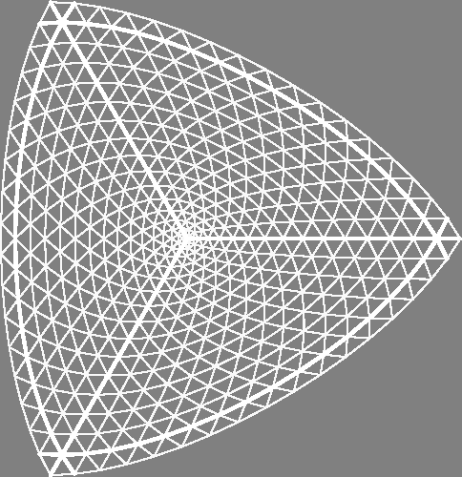
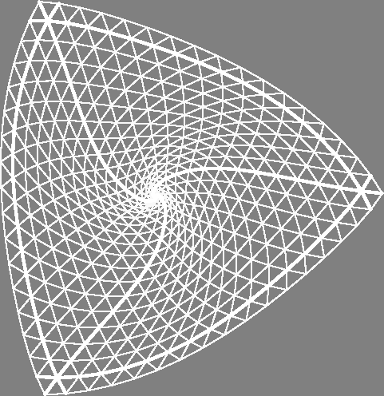
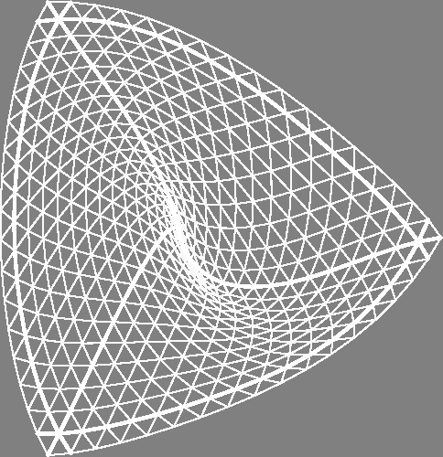
Fun with Subdivision Methods
Behavior of surfaces depends on eigenvalues
(recall that symmetric matrices have real eigenvalues)
Real
Complex
Degenerate
[Zorin]

Slide 35
Outline
Basic Subdivision Schemes
Analysis of Continuity
Exact and Efficient Evaluation (Stam 98)
Slides courtesy James O’Brien

Slide 36
Practical Evaluation
Problems with Uniform Subdivision
  Exponential growth of control mesh
  Need several subdivisions before error is small
  Ok if you are “drawing and forgetting”, otherwise …
(Exact) Evaluation at arbitrary points
Tangent and other derivative evaluation needed
Paper by Jos Stam SIGGRAPH 98 efficient method
  Exact evaluation (essentially take out “subdivision”)
  Smoothness analysis methods used to evaluate

Slide 37
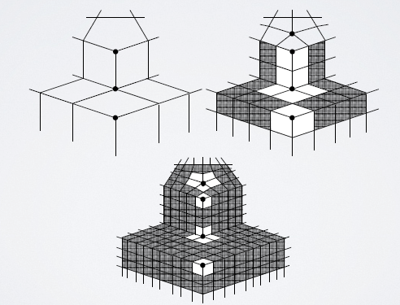
Isolated Extraordinary Points
After 2+ subdivisions, isolated “extraordinary” points where irregular valence
Regular region is usually easy
  For example, Catmull Clark can treat as B-Splines

Slide 38
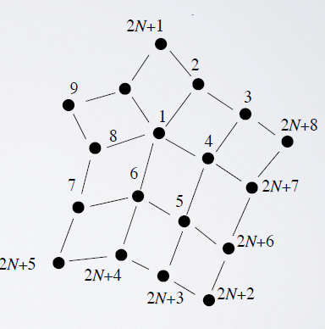
Isolated Extraordinary Points

Slide 39
Subdivision Matrix

Slide 40
Subdivision Matrix

Slide 41
Eigen Space

Slide 42
Comments
Computing Eigen-Vectors is tricky
  See Jos’ paper for details
  He includes solutions for valence up to 500
All eigenvalues are (abs) less than one
  Except for lead value which is exactly one
  Well defined limit behavior
Exact evaluation allows “pushing to limit surface”

Slide 43
Curvature Plots
See Stam 98 for details

Slide 44

Summary
Advantages:
  Simple method for describing
  complex, smooth surfaces
  Relatively easy to implement
  Arbitrary topology
  Local support
  Guaranteed continuity
  Multiresolution
Difficulties:
  Intuitive specification
  Parameterization
  Intersections
[Pixar]

