Slide 1
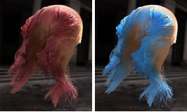

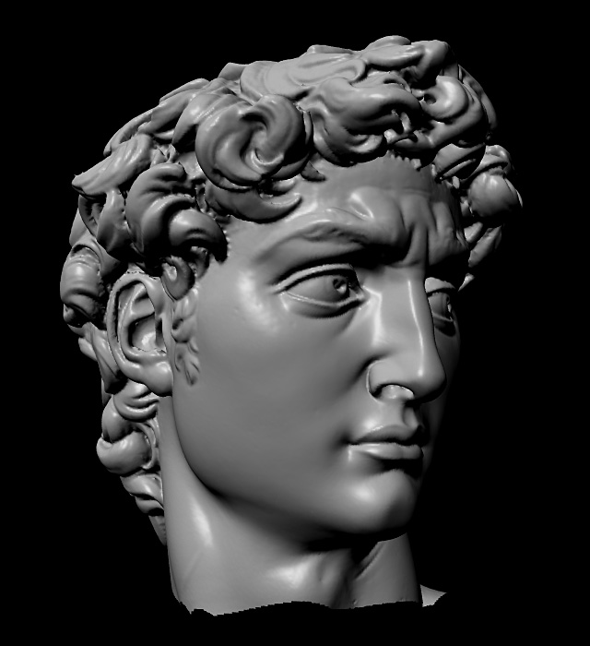

Advanced Computer Graphics
CSE 163 [Spring 2018], Lecture 7
Ravi Ramamoorthi
http://www.cs.ucsd.edu/~ravir

Slide 2
To Do
Assignment 1, Due Apr 27
Any last minute issues or difficulties?
Starting Geometry Processing
Assignment 2 due May 18
This lecture starts discussing relevant content
Please START EARLY. Can do most after this week
Contact us for difficulties, help finding partners etc.

Slide 3
Motivation
A polygon mesh is a collection of triangles
We want to do operations on these triangles
E.g. walk across the mesh for simplification
Display for rendering
Computational geometry
Best representations (mesh data structures)?
Compactness
Generality
Simplicity for computations
Efficiency

Slide 4
Mesh Data Structures
Desirable Characteristics 1
Generality – from most general to least
Polygon soup
Only triangles
2-manifold: ≤ 2 triangles per edge
Orientable: consistent CW / CCW winding
Closed: no boundary
Compact storage

Slide 5
Mesh Data Structures
Desirable characteristics 2
Efficient support for operations:
Given face, find its vertices
Given vertex, find faces touching it
Given face, find neighboring faces
Given vertex, find neighboring vertices
Given edge, find vertices and faces it touches
These are adjacency operations important in mesh simplification (homework), many other applications

Slide 6
Outline
Independent faces
Indexed face set
Adjacency lists
Winged-edge
Half-edge
Overview of mesh decimation and simplification

Slide 7
Independent Faces
Faces list vertex coordinates
Redundant vertices
No topology information
F₀
F₁
Face Table
F₀: (x₀,y₀,z₀), (x₁,y₁,z₁), (x₂,y₂,z₂) F₁: (x₃,y₃,z₃), (x₄,y₄,z₄), (x₅,y₅,z₅)
F₂: (x₆,y₆,z₆), (x₇,y₇,z₇), (x₈,y₈,z₈)
F₂

Slide 8
Indexed Face Set
Faces list vertex references – “shared vertices”
Commonly used (e.g. OFF file format itself)
Augmented versions simple for mesh processing
v₂
v₄
F₀
Vertex Table
v₀: (x₀,y₀,z₀)
v₁: (x₁,y₁,z₁)
v₂: (x₂,y₂,z₂)
v₃: (x₃,y₃,z₃)
v₄: (x₄,y₄,z₄)
Face Table
F₀: 0, 1, 2
F₁: 1, 4, 2
F₂: 1, 3, 4
F₁
F₂
v₀
v₁
v₃
Note CCW ordering

Slide 9
Indexed Face Set
Storage efficiency?
Which operations supported in O(1) time?
v₂
v₄
F₀
Vertex Table
v₀: (x₀,y₀,z₀)
v₁: (x₁,y₁,z₁)
v₂: (x₂,y₂,z₂)
v₃: (x₃,y₃,z₃)
v₄: (x₄,y₄,z₄)
Face Table
F₀: 0, 1, 2
F₁: 1, 4, 2
F₂: 1, 3, 4
F₁
F₂
v₀
v₁
v₃
Note CCW ordering

Slide 10
Efficient Algorithm Design
Can sometimes design algorithms to compensate for operations not supported by data structures
Example: per-vertex normals
Average normal of faces touching each vertex
With indexed face set, vertex ➔ face is O(n)
Naive algorithm for all vertices: O(n²)
Can you think of an O(n) algorithm?

Slide 11
Efficient Algorithm Design
Can sometimes design algorithms to compensate for operations not supported by data structures
Example: per-vertex normals
Average normal of faces touching each vertex
With indexed face set, vertex ➔ face is O(n)
Naive algorithm for all vertices: O(n²)
Can you think of an O(n) algorithm?
Useful to augment with vertex ➔ face adjacency
For all vertices, find adjacent faces as well
Can be implemented while simply looping over faces

Slide 12
Outline
Independent faces
Indexed face set
Adjacency lists
Winged-edge
Half-edge
Overview of mesh decimation and simplification

Slide 13
Full Adjacency Lists
Store all vertex, face, and edge adjacencies
Edge Adjacency Table
e₀: v₀, v₁; F₀,ø; ø,e₂,e₁,ø
e₁: v₁,v₂; F₀,F₁; e₅,e₀,e₂,e₆
…
v₂
v₄
e₆
Face Adjacency Table
F₀: v₀,v₁,v₂; F₁,ø,ø; e₀,e₂,e₁
F₁: v₁,v₄,v₂; ø,F₀,F₂; e₆,e₁,e₅
F₂: v₁,v₃,v₄; ø,F₁,ø; e₄,e₅,e₃
F₀
F₁
e₅
e₂
e₄
e₁
F₂
Vertex Adjacency Table
v₀: v₁,v₂; F₀; e₀,e₂
v₁: v₃,v₄,v₂,v₀; F₂,F₁,F₀; e₃,e₅,e₁,e₀
v₀
e₀
v₁
e₃
v₃
…

Slide 14
Full adjacency: Issues
Garland and Heckbert claim they do this
Easy to find stuff
Issue is storage
And updating everything once you do something like an edge collapse for mesh simplification
I recommend you implement something simpler (like indexed face set plus vertex to face adjacency)

Slide 15
Partial Adjacency Lists
Store some adjacencies, use to derive others
Many possibilities…
Edge Adjacency Table
e₀: v₀, v₁; F₀,ø; ø,e₂,e₁,ø
e₁: v₁,v₂; F₀,F₁; e₅,e₀,e₂,e₆
…
v₂
v₄
e₆
Face Adjacency Table
F₀: v₀,v₁,v₂; F₁,ø,ø; e₀,e₂,e₁
F₁: v₁,v₄,v₂; ø,F₀,F₂; e₆,e₁,e₅
F₂: v₁,v₃,v₄; ø,F₁,ø; e₄,e₅,e₃
F₀
F₁
e₅
e₂
e₄
e₁
F₂
Vertex Adjacency Table
v₀: v₁,v₂; F₀; e₀,e₂
v₁: v₃,v₄,v₂,v₀; F₂,F₁,F₀; e₃,e₅,e₁,e₀
v₀
e₀
v₁
e₃
v₃
…

Slide 16
Partial Adjacency Lists
Some combinations only make sense for closed manifolds
Edge Adjacency Table
e₀: v₀, v₁; F₀,ø; ø,e₂,e₁,ø
e₁: v₁,v₂; F₀,F₁; e₅,e₀,e₂,e₆
…
v₂
v₄
e₆
Face Adjacency Table
F₀: v₀,v₁,v₂; F₁,ø,ø; e₀,e₂,e₁
F₁: v₁,v₄,v₂; ø,F₀,F₂; e₆,e₁,e₅
F₂: v₁,v₃,v₄; ø,F₁,ø; e₄,e₅,e₃
F₀
F₁
e₅
e₂
e₄
e₁
F₂
Vertex Adjacency Table
v₀: v₁,v₂; F₀; e₀,e₂
v₁: v₃,v₄,v₂,v₀; F₂,F₁,F₀; e₃,e₅,e₁,e₀
v₀
e₀
v₁
e₃
v₃
…

Slide 17
Outline
Independent faces
Indexed face set
Adjacency lists
Winged-edge
Half-edge
Overview of mesh decimation and simplification

Slide 18
Winged, Half Edge Representations
Idea is to associate information with edges
Compact Storage
Many operations efficient
Allow one to walk around mesh
Usually general for arbitrary polygons (not triangles)
But implementations can be complex with special cases relative to simple indexed face set++ or partial adjacency table

Slide 19
Winged Edge
Most data stored at edges
Vertices, faces point to one edge each
Edge Adjacency Table
e₀: v₀, v₁; F₀, ø; ø,e₂,e₁, ø
e₁: v₁,v₂; F₀,F₁; e₅,e₀,e₂,e₆
…
v₂
v₄
e₆
Face Adjacency Table
F₀: v₀,v₁,v₂; F₁, ø, ø; e₀,e₂,e₁
F₁: v₁,v₄,v₂; ø,F₀,F₂; e₆,e₁,e₅
F₂: v₁,v₃,v₄; ø,F₁, ø; e₄,e₅,e₃
F₀
F₁
e₅
e₂
e₄
e₁
F₂
Vertex Adjacency Table
v₀: v₁,v₂; F₀; e₀,e₂
v₁: v₃,v₄,v₂,v₀; F₂,F₁,F₀; e₃,e₅,e₁,e₀
v₀
e₀
v₁
e₃
v₃
…

Slide 20
Winged Edge
Each edge stores 2 vertices, 2 faces, 4 edges – fixed size
Enough information to completely “walk around” faces or vertices
Think how to implement
Walking around vertex
Finding neighborhood of face
Other ops for simplification
e_{forw,left}
e_{forw,right}
v_{end}
F_{left}
F_{right}
v_{begin}
e_{back,left}
e_{back,right}

Slide 21
Half Edge
Instead of single edge, 2 directed “half edges”
Makes some operations more efficient
Walk around face very easily (each face need only store one pointer)
he_{next}
F_{left}
he_{inv}
v_{begin}

Slide 22
HalfEdge Data Structure (example)
class HalfEdge { // Only one example, some critical functions
public:
HalfEdgeIter next; // points to the next halfedge around the current face
HalfEdgeIter flip; // points to the other halfedge associated with this edge
VertexIter vertex; // points to the vertex at the "tail" of this halfedge
EdgeIter edge; // points to the edge associated with this halfedge
FaceIter face; // points to the face containing this halfedge
bool onBoundary; // true if this halfedge is contained in a boundary
// loop; false otherwise
} ;
From Keenan Crane Geometry Processing code
https://github.com/dgpdec/course but write your own version

Slide 23
HalfEdge Walk Around Faces
int Vertex :: valence( void ) const { // returns the number of incident faces
int n = 0;
HalfEdgeCIter h = he; // Start loop with half-edge for that vertex
do {
n++; // Increment Valence. Other operations similarly
// For area, A += h -> face -> area() ;
h = h->flip->next; // Next Face. Why does this work?
}
while( h != he ); // Stop when loop is complete. How does this work?
return n;
}
From Keenan Crane Geometry Processing code
https://github.com/dgpdec/course but write your own version

Slide 24
Outline
Independent faces
Indexed face set
Adjacency lists
Winged-edge
Half-edge
Overview of mesh decimation and simplification

Slide 25
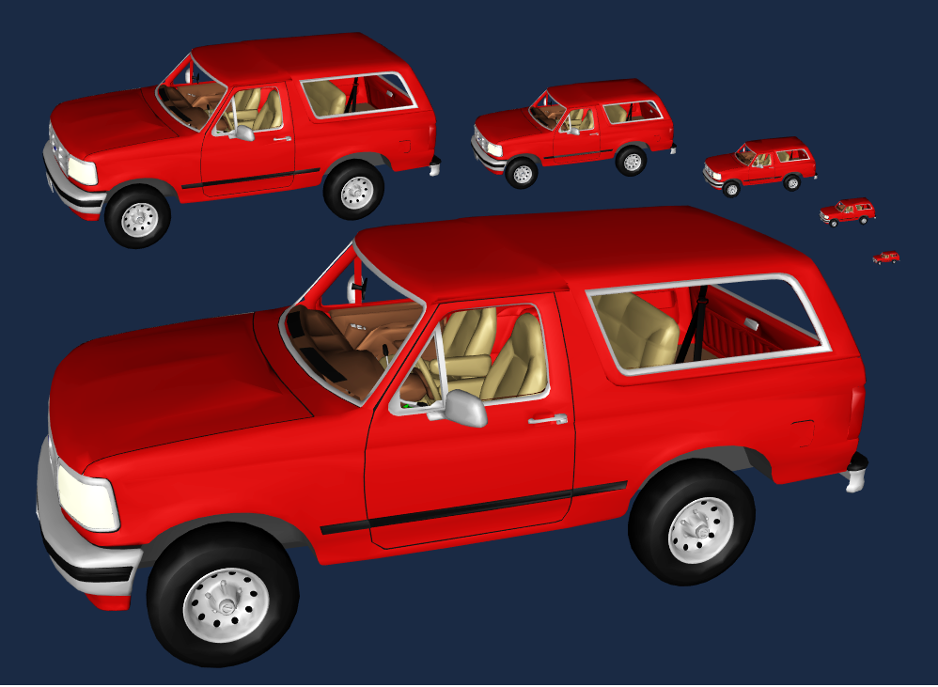
Mesh Decimation
Triangles: 41,855 27,970 20,922 12,939 8,385 4,766
Division, Viewpoint, Cohen

Slide 26
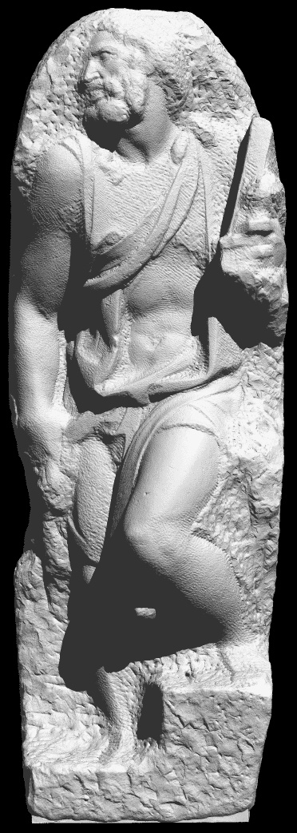
Mesh Decimation
Reduce number of polygons
Less storage
Faster rendering
Simpler manipulation
Desirable properties
Generality
Efficiency
Produces “good” approximation
Michelangelo’s St. Matthew
Original model: ~400M polygons

Slide 27
Primitive Operations
Simplify model a bit at a time by removing a few faces
Repeated to simplify whole mesh
Types of operations
Vertex cluster
Vertex remove
Edge collapse (main operation used in assignment)

Slide 28
Vertex Cluster
Method
Merge vertices based on proximity
Triangles with repeated vertices can collapse to edges or points
Properties
General and robust
Can be unattractive if results in topology change

Slide 29
Vertex Remove
Method
Remove vertex and adjacent faces
Fill hole with new triangles (reduction of 2)
Properties
Requires manifold surface, preserves topology
Typically more attractive
Filling hole well not always easy

Slide 30
Edge Collapse
Method
Merge two edge vertices to one
Delete degenerate triangles
Properties
Special case of vertex cluster
Allows smooth transition
Can change topology
Notes:
Mention what we need to compute - vertex position and
attributes

Slide 31
Mesh Decimation/Simplification
Typical: greedy algorithm
Measure error of possible “simple” operations (primarily edge collapses)
Place operations in queue according to error
Perform operations in queue successively (depending on how much you want to simplify model)
After each operation, re-evaluate error metrics

Slide 32
Geometric Error Metrics
Motivation
Promote accurate 3D shape preservation
Preserve screen-space silhouettes and pixel coverage
Types
Vertex-Vertex Distance
Vertex-Plane Distance
Point-Surface Distance
Surface-Surface Distance

Slide 33
Vertex-Vertex Distance
E = max(|v3−v1|, |v3−v2|)
Appropriate during topology changes
Rossignac and Borrel 93
Luebke and Erikson 97
Loose for topology-preserving collapses
v₃
v₁
v₂

Slide 34
Vertex-Plane Distance
Store set of planes with each vertex
Error based on distance from vertex to planes
When vertices are merged, merge sets
Ronfard and Rossignac 96
Store plane sets, compute max distance
Error Quadrics – Garland and Heckbert 97
Store quadric form, compute sum of squared distances
d_{c}
d_{a}
d_{b}
b
a
c

Slide 35
Point-Surface Distance
For each original vertex, find closest point on simplified surface
Compute sum of squared distances

Slide 36
Surface-Surface Distance
Compute or approximate maximum distance between input and simplified surfaces
Tolerance Volumes - Guéziec 96
Simplification Envelopes - Cohen/Varshney 96
Hausdorff Distance - Klein 96
Mapping Distance - Bajaj/Schikore 96, Cohen et al. 97

Slide 37
Geometric Error Observations
Vertex-vertex and vertex-plane distance
Fast
Low error in practice, but not guaranteed by metric
Surface-surface distance
Required for guaranteed error bounds
Edge swap
vertex-vertex ≠ surface-surface

Slide 38
Mesh Simplification
Advanced Considerations
Type of input mesh?
Modifies topology?
Continuous LOD?
Speed vs. quality?

Slide 39
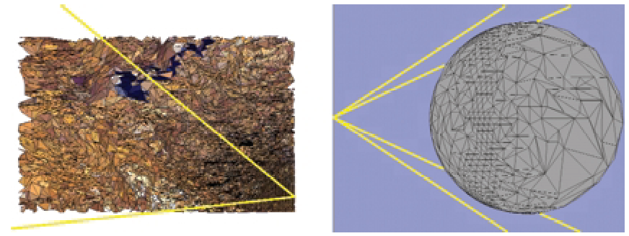
View-Dependent Simplification
Simplify dynamically according to viewpoint
Visibility
Silhouettes
Lighting
Hoppe

Slide 40
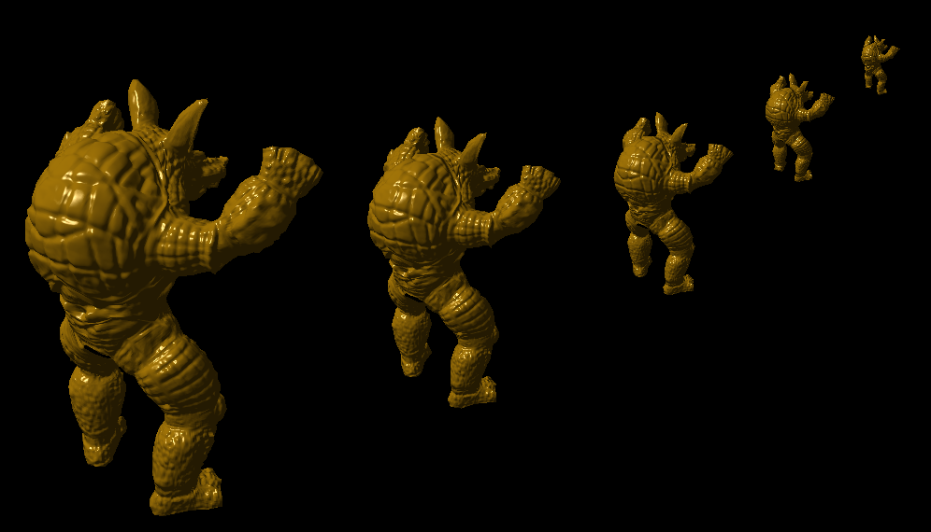
Appearance Preserving
488 tris
975 tris
1,951 tris
3,905 tris
7,809 tris
Caltech & Stanford Graphics Labs and Jonathan Cohen

Slide 41
Summary
Many mesh data structures
Compact storage vs ease, efficiency of use
How fast and easy are key operations
Mesh simplification
Reduce size of mesh in efficient quality-preserving way
Based on edge collapses mainly
Choose appropriate mesh data structure
Efficient to update, edge-collapses are local
Fairly modern ideas (last ~20 years)
Think about some of it yourself, see papers given out
We will cover simplification, quadric metrics next

