Slide 1
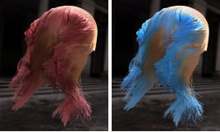

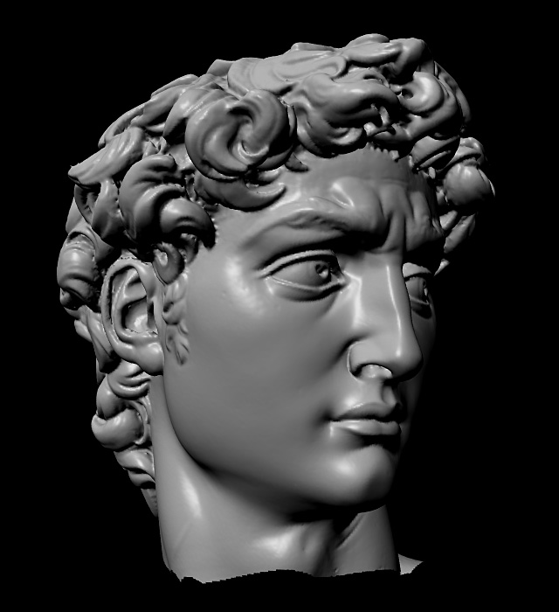
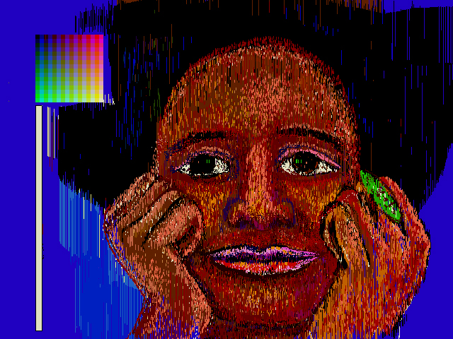
Advanced Computer Graphics
CSE 163 [Spring 2017], Lecture 9
Ravi Ramamoorthi
http://www.cs.ucsd.edu/~ravir

Slide 2
To Do
Assignment 2 due May 19
  Should already be well on way. This is last part
  Contact us for difficulties etc.

Slide 3
Resources
Garland and Heckbert SIGGRAPH 97 paper
Garland website, implementation notes (in thesis)
Notes in this and previous lectures

Slide 4
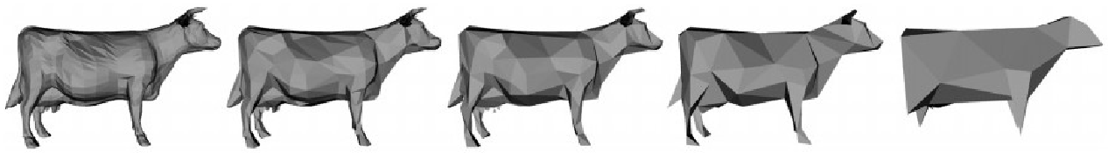
Surface Simplification: Goals (Garland)
Efficiency (70000 to 100 faces in 15s in 1997)
High quality, feature preserving (primary appearance emphasized rather than topology)
Generality, non-manifold models, collapse disjoint regions

Slide 5
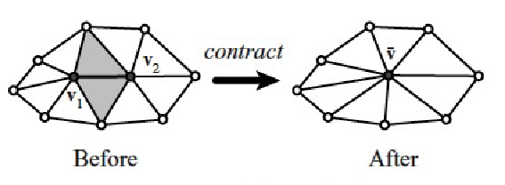
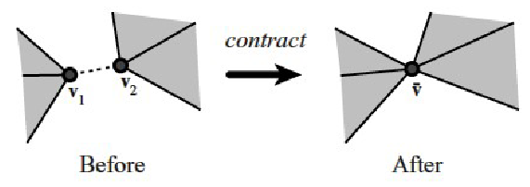
Simplifications
Pair contractions in addition to edge collapses
Previously connected regions may come together

Slide 6
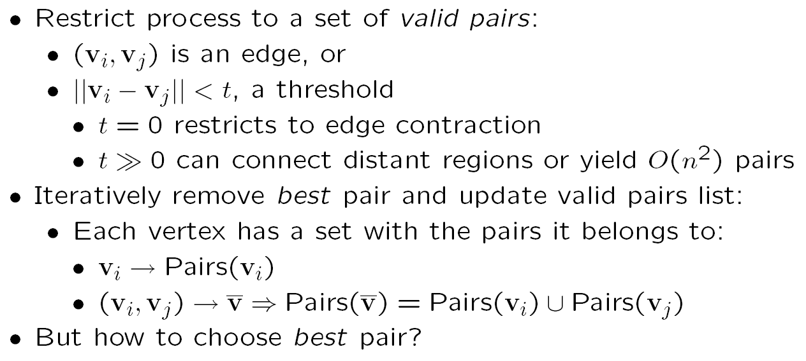
Algorithm Outline

Slide 7
Quadric Error Metrics
Based on point-to-plane distance
Better quality than point-to-point
d_{c}
d_{a}
d_{b}
a
b
c

Slide 8
Background: Computing Planes
Each triangle in mesh has associated plane
For a triangle, find its (normalized) normal using cross products
Plane equation?

Slide 9
Survey
Also examples of homework 1

Slide 10
Quadric Error Metrics
Sum of squared distances from vertex to planes:

Slide 11
Quadric Error Metrics
Common mathematical trick: quadratic form = symmetric matrix Q multiplied twice by a vector

Slide 12
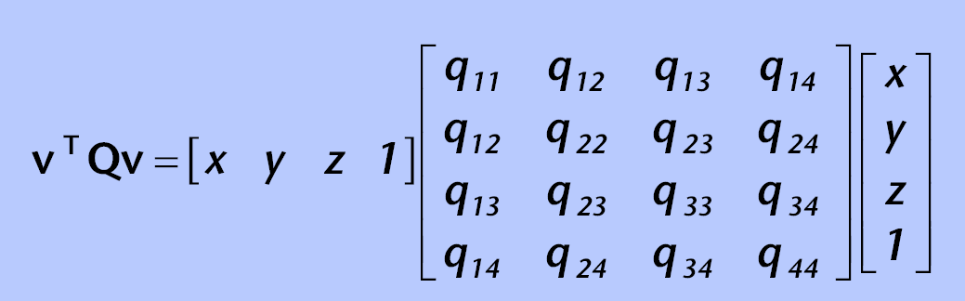
Quadric Error Metrics
Simply a 4x4 symmetric matrix
Storage efficient: 10 floating point numbers per vertex
Initially, error is 0 for all vertices

Slide 13
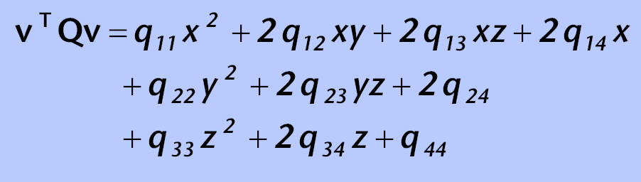
Quadric Error Metrics
2nd degree polynomial in x, y and z
Level surface (v^{T}Qv = k) is a quadric surface
  Ellipsoid, paraboloid, hyperboloid, plane etc.
y

Slide 14
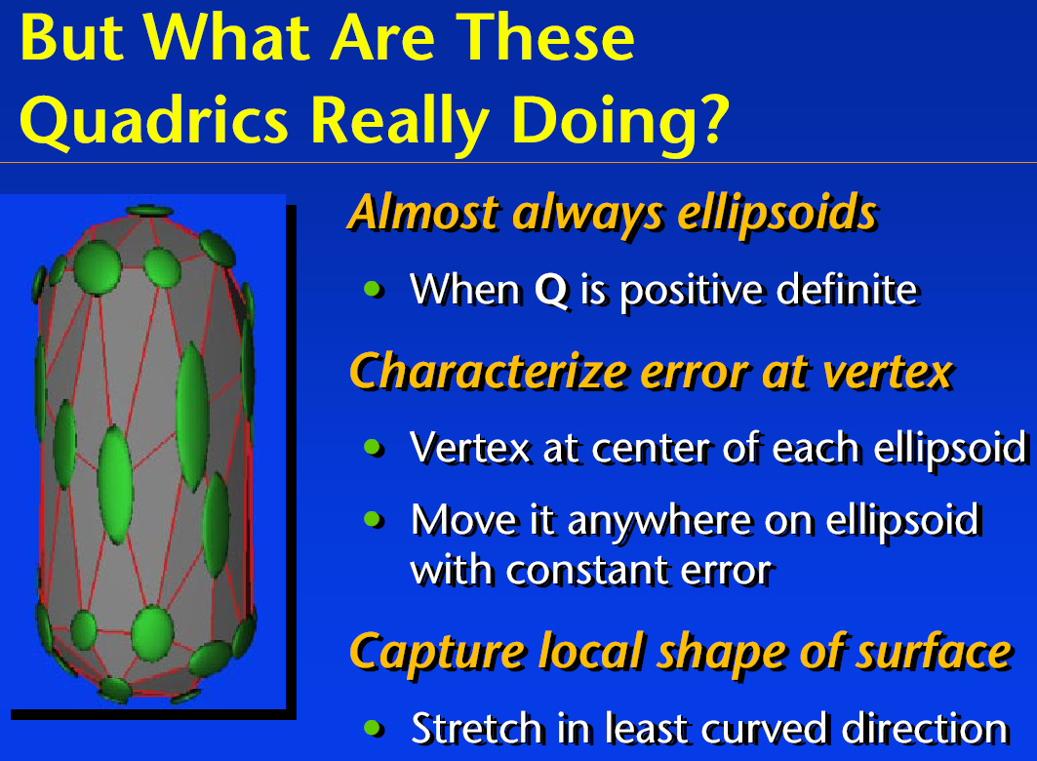

Slide 15
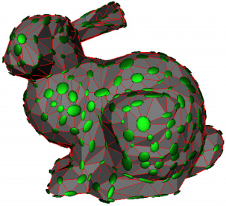
Quadric Visualization
Ellipsoids: iso-error surfaces
Smaller ellipsoid = greater error for a given motion
Lower error for motion parallel to surface
Lower error in flat regions than at corners
Elongated in “cylindrical” regions

Slide 16
Using Quadrics
Approximate error of edge collapses
  Each vertex v has associated quadric Q
  Error of collapsing v₁ and v₂ to v’ is v’^{T}Q₁v’+v’^{T}Q₂v’
  Quadric for new vertex v’ is Q’=Q₁+Q₂

Slide 17
Using Quadrics
Find optimal location v’ after collapse:

Slide 18
Using Quadrics
Find optimal location v’ after collapse:

Slide 19
Algorithm Outline

Slide 20
Algorithm Summary
Compute the Q matrices for all the initial vertices
Select all valid pairs
Compute the optimal contraction target v for each valid pair. The error v^{T}(Q₁+Q₂)v of this target vertex becomes the cost of contracting that pair
Place all pairs in a heap keyed on cost with minimum cost pair on the top
Iteratively remove the least cost pair, contract this pair, and update the costs of all valid pairs of interest

Slide 21
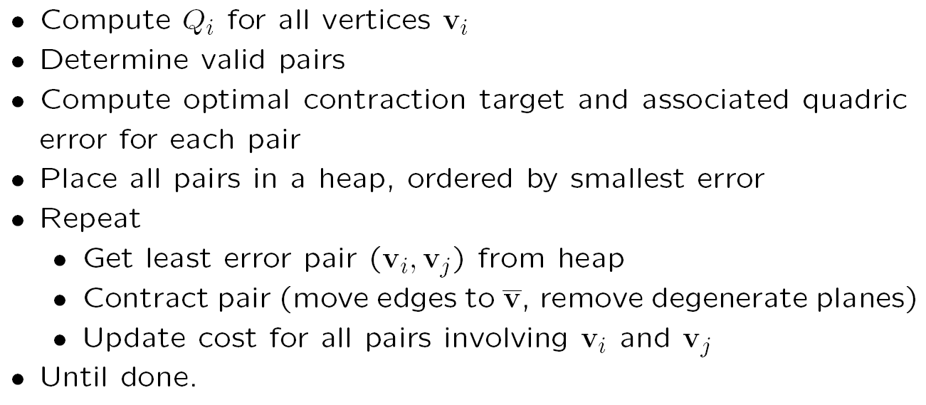
Final Algorithm

Slide 22
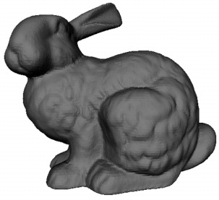

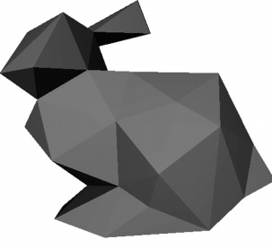
Results
Original
Quadrics
1k tris
100 tris

Slide 23
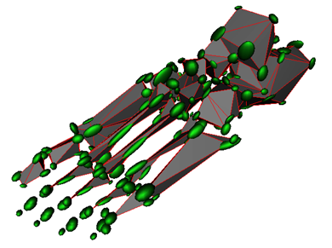
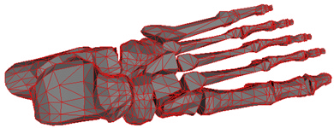
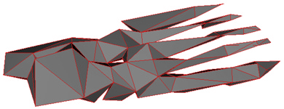
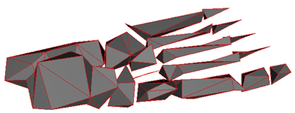
Results
Original
Quadrics
250 tris
250 tris, edge collapses only

Slide 24
Additional Details
Preserving boundaries/discontinuities (weight quadrics by appropriate penalty factors)
Preventing mesh inversion (flipping of orientation): compare normal of neighboring faces, before after
Has been modified for many other applications
  E.g. in silhouettes, want to make sure volume always increases, never decreases
  Take color and texture into account (followup paper)
See paper, other more recent works for details

Slide 25
Implementation Tips
Incremental, test, debug, simple cases
Find good data structure for heap etc.
May help to visualize error quadrics if possible
Challenging, but hopefully rewarding assignment

Slide 26
Questions?
Issues or questions?
All the material for assignment covered
Start early, work hard

