Slide 1
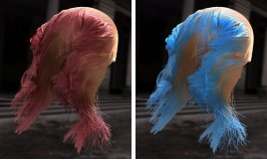

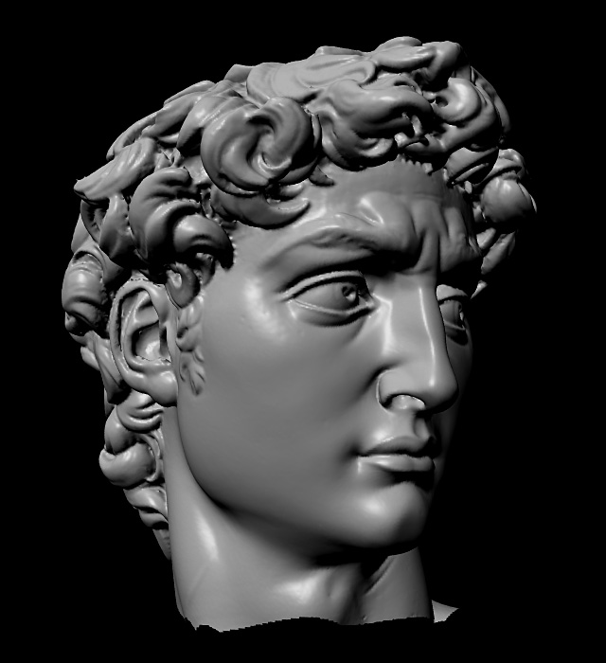
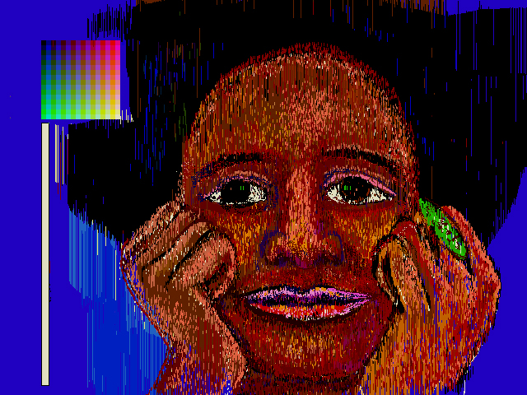
Advanced Computer Graphics
CSE 163 [Spring 2017], Lecture 7
Ravi Ramamoorthi
http://www.cs.ucsd.edu/~ravir

Slide 2
To Do
Assignment 1, Due Apr 28
  Any last minute issues or difficulties?
Starting Geometry Processing
  Assignment 2 due May 19
  This lecture starts discussing relevant content
  Please START EARLY. Can do most after this week
  Contact us for difficulties, help finding partners etc.

Slide 3
Motivation
A polygon mesh is a collection of triangles
We want to do operations on these triangles
  E.g. walk across the mesh for simplification
  Display for rendering
  Computational geometry
Best representations (mesh data structures)?
  Compactness
  Generality
  Simplicity for computations
  Efficiency

Slide 4
Mesh Data Structures
Desirable Characteristics 1
Generality – from most general to least
  Polygon soup
  Only triangles
  2-manifold: ≤ 2 triangles per edge
  Orientable: consistent CW / CCW winding
  Closed: no boundary
Compact storage

Slide 5
Mesh Data Structures
Desirable characteristics 2
Efficient support for operations:
  Given face, find its vertices
  Given vertex, find faces touching it
  Given face, find neighboring faces
  Given vertex, find neighboring vertices
  Given edge, find vertices and faces it touches
These are adjacency operations important in mesh simplification (homework), many other applications

Slide 6
Outline
Independent faces
Indexed face set
Adjacency lists
Winged-edge
Half-edge
Overview of mesh decimation and simplification

Slide 7
Independent Faces
Faces list vertex coordinates
  Redundant vertices
  No topology information
F₀
F₁
Face Table
F₀: (x₀,y₀,z₀), (x₁,y₁,z₁), (x₂,y₂,z₂)
F₁: (x₃,y₃,z₃), (x₄,y₄,z₄), (x₅,y₅,z₅)
F₂: (x₆,y₆,z₆), (x₇,y₇,z₇), (x₈,y₈,z₈)
F₂

Slide 8
Indexed Face Set
Faces list vertex references – “shared vertices”
Commonly used (e.g. OFF file format itself)
Augmented versions simple for mesh processing
v₂
v₄
F₀
Vertex Table
v₀: (x₀,y₀,z₀)
v₁: (x₁,y₁,z₁)
v₂: (x₂,y₂,z₂)
v₃: (x₃,y₃,z₃)
v₄: (x₄,y₄,z₄)
Face Table
F₀: 0, 1, 2
F₁: 1, 4, 2
F₂: 1, 3, 4
F₁
F₂
v₀
v₁
v₃
Note CCW ordering

Slide 9
Indexed Face Set
Storage efficiency?
Which operations supported in O(1) time?
v₂
v₄
F₀
Vertex Table
v₀: (x₀,y₀,z₀)
v₁: (x₁,y₁,z₁)
v₂: (x₂,y₂,z₂)
v₃: (x₃,y₃,z₃)
v₄: (x₄,y₄,z₄)
Face Table
F₀: 0, 1, 2
F₁: 1, 4, 2
F₂: 1, 3, 4
F₁
F₂
v₀
v₁
v₃
Note CCW ordering

Slide 10
Efficient Algorithm Design
Can sometimes design algorithms to compensate for operations not supported by data structures
Example: per-vertex normals
  Average normal of faces touching each vertex
  With indexed face set, vertex ➔ face is O(n)
  Naive algorithm for all vertices: O(n²)
  Can you think of an O(n) algorithm?

Slide 11
Efficient Algorithm Design
Can sometimes design algorithms to compensate for operations not supported by data structures
Example: per-vertex normals
  Average normal of faces touching each vertex
  With indexed face set, vertex ➔ face is O(n)
  Naive algorithm for all vertices: O(n²)
  Can you think of an O(n) algorithm?
Useful to augment with vertex ➔ face adjacency
  For all vertices, find adjacent faces as well
  Can be implemented while simply looping over faces

Slide 12
Outline
Independent faces
Indexed face set
Adjacency lists
Winged-edge
Half-edge
Overview of mesh decimation and simplification

Slide 13
Full Adjacency Lists
Store all vertex, face,
and edge adjacencies
Edge Adjacency Table
e₀: v₀, v₁; F₀,ø; ø,e₂,e₁,ø
e₁: v₁,v₂; F₀,F₁; e₅,e₀,e₂,e₆
…
v₂
v₄
e₆
Face Adjacency Table
F₀: v₀,v₁,v₂; F₁,ø,ø; e₀,e₂,e₁
F₁: v₁,v₄,v₂; ø,F₀,F₂; e₆,e₁,e₅
F₂: v₁,v₃,v₄; ø,F₁,ø; e₄,e₅,e₃
F₀
F₁
e₅
e₂
e₄
e₁
F₂
Vertex Adjacency Table
v₀: v₁,v₂; F₀; e₀,e₂
v₁: v₃,v₄,v₂,v₀; F₂,F₁,F₀; e₃,e₅,e₁,e₀
v₀
e₀
v₁
e₃
v₃
…

Slide 14
Full adjacency: Issues
Garland and Heckbert claim they do this
Easy to find stuff
Issue is storage
And updating everything once you do something like an edge collapse for mesh simplification
I recommend you implement something simpler (like indexed face set plus vertex to face adjacency)

Slide 15
Partial Adjacency Lists
Store some adjacencies,
use to derive others
Many possibilities…
Edge Adjacency Table
e₀: v₀, v₁; F₀,ø; ø,e₂,e₁,ø
e₁: v₁,v₂; F₀,F₁; e₅,e₀,e₂,e₆
…
v₂
v₄
e₆
Face Adjacency Table
F₀: v₀,v₁,v₂; F₁,ø,ø; e₀,e₂,e₁
F₁: v₁,v₄,v₂; ø,F₀,F₂; e₆,e₁,e₅
F₂: v₁,v₃,v₄; ø,F₁,ø; e₄,e₅,e₃
F₀
F₁
e₅
e₂
e₄
e₁
F₂
Vertex Adjacency Table
v₀: v₁,v₂; F₀; e₀,e₂
v₁: v₃,v₄,v₂,v₀; F₂,F₁,F₀; e₃,e₅,e₁,e₀
v₀
e₀
v₁
e₃
v₃
…

Slide 16
Partial Adjacency Lists
Some combinations only
make sense for closed
manifolds
Edge Adjacency Table
e₀: v₀, v₁; F₀,ø; ø,e₂,e₁,ø
e₁: v₁,v₂; F₀,F₁; e₅,e₀,e₂,e₆
…
v₂
v₄
e₆
Face Adjacency Table
F₀: v₀,v₁,v₂; F₁,ø,ø; e₀,e₂,e₁
F₁: v₁,v₄,v₂; ø,F₀,F₂; e₆,e₁,e₅
F₂: v₁,v₃,v₄; ø,F₁,ø; e₄,e₅,e₃
F₀
F₁
e₅
e₂
e₄
e₁
F₂
Vertex Adjacency Table
v₀: v₁,v₂; F₀; e₀,e₂
v₁: v₃,v₄,v₂,v₀; F₂,F₁,F₀; e₃,e₅,e₁,e₀
v₀
e₀
v₁
e₃
v₃
…

Slide 17
Outline
Independent faces
Indexed face set
Adjacency lists
Winged-edge
Half-edge
Overview of mesh decimation and simplification

Slide 18
Winged, Half Edge Representations
Idea is to associate information with edges
Compact Storage
Many operations efficient
Allow one to walk around mesh
Usually general for arbitrary polygons (not triangles)
But implementations can be complex with special cases relative to simple indexed face set++ or partial adjacency table

Slide 19
Winged Edge
Most data stored at edges
Vertices, faces point to
one edge each
Edge Adjacency Table
e₀: v₀, v₁; F₀, ø; ø,e₂,e₁, ø
e₁: v₁,v₂; F₀,F₁; e₅,e₀,e₂,e₆
…
v₂
v₄
e₆
Face Adjacency Table
F₀: v₀,v₁,v₂; F₁, ø, ø; e₀,e₂,e₁
F₁: v₁,v₄,v₂; ø,F₀,F₂; e₆,e₁,e₅
F₂: v₁,v₃,v₄; ø,F₁, ø; e₄,e₅,e₃
F₀
F₁
e₅
e₂
e₄
e₁
F₂
Vertex Adjacency Table
v₀: v₁,v₂; F₀; e₀,e₂
v₁: v₃,v₄,v₂,v₀; F₂,F₁,F₀; e₃,e₅,e₁,e₀
v₀
e₀
v₁
e₃
v₃
…

Slide 20
Winged Edge
Each edge stores 2 vertices, 2 faces, 4 edges – fixed size
Enough information to completely “walk around” faces or vertices
Think how to implement
  Walking around vertex
  Finding neighborhood of face
  Other ops for simplification
e_{forw,left}
e_{forw,right}
v_{end}
F_{left}
F_{right}
v_{begin}
e_{back,left}
e_{back,right}

Slide 21
Half Edge
Instead of single edge, 2 directed “half edges”
Makes some operations more efficient
Walk around face very easily (each face need only store one pointer)
he_{next}
F_{left}
he_{inv}
v_{begin}

Slide 22
Outline
Independent faces
Indexed face set
Adjacency lists
Winged-edge
Half-edge
Overview of mesh decimation and simplification

Slide 23
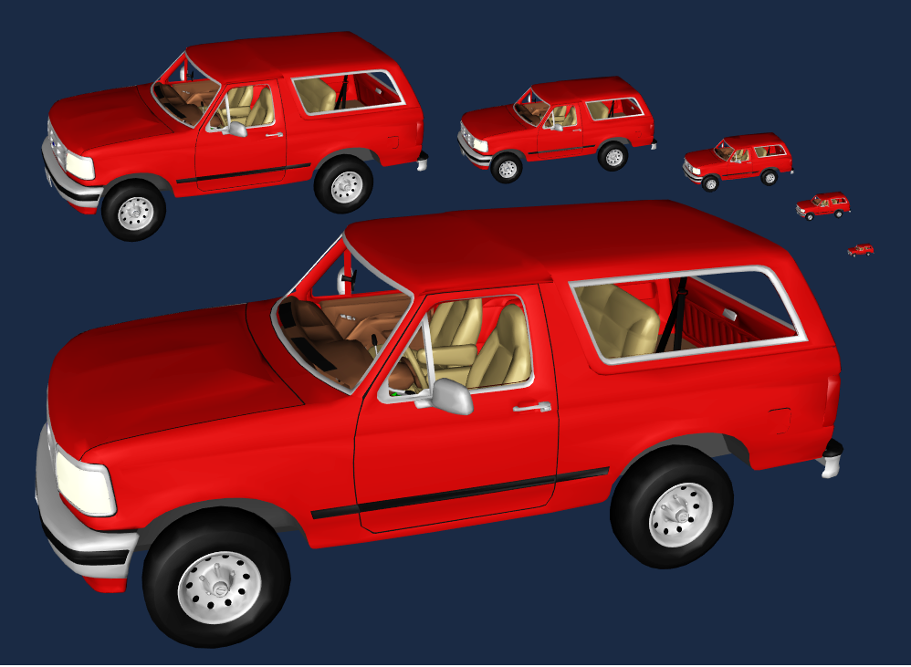
Mesh Decimation
Triangles: 41,855 27,970 20,922 12,939 8,385 4,766
Division, Viewpoint, Cohen

Slide 24
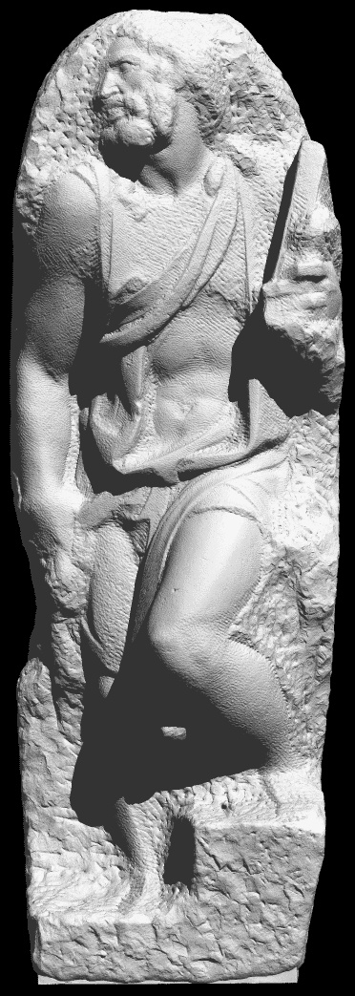
Mesh Decimation
Reduce number of polygons
  Less storage
  Faster rendering
  Simpler manipulation
Desirable properties
  Generality
  Efficiency
  Produces “good” approximation
Michelangelo’s St. Matthew
Original model: ~400M polygons

Slide 25
Primitive Operations
Simplify model a bit at a time by
removing a few faces
  Repeated to simplify whole mesh
Types of operations
  Vertex cluster
  Vertex remove
  Edge collapse (main operation used in assignment)

Slide 26
Vertex Cluster
Method
  Merge vertices based on proximity
  Triangles with repeated vertices can collapse to edges or points
Properties
  General and robust
  Can be unattractive if results in topology change

Slide 27
Vertex Remove
Method
  Remove vertex and adjacent faces
  Fill hole with new triangles (reduction of 2)
Properties
  Requires manifold surface, preserves topology
  Typically more attractive
  Filling hole well not always easy

Slide 28
Edge Collapse
Method
  Merge two edge vertices to one
  Delete degenerate triangles
Properties
  Special case of vertex cluster
  Allows smooth transition
  Can change topology
Notes:
Mention what we need to compute - vertex position and
attributes

Slide 29
Mesh Decimation/Simplification
Typical: greedy algorithm
  Measure error of possible “simple” operations (primarily edge collapses)
  Place operations in queue according to error
  Perform operations in queue successively (depending on how much you want to simplify model)
  After each operation, re-evaluate error metrics

Slide 30
Geometric Error Metrics
Motivation
  Promote accurate 3D shape preservation
  Preserve screen-space silhouettes and pixel coverage
Types
  Vertex-Vertex Distance
  Vertex-Plane Distance
  Point-Surface Distance
  Surface-Surface Distance

Slide 31
Vertex-Vertex Distance
E = max(|v3−v1|, |v3−v2|)
Appropriate during topology changes
  Rossignac and Borrel 93
  Luebke and Erikson 97
Loose for topology-preserving collapses
v₃
v₁
v₂

Slide 32
Vertex-Plane Distance
Store set of planes with each vertex
  Error based on distance from vertex to planes
  When vertices are merged, merge sets
Ronfard and Rossignac 96
  Store plane sets, compute max distance
Error Quadrics – Garland and Heckbert 97
  Store quadric form, compute sum of squared distances
d_{c}
d_{a}
d_{b}
b
a
c

Slide 33
Point-Surface Distance
For each original vertex,
find closest point on simplified surface
Compute sum of squared distances

Slide 34
Surface-Surface Distance
Compute or approximate maximum distance between input and simplified surfaces
  Tolerance Volumes - Guéziec 96
  Simplification Envelopes - Cohen/Varshney 96
  Hausdorff Distance - Klein 96
  Mapping Distance - Bajaj/Schikore 96, Cohen et al. 97

Slide 35
Geometric Error Observations
Vertex-vertex and vertex-plane distance
  Fast
  Low error in practice, but not guaranteed by metric
Surface-surface distance
  Required for guaranteed error bounds
Edge swap
vertex-vertex ≠ surface-surface

Slide 36
Mesh Simplification
Advanced Considerations
Type of input mesh?
Modifies topology?
Continuous LOD?
Speed vs. quality?

Slide 37
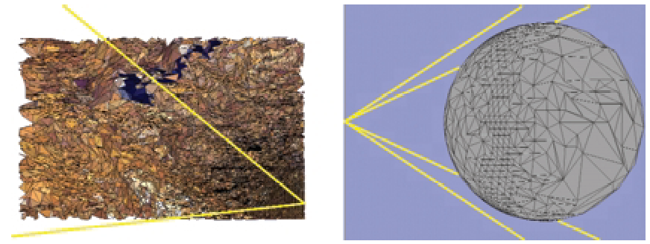
View-Dependent Simplification
Simplify dynamically according to viewpoint
  Visibility
  Silhouettes
  Lighting
Hoppe

Slide 38
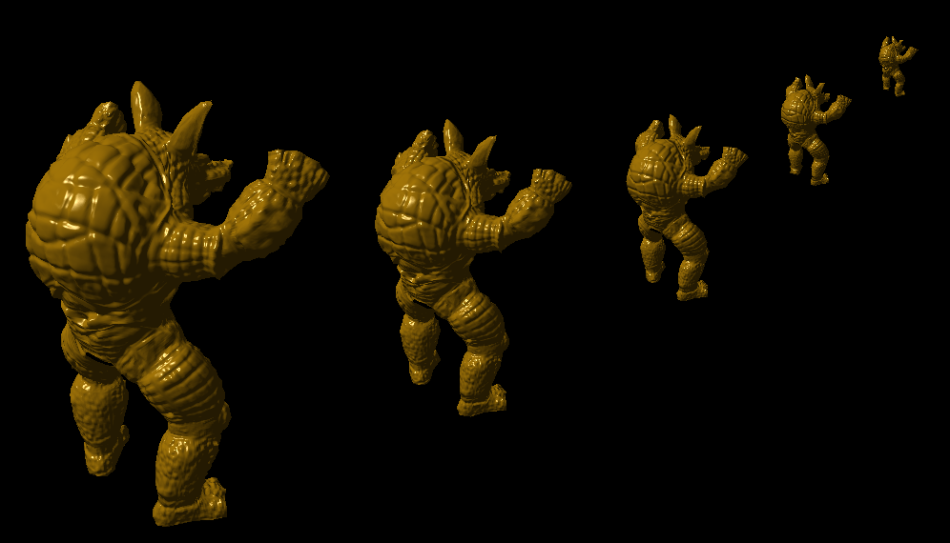
Appearance Preserving
488 tris
975 tris
1,951 tris
3,905 tris
7,809 tris
Caltech & Stanford Graphics Labs and Jonathan Cohen

Slide 39
Summary
Many mesh data structures
  Compact storage vs ease, efficiency of use
  How fast and easy are key operations
Mesh simplification
  Reduce size of mesh in efficient quality-preserving way
  Based on edge collapses mainly
Choose appropriate mesh data structure
  Efficient to update, edge-collapses are local
Fairly modern ideas (last 15-20 years)
  Think about some of it yourself, see papers given out
  We will cover simplification, quadric metrics next

