Slide 1
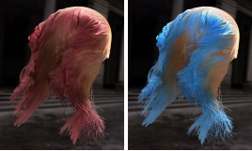

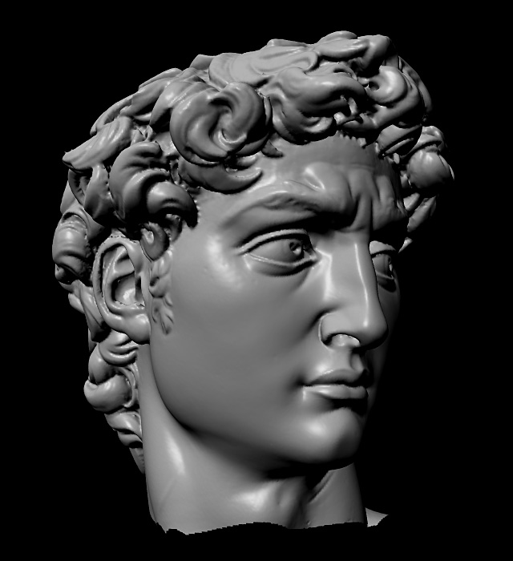
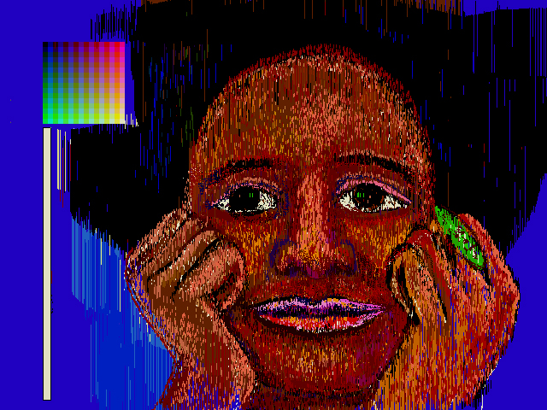
Advanced Computer Graphics
CSE 163 [Spring 2017], Lecture 6
Ravi Ramamoorthi
http://www.cs.ucsd.edu/~ravir

Slide 2
To Do
Assignment 1, Due Apr 28
Starting Geometry Processing
Assignment 2 due May 19
Please START EARLY
Contact us for difficulties, help finding partners etc.

Slide 3
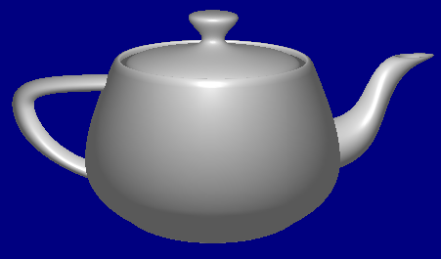
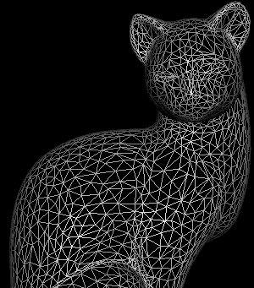
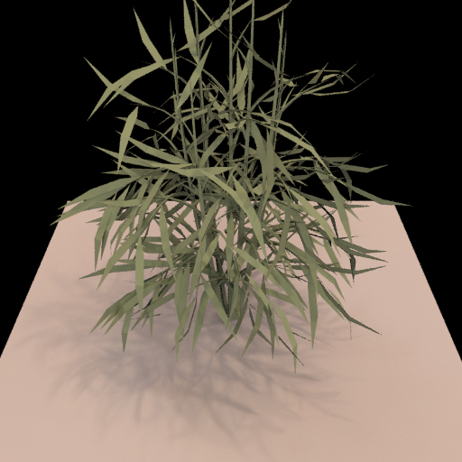
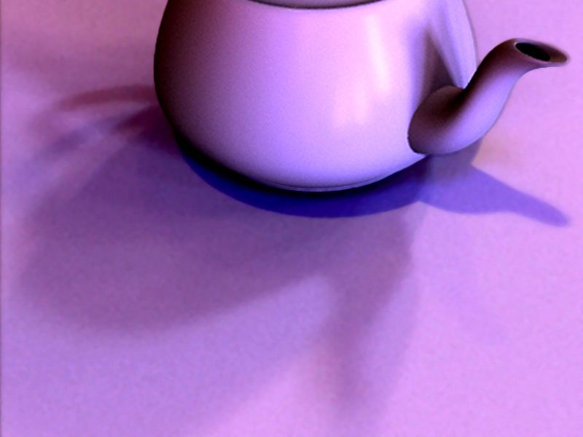
Course Outline
3D Graphics Pipeline
Rendering
(Creating, shading images from geometry, lighting, materials)
Modeling
(Creating 3D Geometry)

Slide 4
Course Outline
3D Graphics Pipeline
Rendering
(Creating, shading images from geometry, lighting, materials)
Modeling
(Creating 3D Geometry)
Unit 1: Foundations of Signal and Image Processing
Understanding the way 2D images are formed and displayed, the important concepts and algorithms, and to build an image processing utility like Photoshop
Weeks 1 – 3. Assignment 1
Unit 2: Meshes, Modeling
Weeks 3 – 5. Assignment 2 Feb 19

Slide 5
Modeling
Spline curves, surfaces: 70^{s} – 80^{s}
Utah teapot: Famous 3D model
More recently: Triangle meshes often acquired from real objects

Slide 6
Relevance to Course
Main idea is to talk about mesh processing algs.
Will learn to represent, work with meshes
Do mesh simplification, progressive meshes

Slide 7

Progressive Mesh Movie

Slide 8
Outline for Today
Overview of types of 3D representations
3D objects can be represented in a variety of ways. We survey these today
Before talking specifically about polygon meshes, which are often most common way
Much of material in this lecture courtesy Szymon Rusinkiewicz

Slide 9
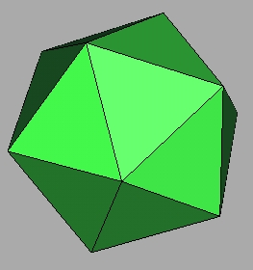
3D Objects
How can this object be represented in a computer?

Slide 10
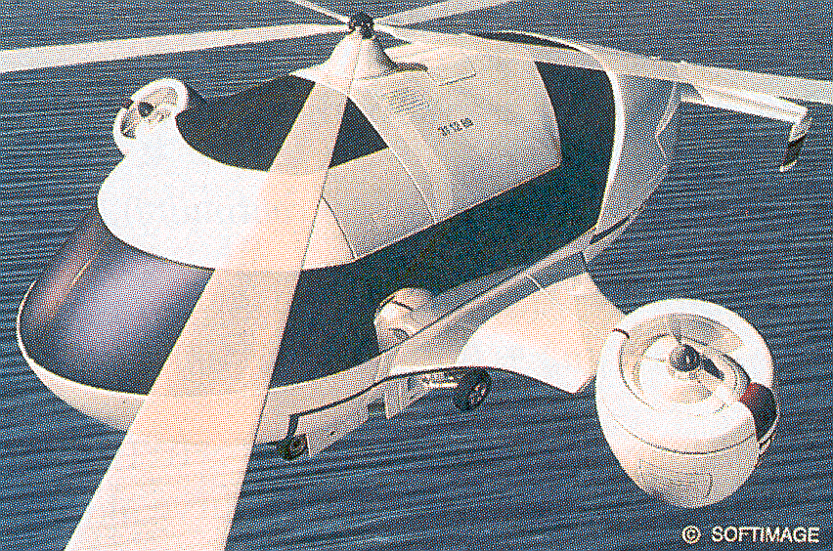
3D Objects
H&B Figure 10.46
This one?

Slide 11
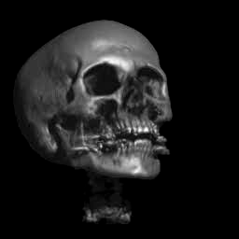
3D Objects
How about this one?

Slide 12
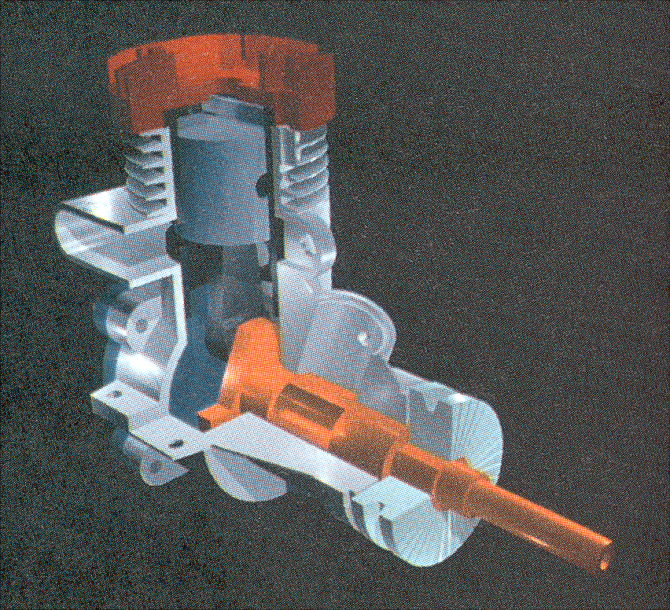
3D Objects
H&B Figure 9.9
This one?

Slide 13
Types of 3D object data
Polygon meshes for complex real-world objects
Spline patches from modeling programs
Volume data or voxels (e.g. visible human project)
Machine parts (Constructive Solid Geometry)
And a few more
All have advantages, disadvantages. Increasingly, meshes are easiest to use and simplest

Slide 14
Comparisons
Efficient hardware rendering (meshes simple)
Manipulation (edit, simplify, compress etc.)
Splines easiest originally, but now many algorithms for polygon meshes
Acquisition or Modeling
Splines, CSG originally used for modeling
But increasingly, complex meshes acquired from real world
Compactness
Simplicity (meshes win big here)

Slide 15
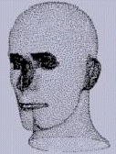
Point Cloud
Unstructured samples
Advantage: simplicity
Disadvantage: no information on adjacency / connectivity
Have to use e.g. k-nearest neighbors
Increasingly hot topic in graphics today
Hoppe

Slide 16
Range Image
Image: stores an intensity / color along each of a set of regularly-spaced rays in space
Range image: stores a depth along each of a set of regularly-spaced rays in space
Obtained using devices known as range scanners
Advantages:
Uniform (?) parameterization
Adjacency / connectivity information

Slide 17
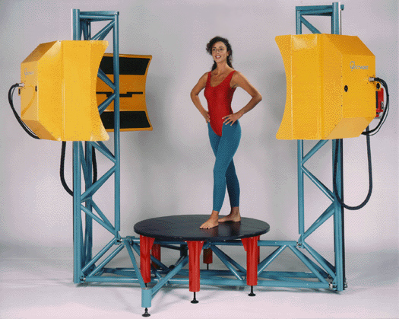
Cyberware whole body 3D scanner

Slide 18
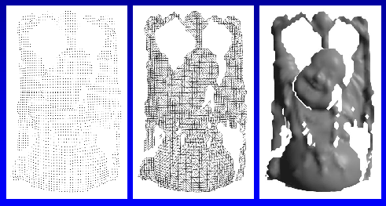
Range Image
Not a complete 3D description: does not include part of object occluded from viewpoint
Range Image
Tessellation
Range Surface
Curless

Slide 19
Range Image
Adjacency in range image not equal to adjacency on surface

Slide 20
Range Image
Avoid connecting across these discontinuities
Heuristic: depth threshold
Adjacency in range image not equal to adjacency on surface

Slide 21
Range Image Terminology
Range images
Range surfaces
Depth images
Depth maps
Height fields
2½-D images
Surface profiles
xyz maps
…

Slide 22
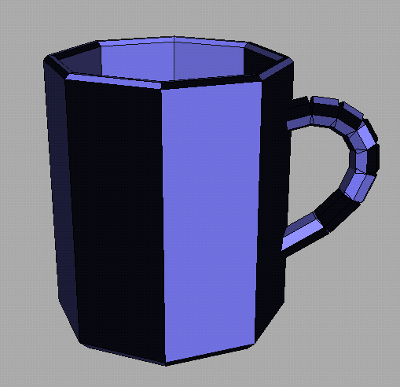
Polygon Soup
Unstructured set of polygons:
Often the output of interactive modeling systems
Often sufficient for rendering, but not other operations
Larson

Slide 23
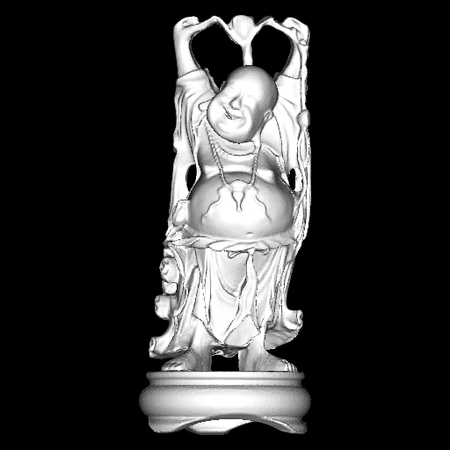
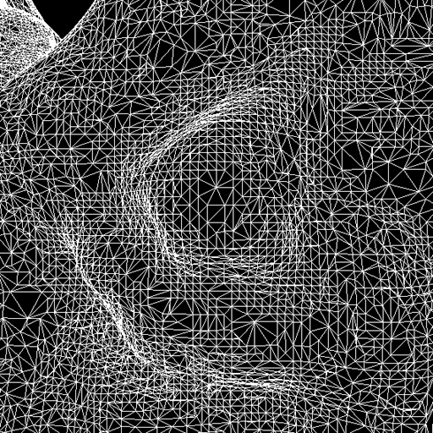
Mesh
Connected set of polygons (usually triangles)
May not be closed
Representation (simplest): Vertices, Indexed Face Set
Focus of your assignment and easy to work with
Curless

Slide 24
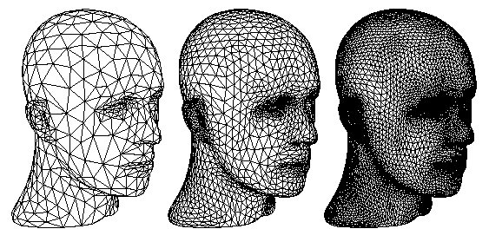
Subdivision Surface
Coarse mesh + subdivision rule
Smooth surface is limit of refinements
Zorin & Schroder

Slide 25
Current Research
All representations described are widely used, and topics of current research
Range images, and combinations to construct entire surfaces widely used (3D photography, 3D objects in movies, …)
Triangle meshes perhaps most common
Subdivision surfaces commonly used in movies, …
Point clouds becoming increasingly relevant
Replace older representations in many cases (parametric, spline patches, CSG, etc.)

Slide 26
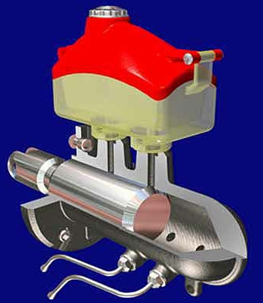
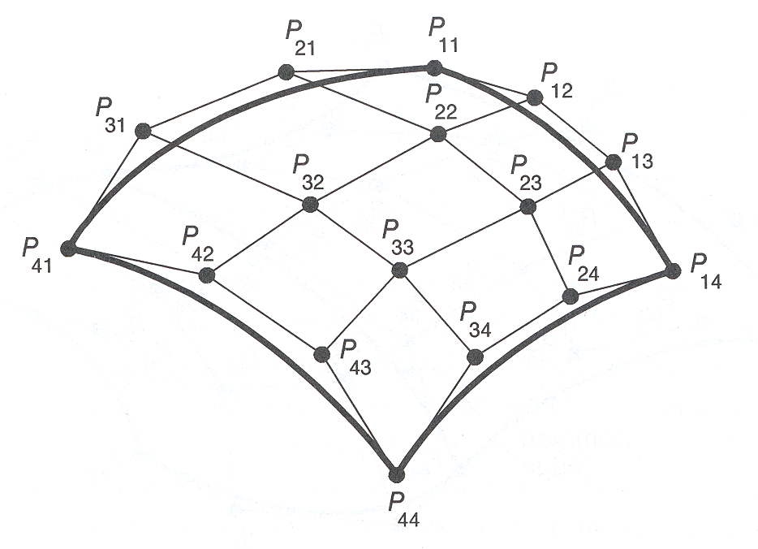
Parametric Surface
Tensor product spline patches
Careful constraints to maintain continuity
FvDFH

Slide 27
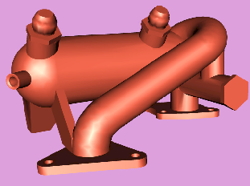
Implicit Surfaces
Points satisfying: F(x,y,z) = 0
Polygonal Model
Implicit Model
Lorensen

Slide 28
Why Implicit Surfaces?
Function usually sampled regularly (voxel grid)
Can guarantee that model is hole-free
Easy to change topology
Algorithms must traverse volume: slow
More space than parametric representation

Slide 29
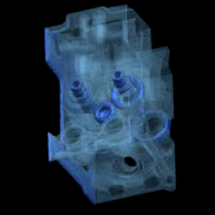
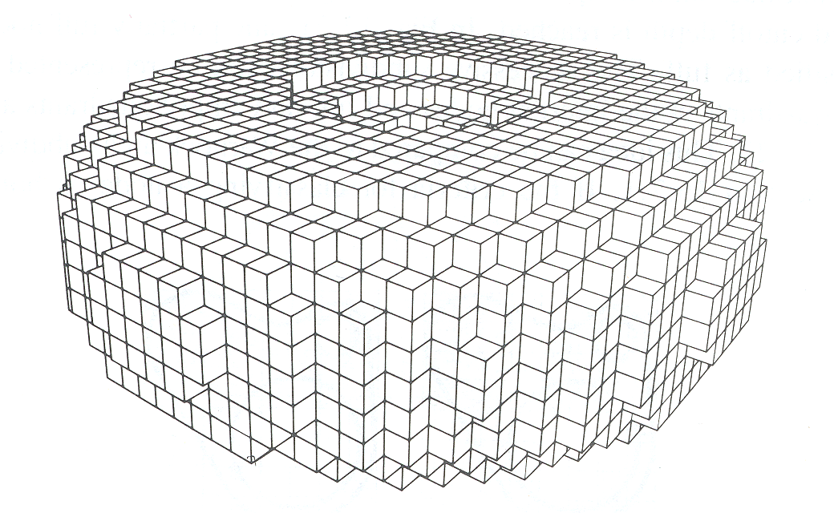
Voxels
Uniform grid of occupancy, density, etc.
Often acquired from CAT, MRI, etc.
FvDFH Figure 12.20
Stanford Graphics Laboratory

Slide 30
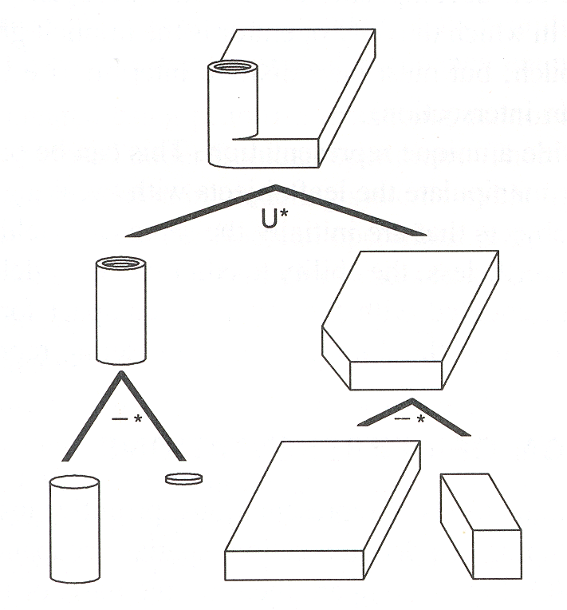
Constructive Solid Geometry
Hierarchy of boolean operations (union, difference, intersect) applied to simple shapes
FvDFH Figure 12.27
H&B Figure 9.9

Slide 31
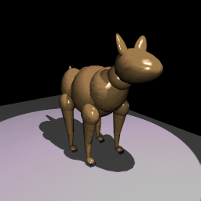
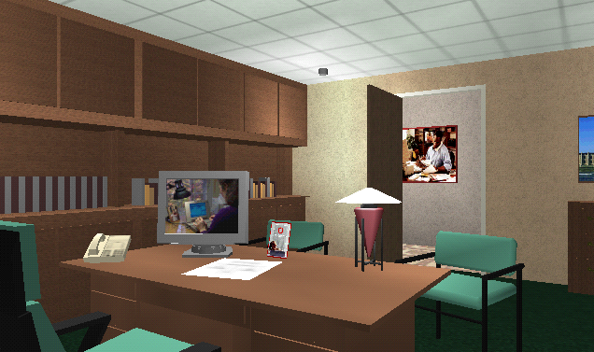
Scene Graph
Union of objects at leaf nodes
Bell Laboratories
avalon.viewpoint.com

Slide 32
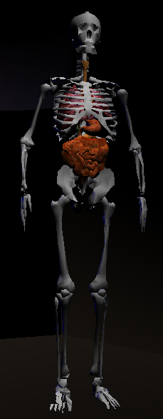
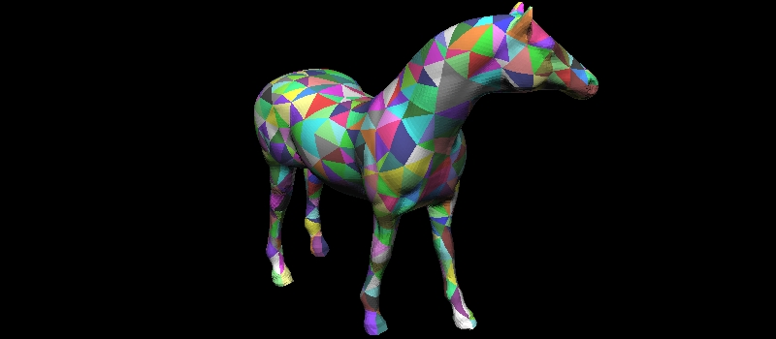
Skeleton
Graph of curves with radii
Stanford Graphics Laboratory
SGI

Slide 33
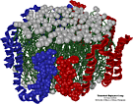
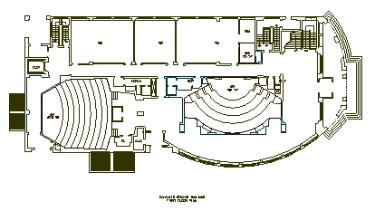
Application-Specific Models
Domain-specific semantic information + geometry
Apo A-1
(Theoretical Biophysics Group,
University of Illinois at Urbana-Champaign)
Architectural Floorplan
(CS Building, Princeton University)

Slide 34
3D Objects
How can this object be represented in a computer?

Slide 35
3D Objects
H&B Figure 10.46
This one?

Slide 36
3D Objects
How about this one?

Slide 37
3D Objects
H&B Figure 9.9
This one?

Slide 38
Outline for Today
Overview of types of 3D representations
3D objects can be represented in a variety of ways. We survey these today
Before talking specifically about polygon meshes, which are often most common way (next lecture)

