Slide 1
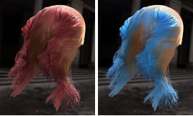

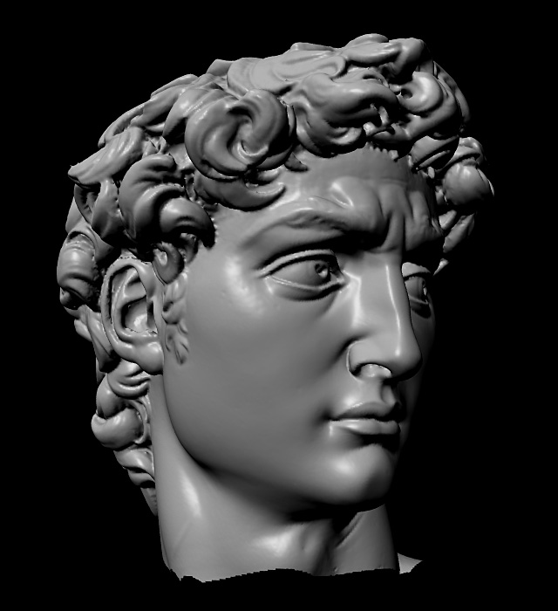
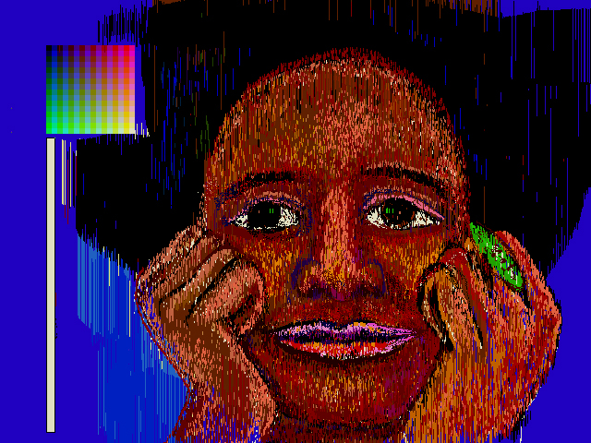
Advanced Computer Graphics
CSE 163 [Spring 2017], Lecture 5
Ravi Ramamoorthi
http://www.cs.ucsd.edu/~ravir

Slide 2
To Do
Assignment 1, Due Apr 28.
This lecture only extra credit and clear up difficulties
Questions/difficulties so far in doing assignment?

Slide 3
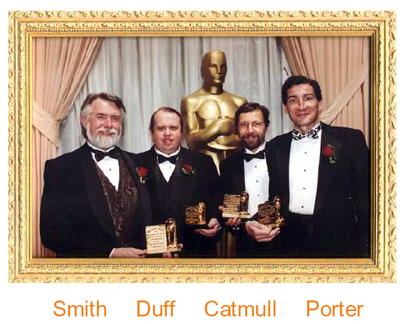
Digital Image Compositing
1996: Academy scientific and engineering achievement award (oscar ceremony) “For their pioneering inventions in digital image compositing”

Slide 4
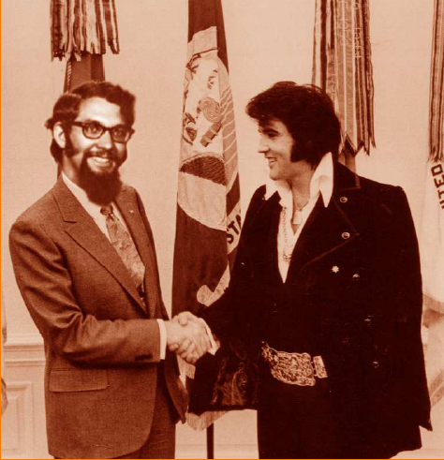
Image Compositing
Separate an image into elements
Each part is rendered separately
Then pasted together or composited into a scene
Many slides courtesy Tom Funkhouser

Slide 5
Outline
Compositing
Blue screen matting
Alpha channel
Porter-Duff compositing algebra (Siggraph 84)
Morphing (Beier-Neely, Siggraph 92)

Slide 6
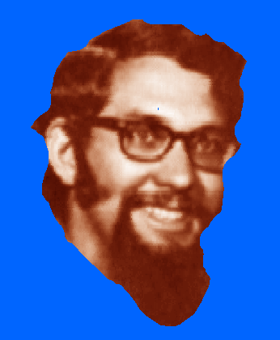
Blue Screen Matting
Photograph or create image of object against blue screen (blue usually diff from colors like skin)
Then extract foreground (non-blue pixels)
Add (composite) to new image
Problem: aliasing [hair] (no notion of partial coverage/blue)

Slide 7
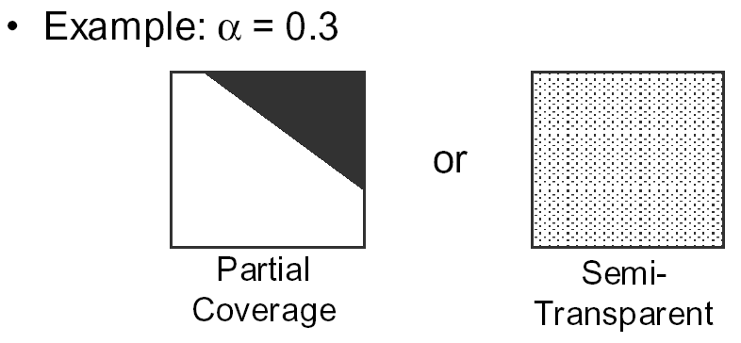
Alpha Channel
In general, 32 bit RGBα images
Alpha encodes coverage (0=transparent, 1=opaque)
Simple compositing:

Slide 8
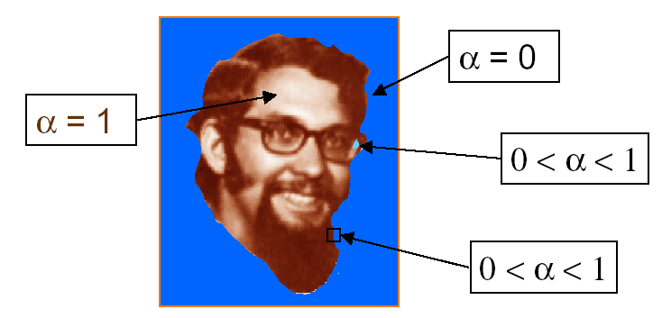
Alpha Channel

Slide 9
Pixels with Alpha: Conventions
Pre-multiplication
Color C = (r,g,b) and coverage alpha is often represented as
One benefit: color components αF directly displayed (analogous to homogeneous coordinates)
What is ( α , C ) for the following?
(0, 1, 0, 1) = Full green, full coverage
(0, ½ , 0, 1) = Half green, full coverage
(0, ½, 0, ½) = Full green, half (partial) coverage
(0, ½, 0, 0) = No coverage

Slide 10
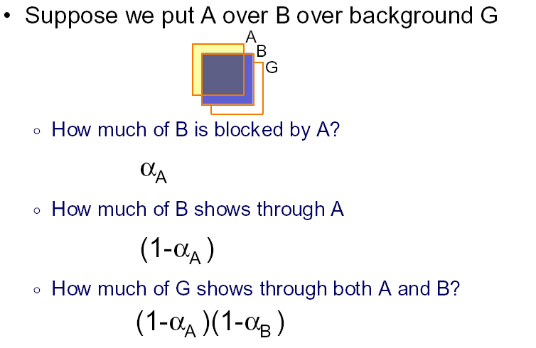
Compositing with Alpha

Slide 11
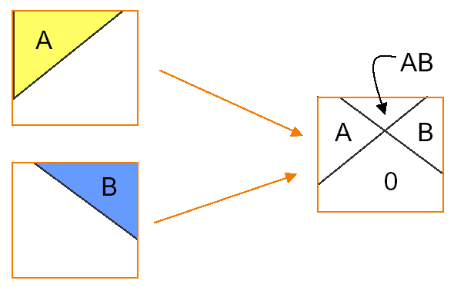
Opaque Objects
In this case, α controls the amount of pixel covered (as in blue screening).
How to combine 2 partially covered pixels? 4 possible outcomes

Slide 12
Outline
Compositing
Blue screen matting
Alpha channel
Porter-Duff compositing algebra (Siggraph 84)
Morphing (Beier-Neely, Siggraph 92)

Slide 13
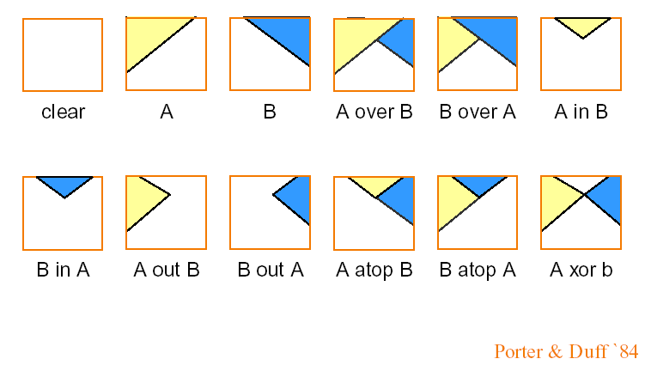
Compositing Algebra
12 reasonable combinations (operators)

Slide 14
Computing Colors with Compositing
Coverages shown previously only examples
We only have α, not exact coverage, so we assume coverages of A and B are uncorrelated
How to compute net coverage for operators?

Slide 15
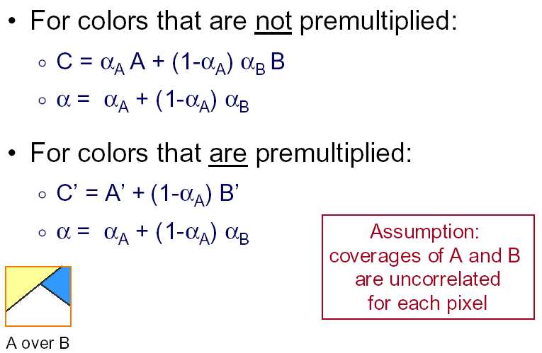
Example: C = A over B

Slide 16
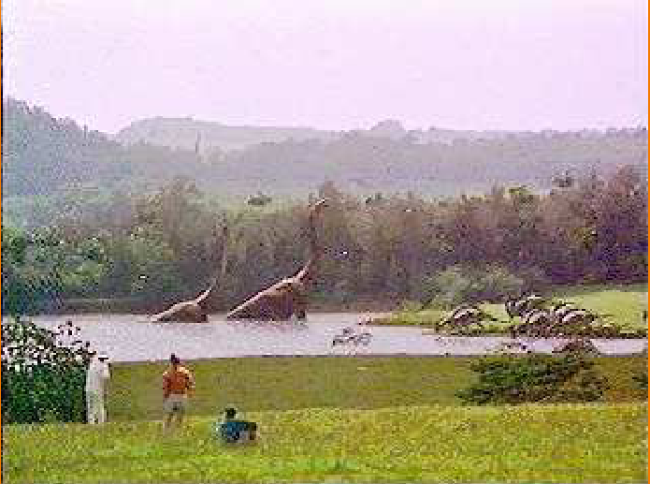
Image Compositing Example
Jurassic Park 93

Slide 17
Outline
Compositing
Blue screen matting
Alpha channel
Porter-Duff compositing algebra (Siggraph 84)
Morphing (Beier-Neely, Siggraph 92)

Slide 18
Examples
Famous example: Michael Jackson Black and White Video (Nov 14, 1991).
https://www.youtube.com/watch?v=F2AitTPI5U0
Easy enough to implement: assignment in many courses (we show example from CMU course):
No music, but the good poor man’s alternative

Slide 19
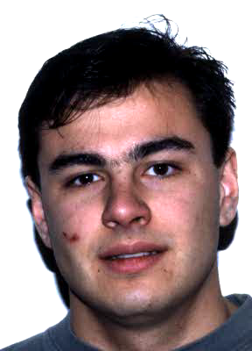
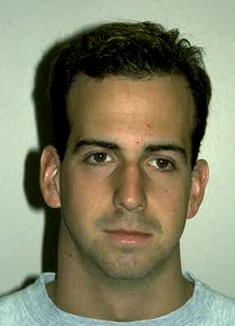
Examples

Slide 20
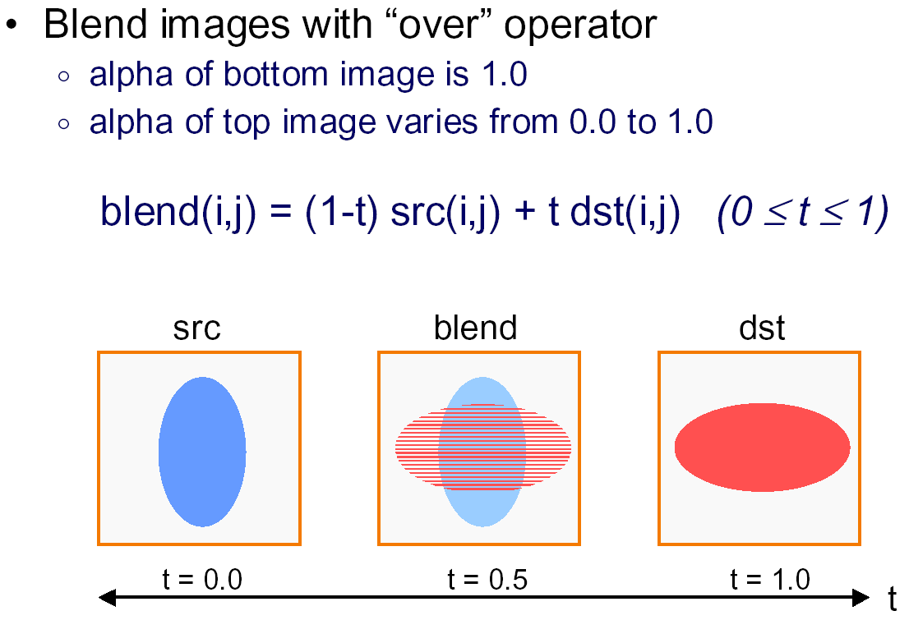
Simple Cross-Dissolve

Slide 21
The idea in morphing
User marks line segments
These are used to warp image 1 and image 2
Images are then blended
Key step is warping
Why is it needed? Why not just cross-dissolve or blend two images based on alpha (how far between them)
How is it to be done with line segments?

Slide 22
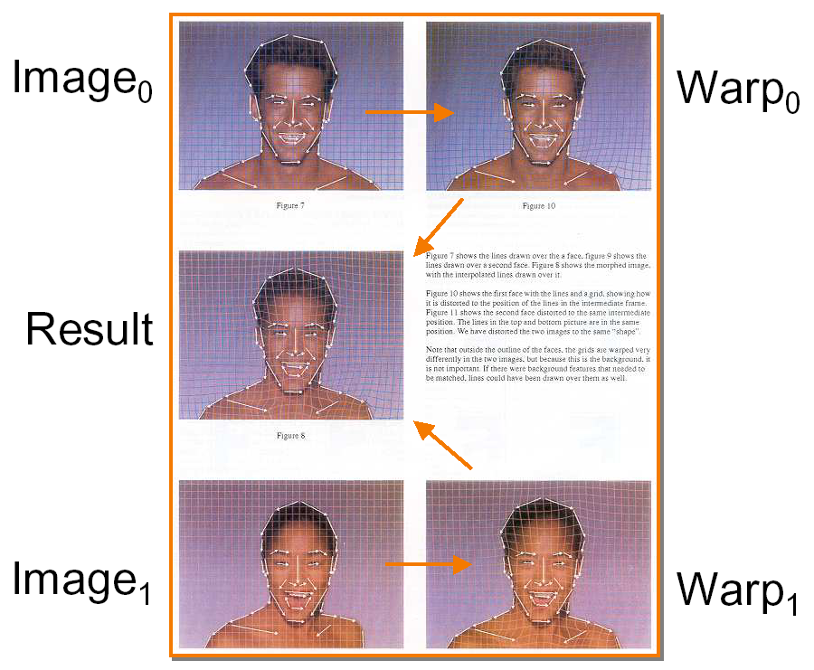
Beier-Neely examples

Slide 23
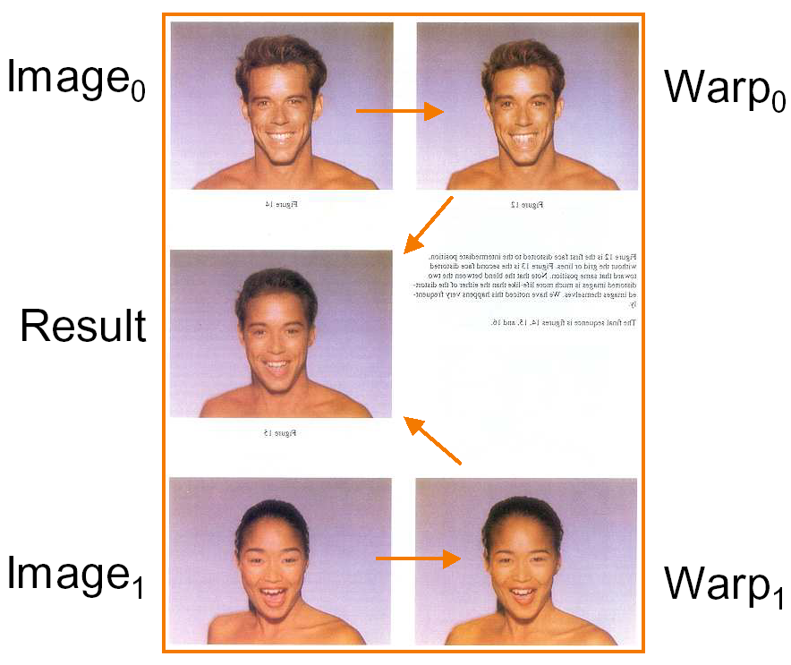

Slide 24
Feature-Based Warping
To warp image 1 into image 2, we must establish correspondence between like features
Then, those features transform (and rest of image moves with them)
In Beier-Neely, features are user-specified line segments (nose, face outline etc.)
Warping is an image transformation (generally more complex than scale or shift, but same basic idea)
Morphing takes two warped images, cross-dissolves

Slide 25
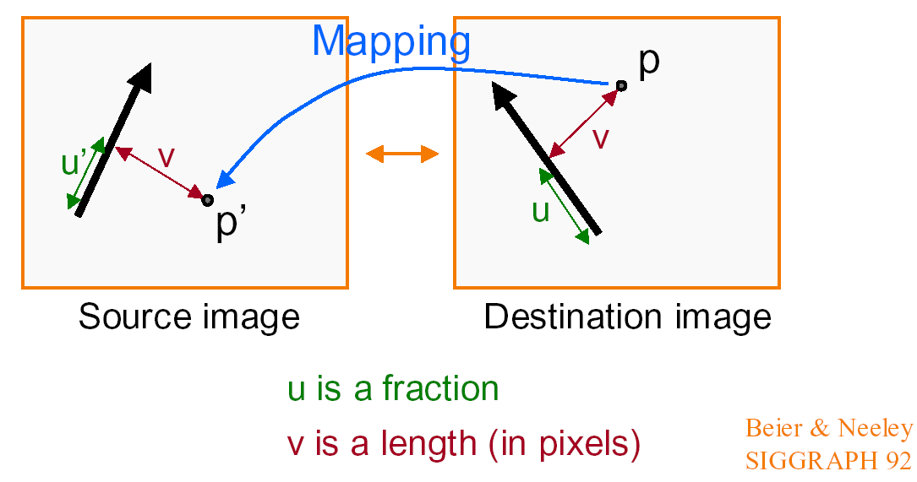
Warping with Line Segments
We know how line warps, but what about whole img?
Given p in dest image, where is p’ in source image?

Slide 26
Warping with one Line Pair
What happens to the F?
Translation!!

Slide 27
Warping with one Line Pair
What happens to the F?
Similar ideas apply to rotation,
other similarity transforms
Scale !!

Slide 28
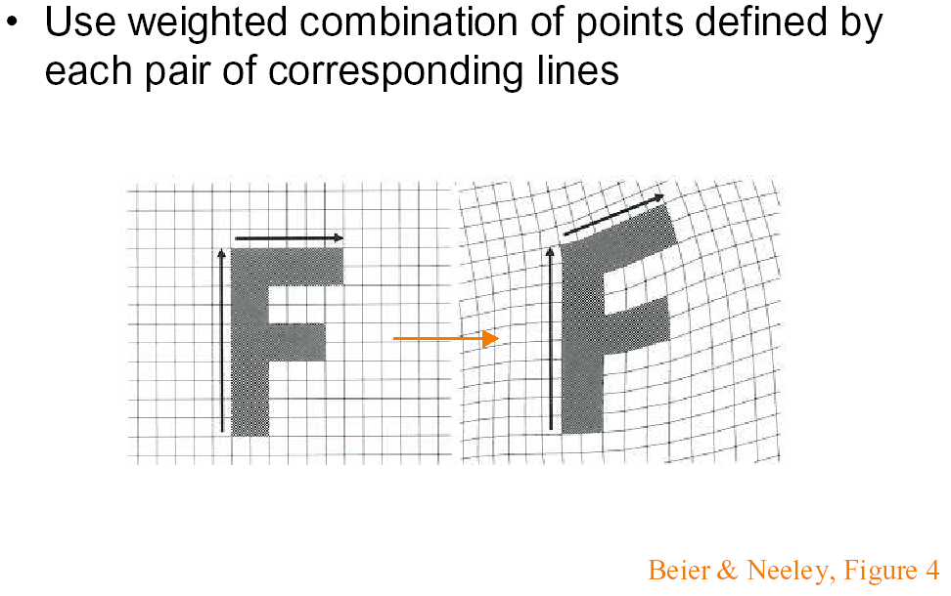
Warping with Multiple Line Pairs

Slide 29
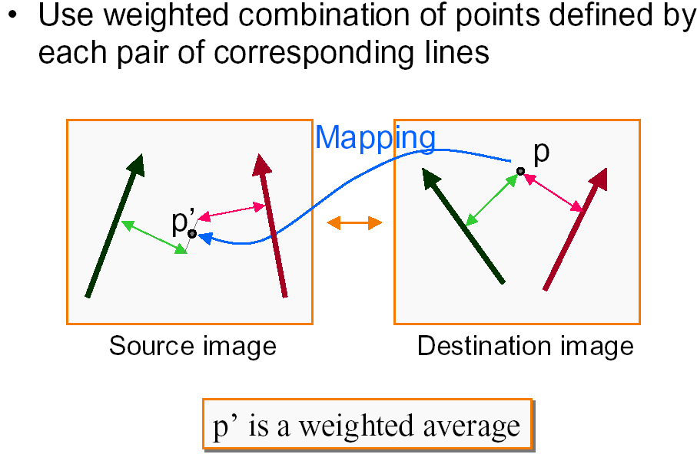
Details

Slide 30
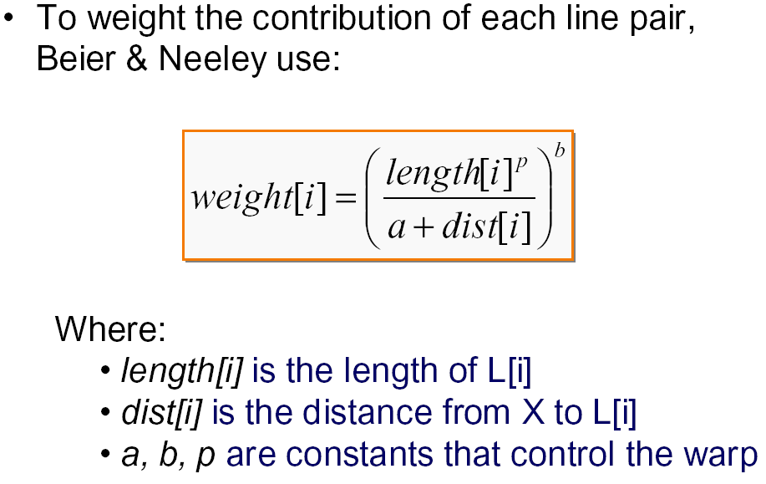
Weighting effect of each line pair

Slide 31
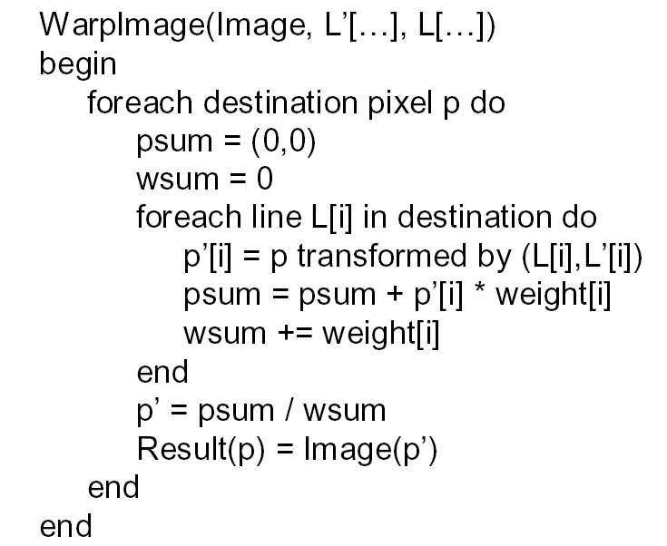
Warping Pseudocode

Slide 32
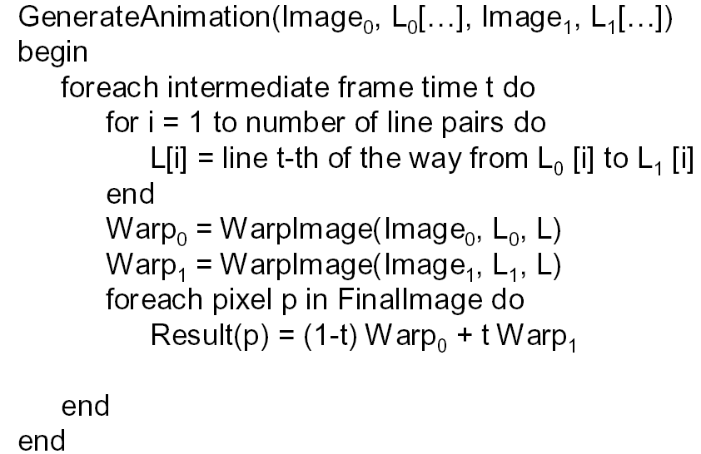
Morphing Pseudocode

Slide 33
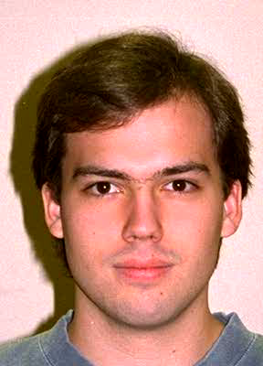
Examples

Slide 34
Bonus: Reconstruction
Section 14.10.5 of textbook (in handout)
Some interesting, more technical ideas
Discuss briefly if time permits

Slide 35
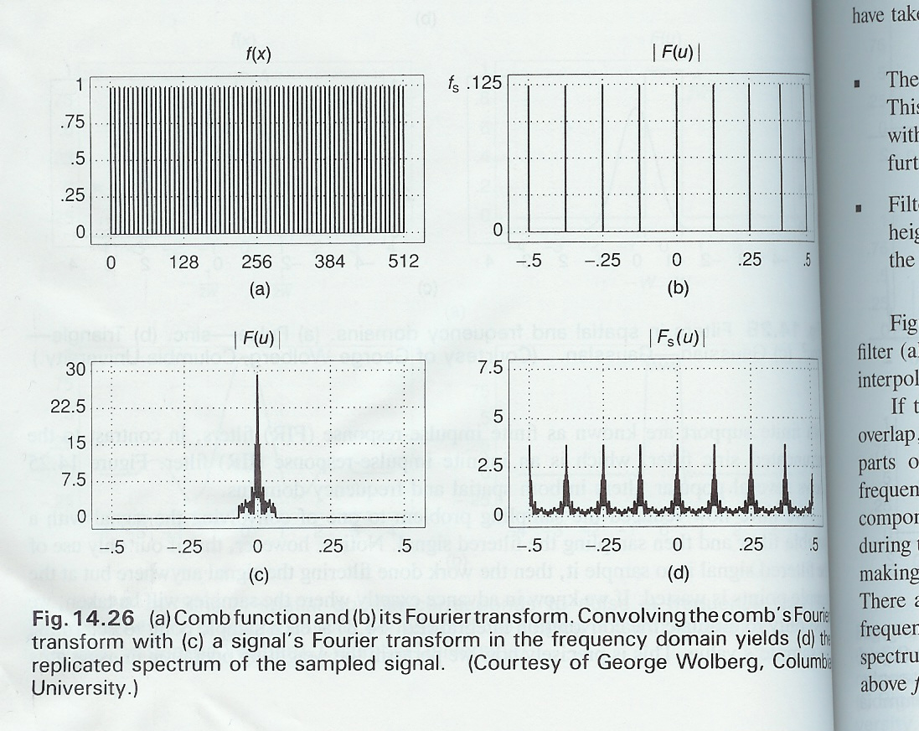
Discrete Reconstruction
Equivalent to multiplying by comb function (a)
Convolving with similar fn in frequency domain (b). Separation in frequency domain depends on spatial sampling rate
Replicated Fourier spectra (when is this safe?)

Slide 36
Replicated Fourier Spectra
One can window to eliminate unwanted spectra
Equivalent to convolution with sinc
No aliasing if spectra well enough separated (initial spatial sampling rate high enough)
In practice, we use some reconstruction filter (not sinc), such as triangle or Mitchell filter

Slide 37
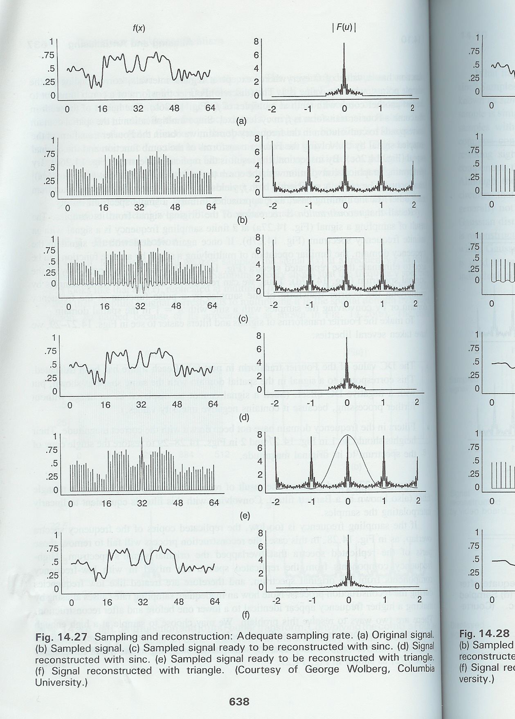
Adequate Sampling Rate

Slide 38
Adequate Sampling Rate

Slide 39
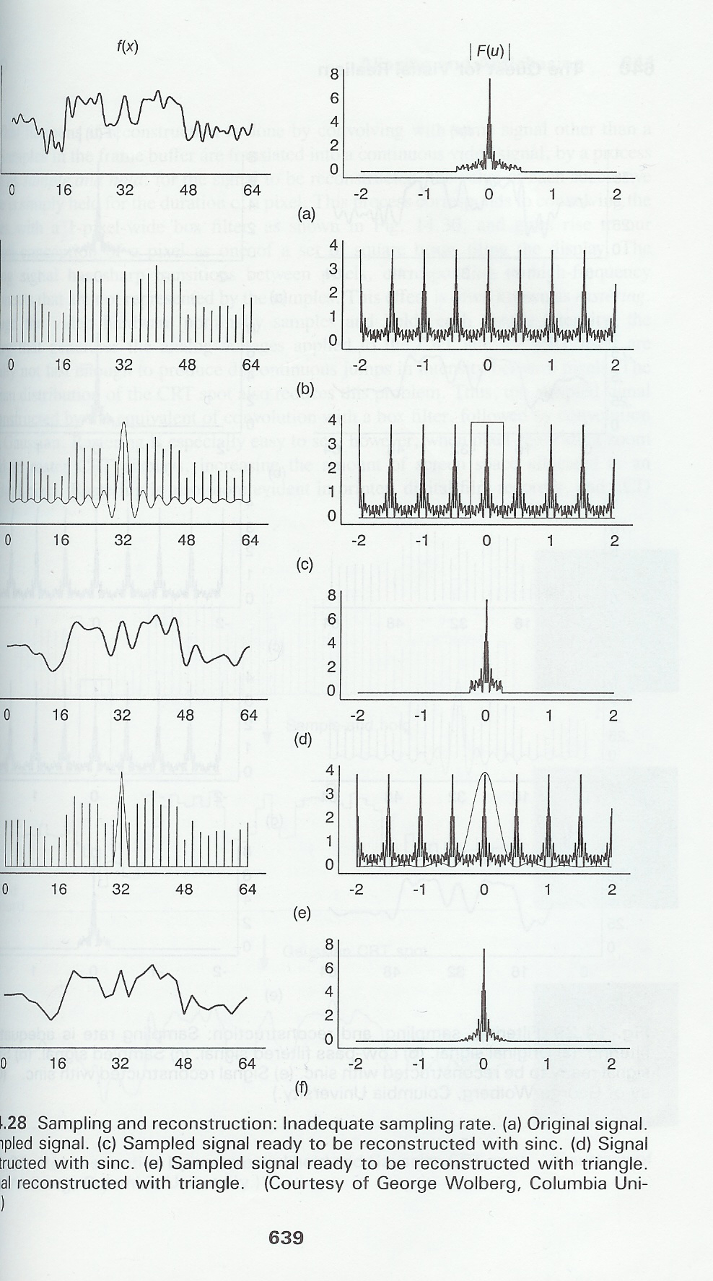
Inadequate Sampling Rate

Slide 40
Inadequate Sampling Rate

Slide 41
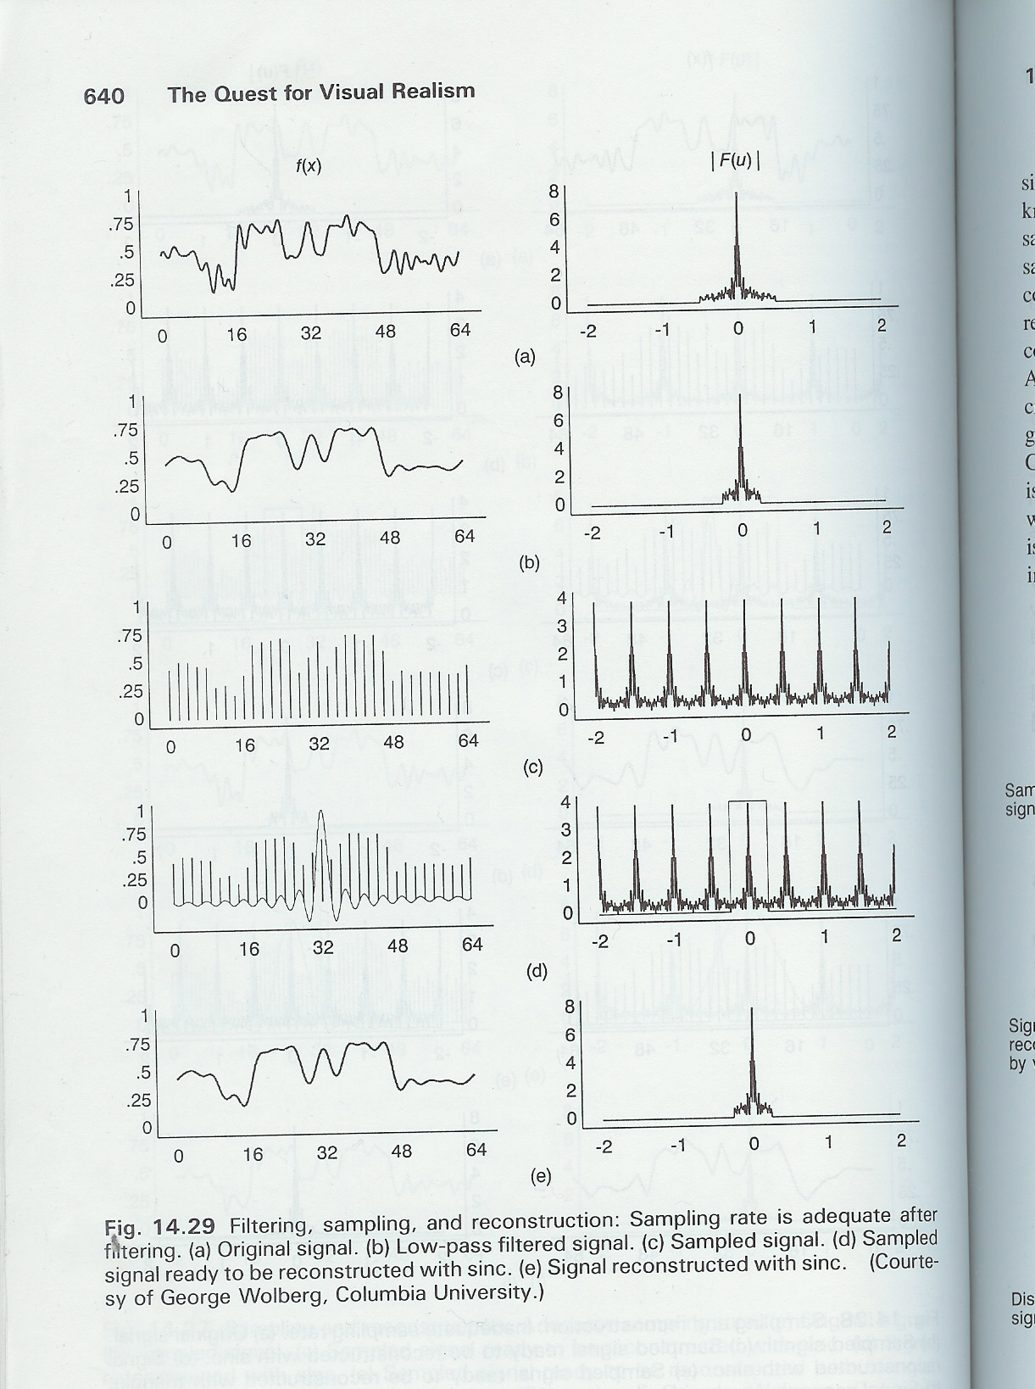
Filter first

Slide 42
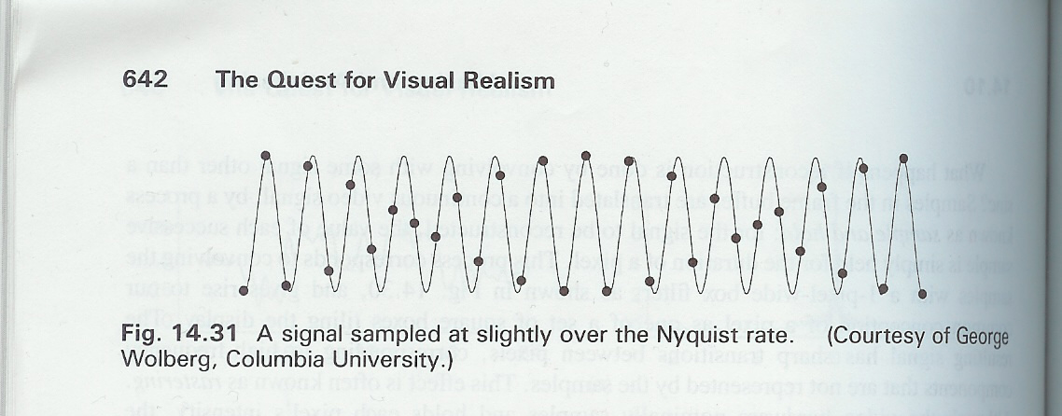
Non-Ideal Reconstruction
In practice, convolution never with sinc
Sampling frequency must be even higher than Nyquist, or we get substantial aliasing
In figure, samples trace out original modulated by a low-frequency sine wave. Low freq amplitude modulation remains, compounded by rastering if reconstruct box filter

