Slide 1
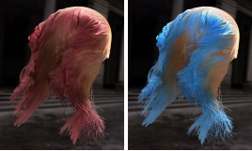

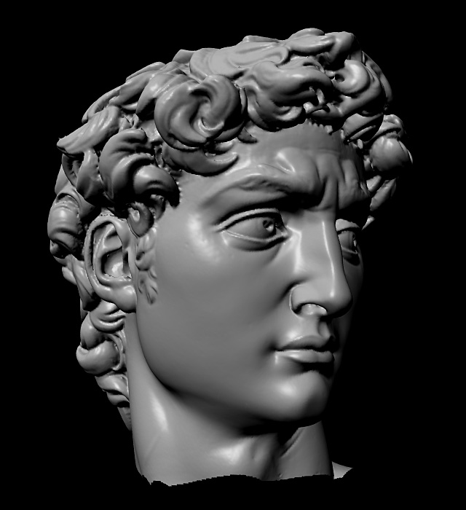
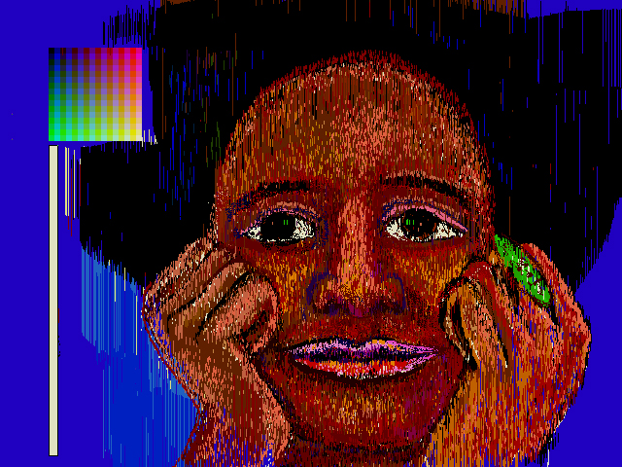
Advanced Computer Graphics
CSE 163 [Spring 2017], Lecture 3
Ravi Ramamoorthi
http://www.cs.ucsd.edu/~ravir

Slide 2
To Do
Sign up for Piazza
Assignment 1, Due Apr 28.
Anyone need help finding partners?
Any issues with skeleton code?
Please START EARLY

Slide 3
Outline
Basic ideas of sampling, reconstruction, aliasing
Signal processing and Fourier analysis
Implementation of digital filters (second part of homework): next lecture
Section 14.10 of FvDFH 2nd edition (should read)
Readings: Chapter 13 (color) and 14.10
Some slides courtesy Tom Funkhouser

Slide 4
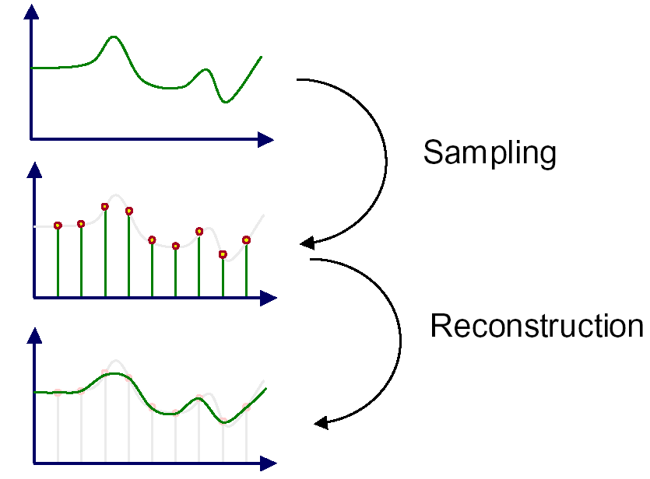
Sampling and Reconstruction
An image is a 2D array of samples
Discrete samples from real-world continuous signal

Slide 5
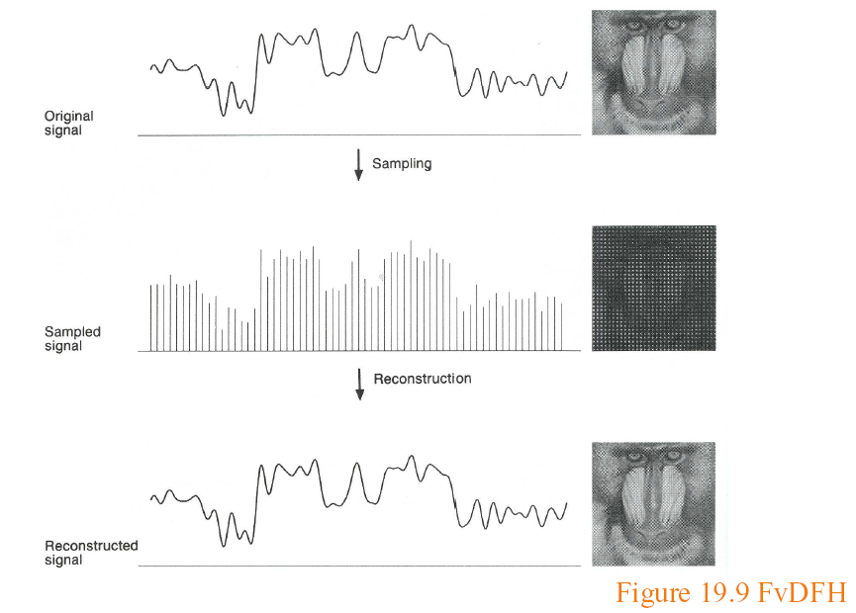
Sampling and Reconstruction

Slide 6
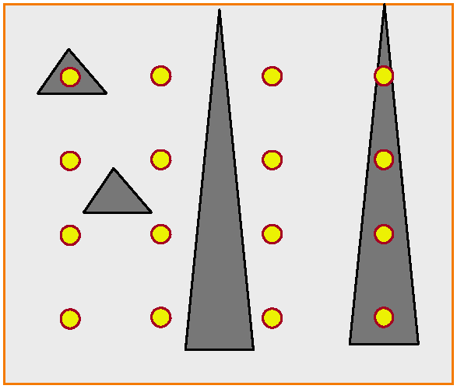
(Spatial) Aliasing

Slide 7
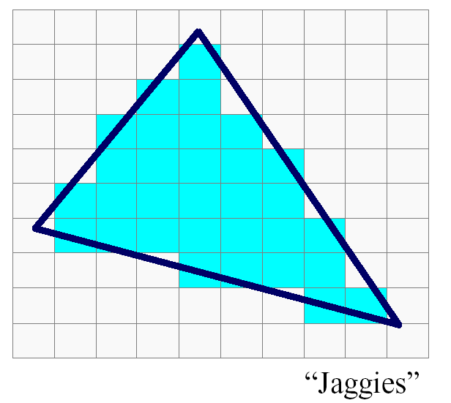
(Spatial) Aliasing
Jaggies probably biggest aliasing problem

Slide 8
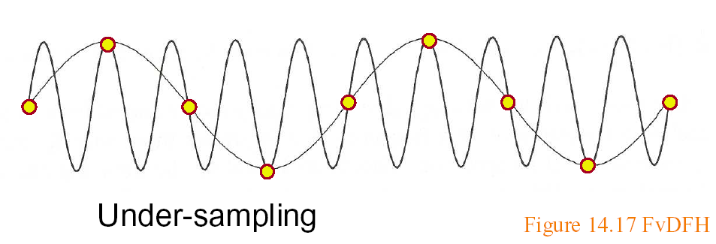
Sampling and Aliasing
Artifacts due to undersampling or poor reconstruction
Formally, high frequencies masquerading as low
E.g. high frequency line as low freq jaggies

Slide 9
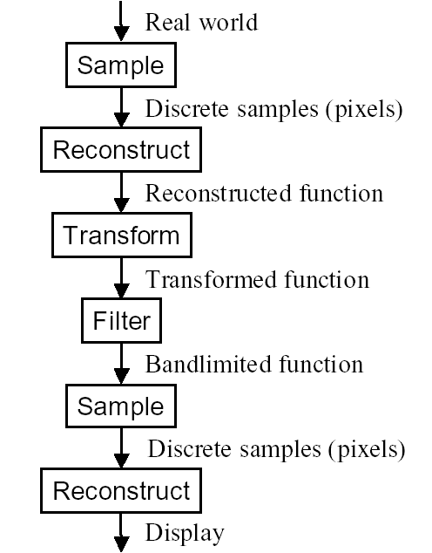
Image Processing pipeline

Slide 10
Outline
Basic ideas of sampling, reconstruction, aliasing
Signal processing and Fourier analysis
Implementation of digital filters (second part of homework): next lecture
Section 14.10 of FvDFH 2nd edition (should read)
Readings: Chapter 13 (color) and 14.10
Some slides courtesy Tom Funkhouser

Slide 11
Motivation
Formal analysis of sampling and reconstruction
Important theory (signal-processing) for graphics
Also relevant in rendering, modeling, animation

Slide 12
Ideas
Signal (function of time generally, here of space)
Continuous: defined at all points; discrete: on a grid
High frequency: rapid variation; Low Freq: slow variation
Images are converting continuous to discrete. Do this sampling as best as possible.
Signal processing theory tells us how best to do this
Based on concept of frequency domain Fourier analysis

Slide 13
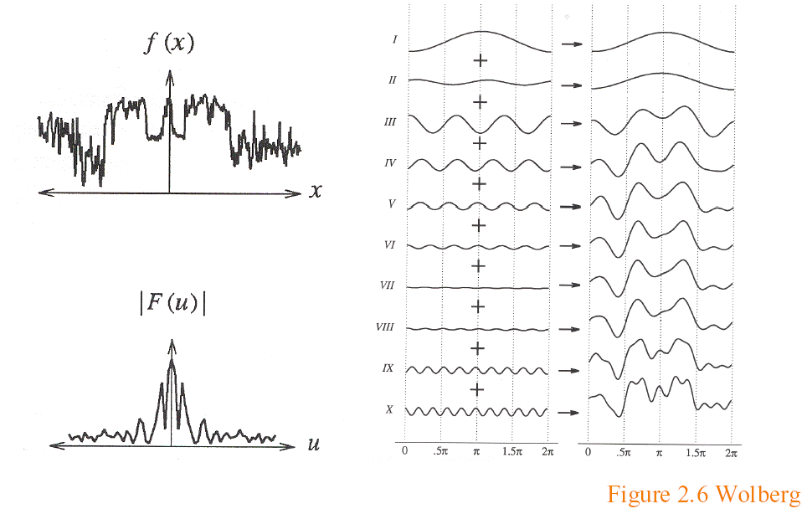
Sampling Theory
Analysis in the frequency (not spatial) domain
Sum of sine waves, with possibly different offsets (phase)
Each wave different frequency, amplitude

Slide 14
Fourier Transform
Tool for converting from spatial to frequency domain
Or vice versa
One of most important mathematical ideas
Computational algorithm: Fast Fourier Transform
One of 10 great algorithms scientific computing
Makes Fourier processing possible (images etc.)
Not discussed here, but look up if interested

Slide 15
Fourier Transform
Simple case, function sum of sines, cosines
Continuous infinite case

Slide 16
Fourier Transform
Simple case, function sum of sines, cosines
Discrete case

Slide 17
Fourier Transform: Examples 1
Single sine curve (+constant DC term)

Slide 18
Fourier Transform Examples 2
Common examples

Slide 19
Fourier Transform Properties
Common properties
Linearity:
Derivatives: [integrate by parts]
2D Fourier Transform
Convolution (next)

Slide 20
Sampling Theorem, Bandlimiting
A signal can be reconstructed from its samples, if the original signal has no frequencies above half the sampling frequency – Shannon
The minimum sampling rate for a bandlimited function is called the Nyquist rate

Slide 21
Sampling Theorem, Bandlimiting
A signal can be reconstructed from its samples, if the original signal has no frequencies above half the sampling frequency – Shannon
The minimum sampling rate for a bandlimited function is called the Nyquist rate
A signal is bandlimited if the highest frequency is bounded. This frequency is called the bandwidth
In general, when we transform, we want to filter to bandlimit before sampling, to avoid aliasing

Slide 22
Antialiasing
Sample at higher rate
Not always possible
Real world: lines have infinitely high frequencies, can’t sample at high enough resolution
Prefilter to bandlimit signal
Low-pass filtering (blurring)
Trade blurriness for aliasing

Slide 23
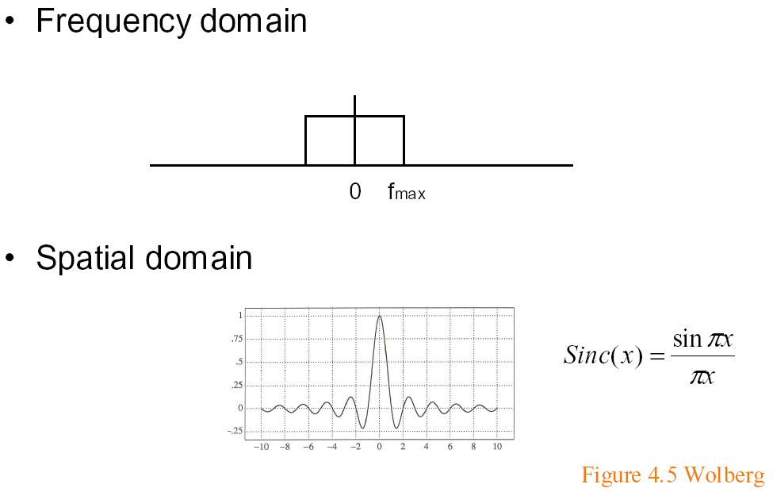
Ideal bandlimiting filter
Formal derivation is homework exercise

Slide 24
Outline
Basic ideas of sampling, reconstruction, aliasing
Signal processing and Fourier analysis
Convolution
Implementation of digital filters (second part of homework): next lecture
Section 14.10 of FvDFH 2nd edition (should read)
Readings: Chapter 13 (color) and 14.10
Some slides courtesy Tom Funkhouser

Slide 25
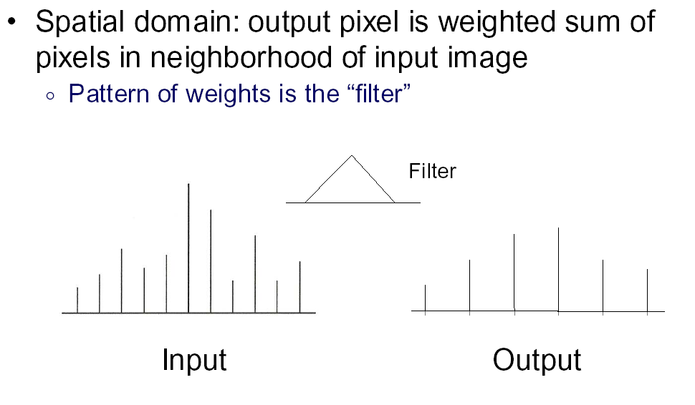
Convolution 1

Slide 26
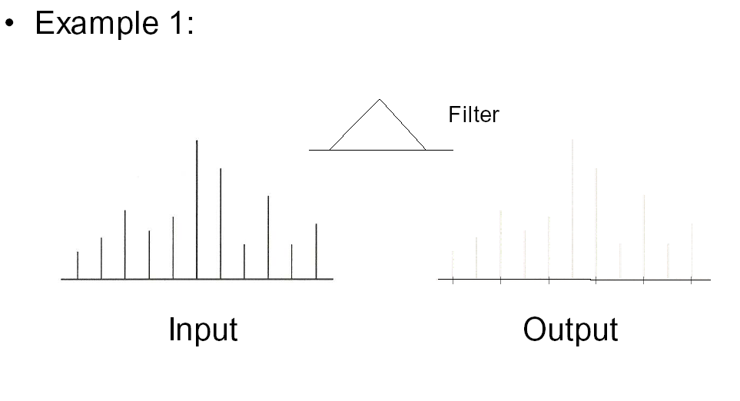
Convolution 2

Slide 27
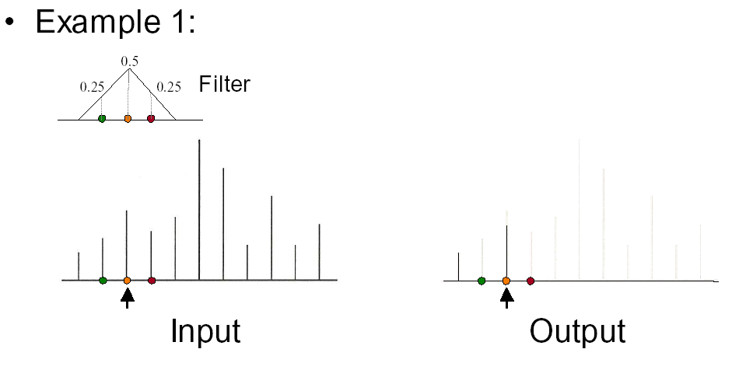
Convolution 3

Slide 28
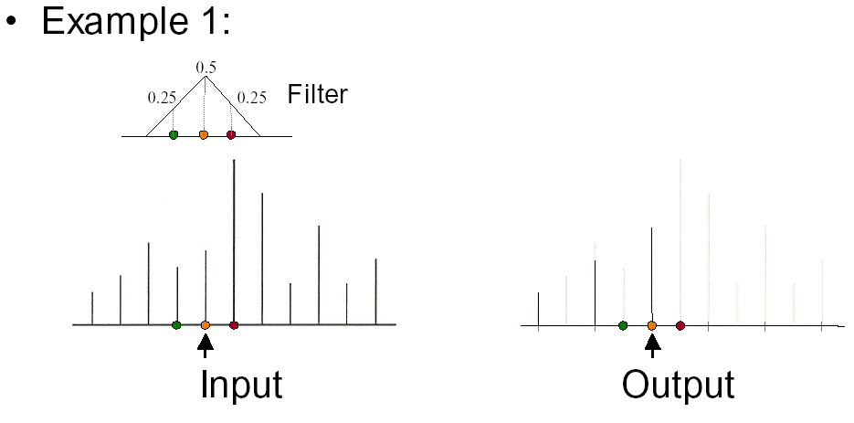
Convolution 4

Slide 29
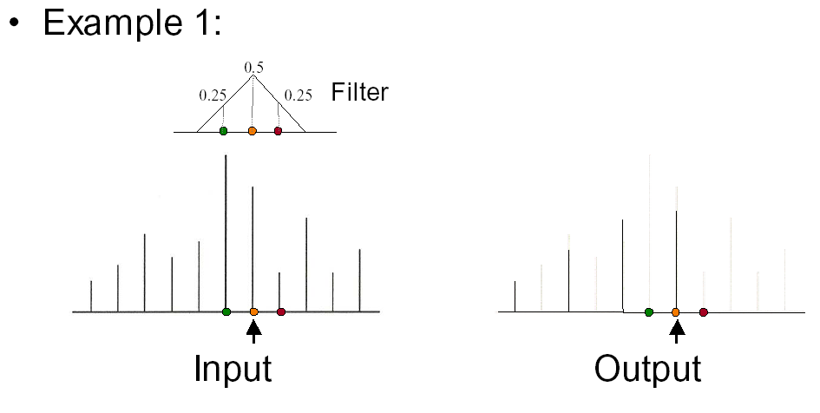
Convolution 5

Slide 30
Convolution in Frequency Domain
Convolution (f is signal ; g is filter [or vice versa])
Fourier analysis (frequency domain multiplication)

Slide 31
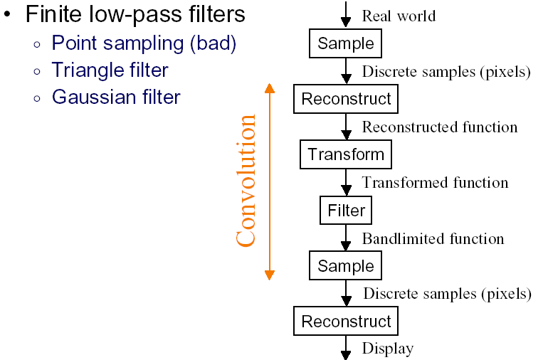
Practical Image Processing
Discrete convolution (in spatial domain) with filters for various digital signal processing operations
Easy to analyze, understand effects in frequency domain
E.g. blurring or bandlimiting by convolving with low pass filter

Slide 32
Outline
Basic ideas of sampling, reconstruction, aliasing
Signal processing and Fourier analysis
Implementation of digital filters (second part of homework): next lecture
Section 14.10 of FvDFH 2nd edition (should read)
Readings: Chapter 13 (color) and 14.10
Some slides courtesy Tom Funkhouser

