Slide 1
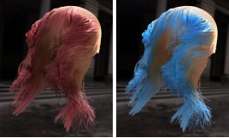

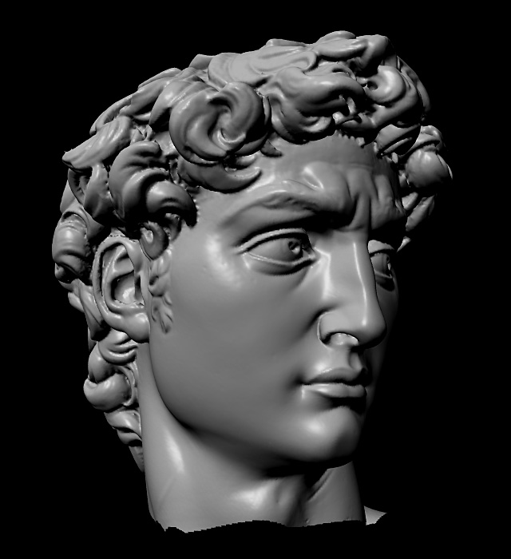
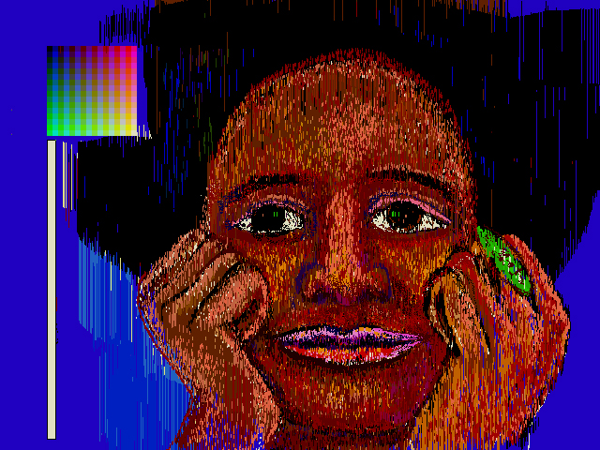
Advanced Computer Graphics
CSE 163 [Spring 2017], Lecture 2
Ravi Ramamoorthi
http://www.cs.ucsd.edu/~ravir

Slide 2
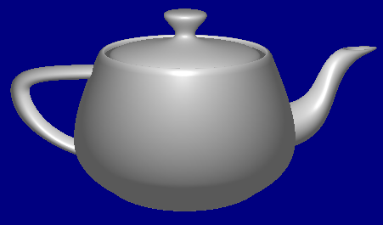
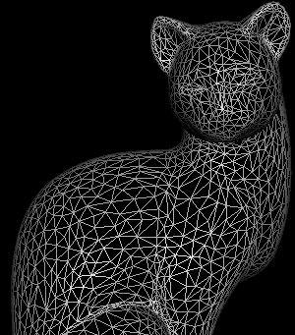
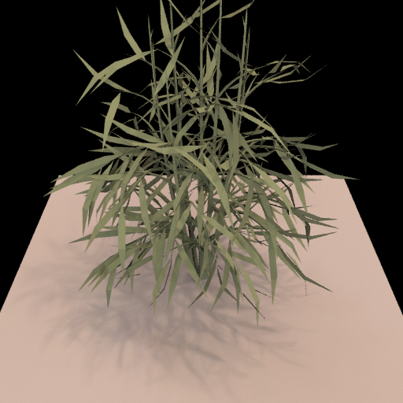
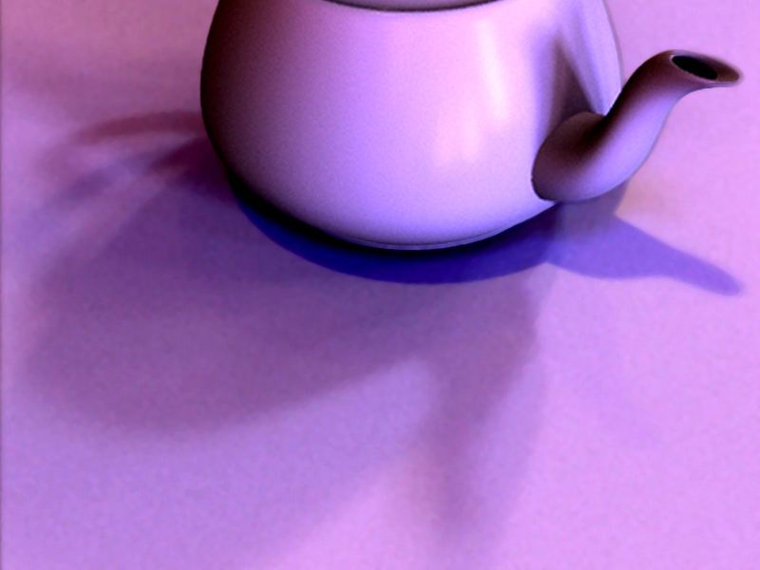
Course Outline
3D Graphics Pipeline
Rendering
(Creating, shading images from geometry, lighting, materials)
Modeling
(Creating 3D Geometry)

Slide 3
Course Outline
3D Graphics Pipeline
Rendering
(Creating, shading images from geometry, lighting, materials)
Modeling
(Creating 3D Geometry)
Unit 1: Foundations of Signal and Image Processing
Understanding the way 2D images are formed and displayed, the important concepts and algorithms, and to build an image processing utility like Photoshop
Weeks 1 – 3. Assignment 1

Slide 4
To Do
Assignment 1, Due Apr 28.
  Anyone need help finding partners?
  Should already have downloaded code, skimmed assn
  After today, enough to finish 3.2, 3.3 (first half)
  Should START EARLY (this week) on assn
  Second half next week.
Class participation, discussion important
  If you have to miss a class, see podcast if available
Please sign up for Piazza

Slide 5
Outline
Intensity and Color (briefly)
  Basic operations (3.2 in assignment [10 points])
Quantization, Halftoning and Dithering
  (3.3 in assignment [10 points])
Next week: Sampling and Reconstruction
  Including signal processing and fourier analysis
  Implementation of simple digital filters, resizing
  Second half of assignment
Lectures main source; will also try handout

Slide 6
Intensities: Human Perception
Human eye can perceive wide range of intensities
  Dimly lit darkened room to bright sunlight
  Radiance ratio in these cases is a million to one or more
How does it work? [image only 256 gray levels]
  Nonlinear human response
  Care about ratio of intensities (log scale). So jump from 0.1 to 0.11 as important as 0.50 to 0.55 (not .5 to .51)
  E.g.: cycle through 50W,100W,150W (step from 50 to 100 much greater than from 100 to 150)
Technically, equispaced intensities multiplicative
  0.02, 0.0203, 0.0206, … 0.9848, 1.000 [for 100 values]
Area of CG known as tonemapping (we ignore)

Slide 7
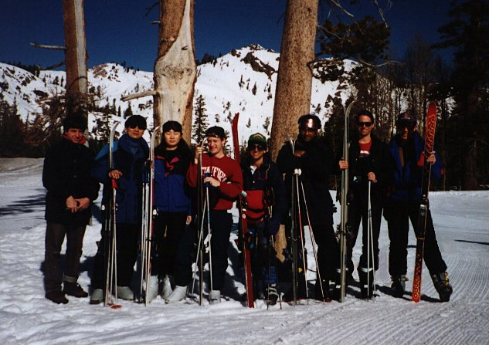
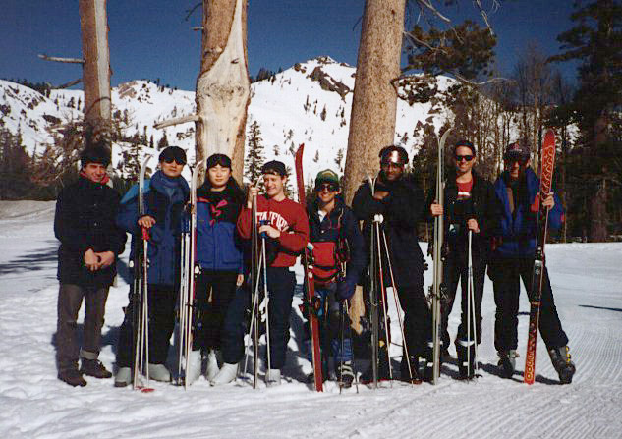
Gamma Correction
Website: http://graphics.stanford.edu/gamma.html
Practical problem: Images look too dark/bright…

Slide 8
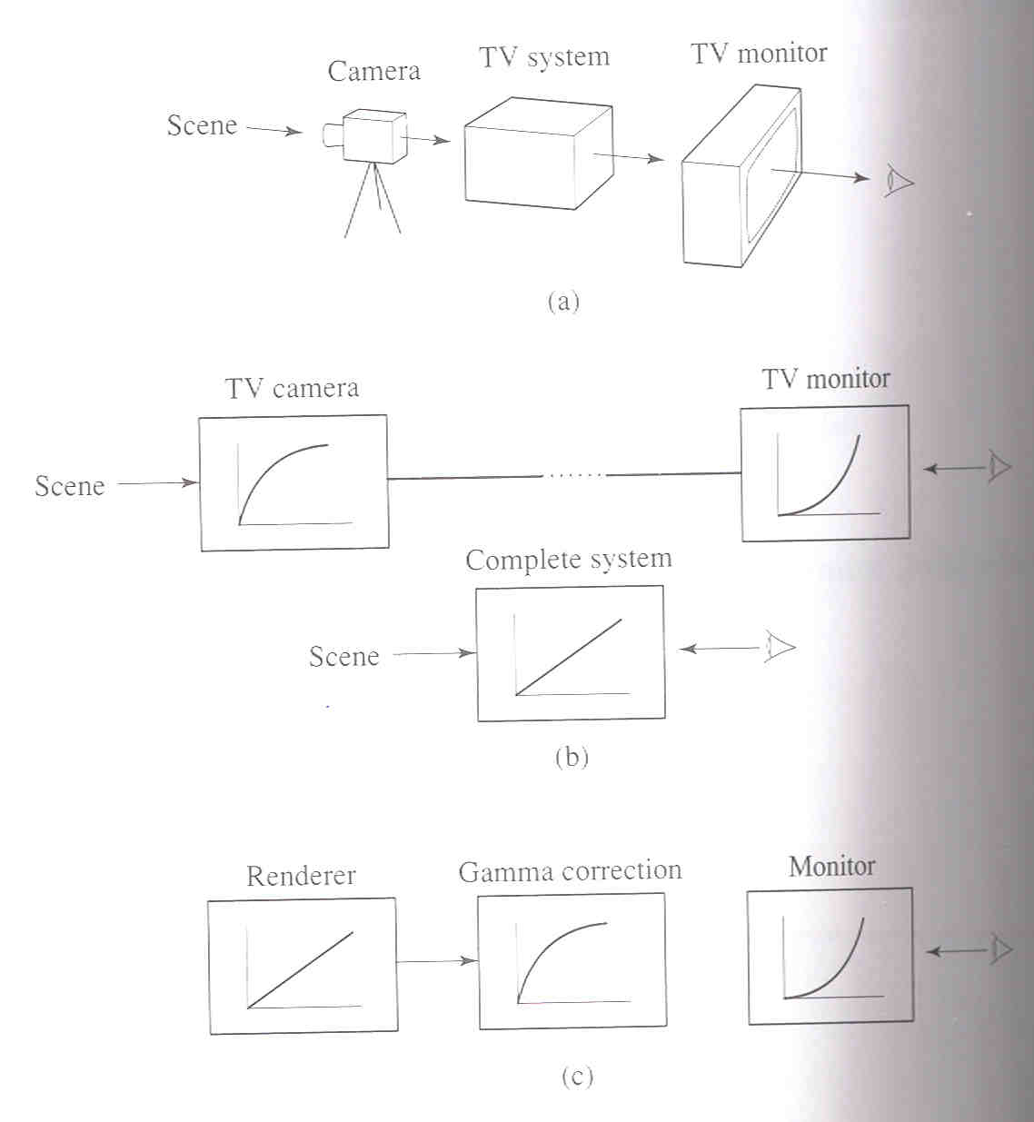
Gamma Correction
Monitors were CRT displays with nonlinear resp.
NTSC, use 2.2 (camera pre-corrected)
Rendering linear (physical space) Gamma Correct
γ=2.5+
Watt Page 440

Slide 9
Example
Say RGB is something like (1, 0.5, 0)
Values of 1 and 0 don’t change (black, white, primary colors unaffected by gamma correction)
Value of .5 becomes .707 (power of ½, gamma = 2)
Final color is (1, 0.707, 0) [brighter, less saturated]

Slide 10
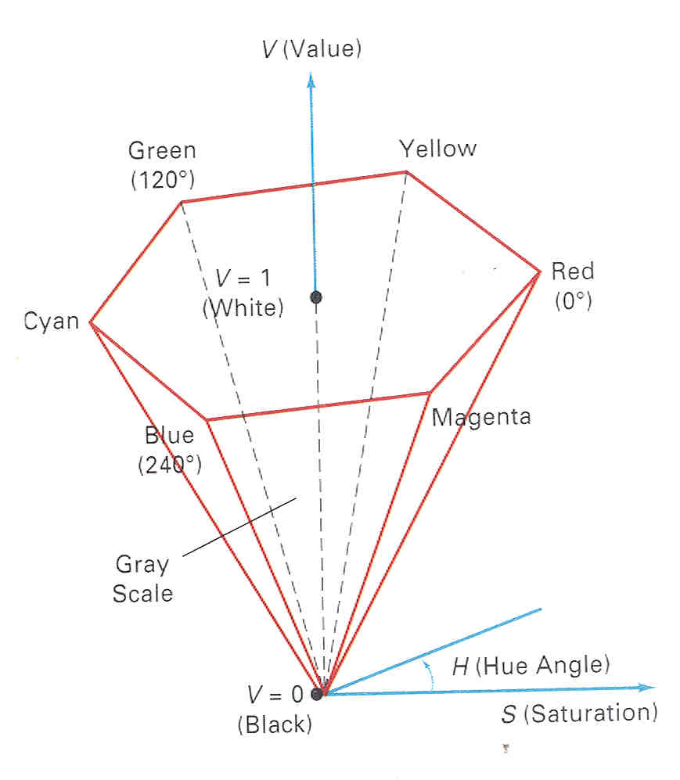
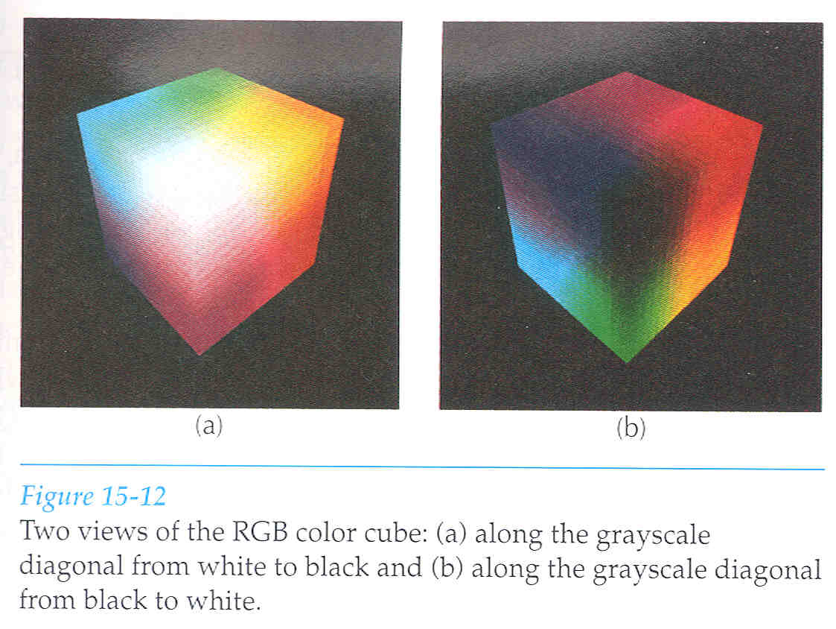
Color
Already seen: RGB model (color cube)
Today: A very brief overview of real story
Intuitive specify: Hue, Saturation, Lightness
  Hexacone
  Can convert HSV to RGB
  Many other fancy, perceptual spaces

Slide 11
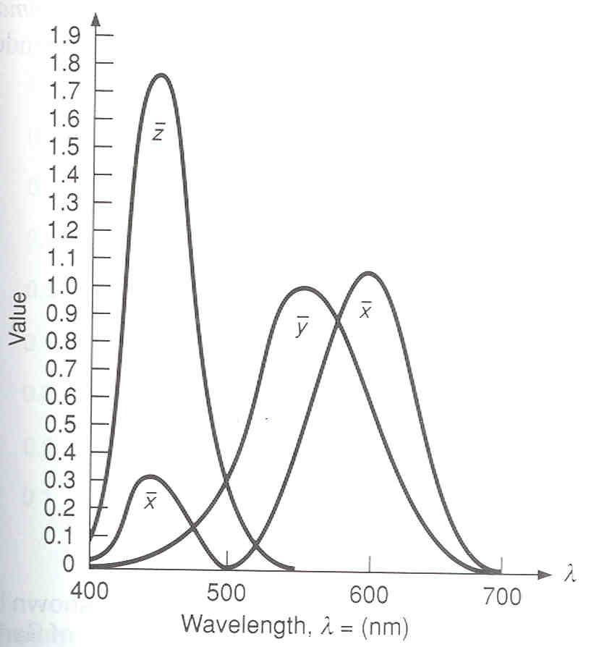
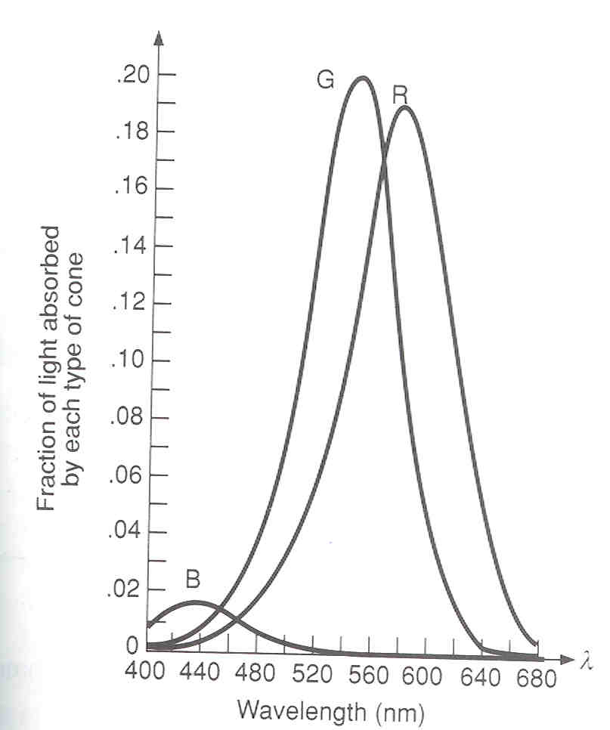
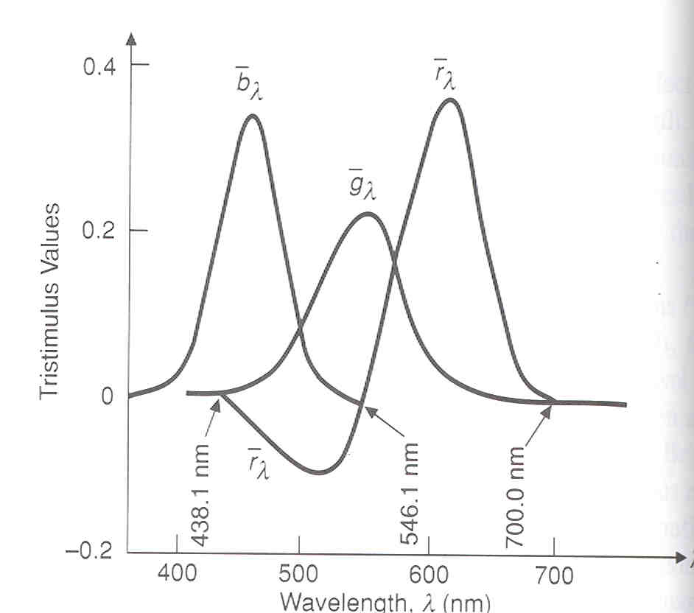
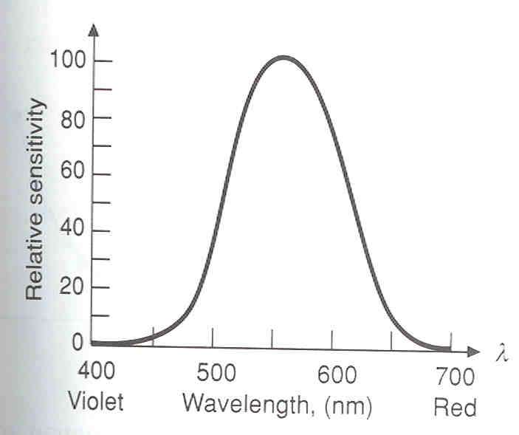
Color: Tristimulus Theory
Perception: Tri-stimulus theory
  3 types of cones: basis for RGB
  Cone response functions
  Luminous efficiency (G>R>B)
  Color matching: Note “negative colors”
  CIE overview
Cone response
Luminous efficiency
Color Matching
Match w CIE primaries

Slide 12
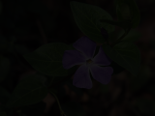
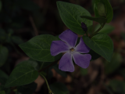
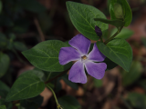
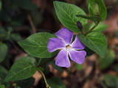
Basic Image Processing (HW 1: 3.2)
Brightness: Simply scale pixel RGB values (1 leaves image intact, 0 makes it black)
Gamma Correction
Crop (integer coords) to focus on important aspects
0.1
0.4
0.7
1.0

Slide 13
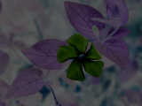

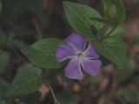
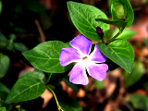
Basic Image Processing (HW 1: 3.2)
Contrast [0 is constant grey image, 1 is original]
  Find constant grey image by averaging
  Interpolate between this and original
-0.5
0
0.5
1.0
2.0

Slide 14
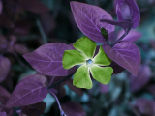
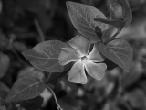

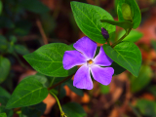
Basic Image Processing (HW 1: 3.2)
Saturation [0 is greyscale, 1 is original colors]
  Interpolate between grayscale (but not const) and orig.
  Negative values correspond to inverting hues [negative]
-1.0
0.0
0.5
1.0
2.0

Slide 15
Outline
Intensity and Color (briefly)
  Basic operations (3.2 in assignment [10 points]
Quantization, Halftoning and Dithering
  (3.3 in assignment [10 points])
Next week: Sampling and Reconstruction
  Including signal processing and fourier analysis
  Implementation of simple digital filters, resizing
  Second half of assignment (and written part)

Slide 16
Images and Resolution
Image is a 2D rectilinear discrete array of samples
There are resolution issues:
  Intensity resolution: Each pixel has only Depth bits
  Spatial resolution: Image is only width*height pixels
  Temporal resolution: Monitor refreshes only at some rate
NTSC | 640x480 | 8 bits | 30 Hz
PC | 1280x1024 | 24 bits RGB | 75 Hz
Film | 3000x2000 | 12 bits | 24 Hz
Laser Printer | 7000x2000 | 1 (on or off)
Some material for slides courtesy Greg Humphreys and Tom Funkhouser

Slide 17
Sources of Error or Artifacts
Quantization: Not enough intensity resolution (bits)
  Halftoning/dithering: Reduce visual artifacts due to quantization
Spatial and Temporal Aliasing: not enough resolution
  Sampling and reconstruction to reduce visual artifacts due to aliasing (next week)

Slide 18
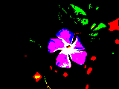
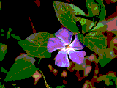
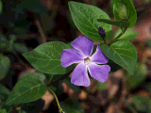
Uniform Quantization
1 bit
8 bits
2 bits: NOTE CONTOURS
4 bits

Slide 19
Uniform Quantization
2 bits: NOTE CONTOURS

Slide 20
Reducing Quantization
Halftoning
Dithering
  Random Dither
  Error Diffusion (Floyd-Steinberg)

Slide 21
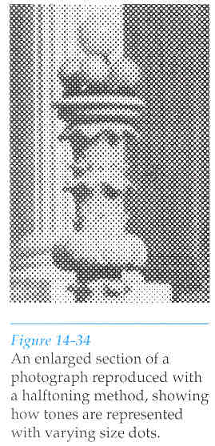
Halftoning
Motivation: bilevel printing. Trade off spatial resolution for more intensity levels
Dots of appropriate size to simulate grey levels
Area of dots proportional intensity

Slide 22
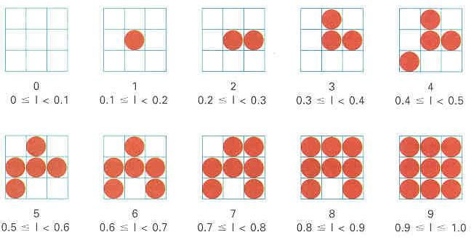
Halftone Patterns
Cluster of dots (pixels) to represent intensity (trading spatial resolution for increased intensity resolution)
Exploits spatial integration in eye

Slide 23
Reducing Quantization
Halftoning
Dithering (distribute errors among pixels)
  Random Dither
  Error Diffusion (Floyd-Steinberg)

Slide 24
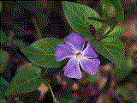
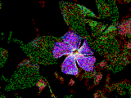
Dithering
8 bits original
2 bits quantize: Note Contours
2 bits FLOYD STEINBERG
2 bits random dither: noise not contours

Slide 25
Random Dither
Randomize quantization errors [see assignment for exact details on adding random noise]
Seems silly (add random noise), but eye more tolerant of high-frequency noise than contours or aliasing
More complex algorithms (not considered here) are ordered dither with patterns of thresholds rather than completely random noise

Slide 26
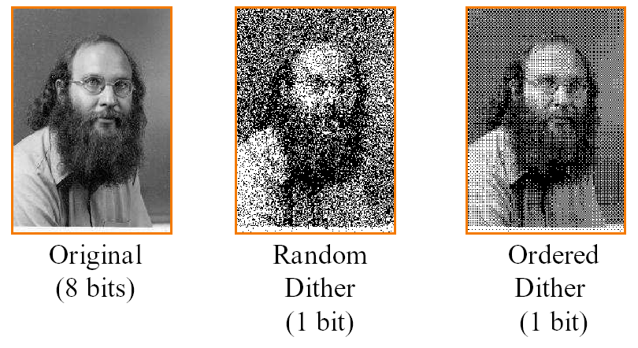
Random Dither
Image and example courtesy Tom Funkhouser

Slide 27
Error Diffusion
Spread quantization error to neighboring pixels to the right and below (later in the process)
Reduces net error, gives best results
7/16
3/16
5/16
1/16

Slide 28
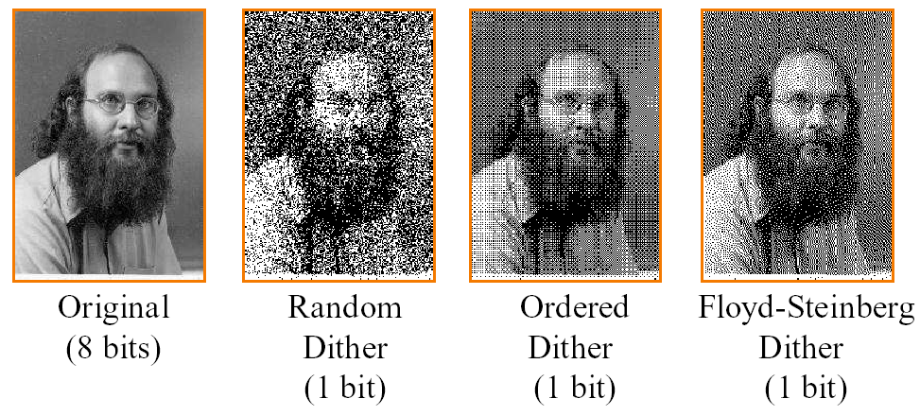
Floyd Steinberg Results

Slide 29
Quantization (Sec 3.3 Ass 1)
Simple quantization (should be straightforward)
Random Dither (just add noise, pretty simple)
Floyd-Steinberg (trickiest)
  Must implement a diffusion of error to other pixels (simply add in appropriate error to them)
  Uses fractions, so must use floating point
  And possibly negative numbers since error can be minus
  Boundary conditions (what if no right etc.) toroidal [may not be relevant in this case] or change weights appropriately, but don’t darken boundaries

