Slide 1
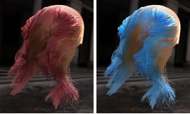

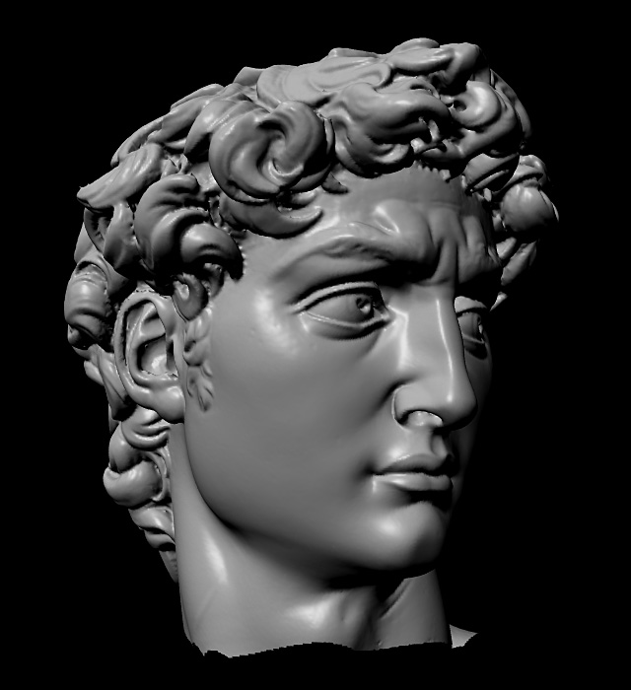
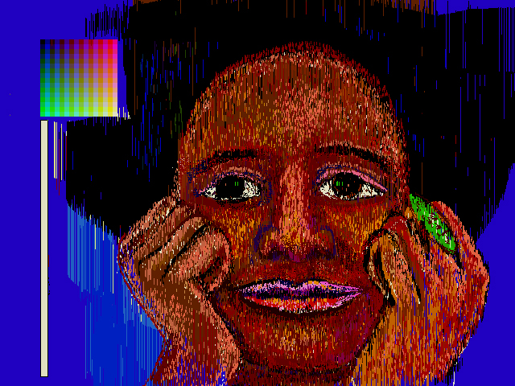
Advanced Computer Graphics
CSE 163 [Spring 2017], Lecture 19
Ravi Ramamoorthi
http://www.cs.ucsd.edu/~ravir

Slide 2
To Do
Assignment 3 due Jun 14
  Should already be well on way
  Contact us for difficulties etc
Please fill out CAPE evaluations (Now!)

Slide 3
Course Outline
3D Graphics Pipeline
Rendering
(Creating, shading images from geometry, lighting, materials)
Modeling
(Creating 3D Geometry)
Unit 1: Foundations of Signal and Image Processing
Understanding the way 2D images are formed and displayed, the important concepts and algorithms, and to build an image processing utility like Photoshop
Weeks 1 – 3. Assignment 1
Unit 3: Advanced Rendering
Weeks 6 – 8. (Final Project)
Unit 2: Meshes, Modeling
Weeks 3 – 5. Assignment 2
Unit 4: Animation, Imaging
Weeks 9, 10. (Final Project)

Slide 4
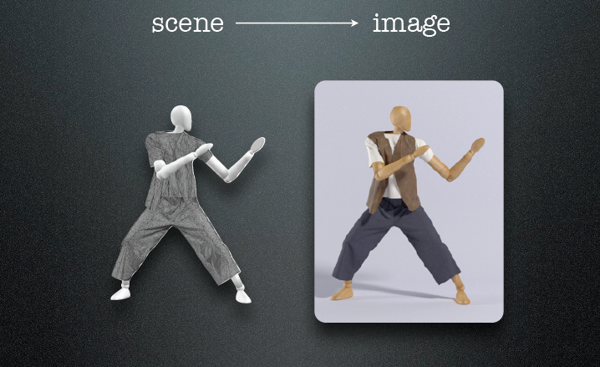
The Story So Far
Slides courtesy Rahul Narain and James O’Brien

Slide 5
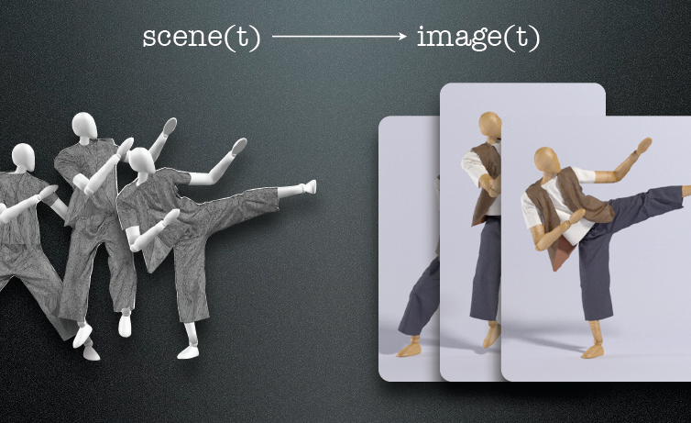
Animation

Slide 6
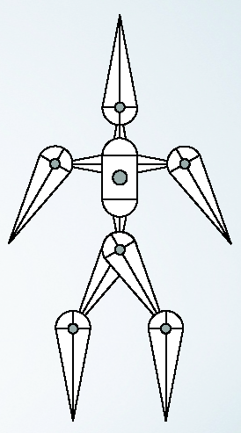
Forward Kinematics
Root body
Position set by global transform
Root joint: position, rotation
Other bodies relative to root
Inboard toward the root
Outboard away from the root
Tree structure: loop joints break
“tree-ness”

Slide 7
Inboard and Outboard
Joints
Inboard body
Outboard body
Body
Inboard joint
Outboard joint (may be several)

Slide 8
Inboard and Outboard
Joints
Inboard body
Outboard body
Body
Inboard joint
Outboard joint (may be several)

Slide 9
Bodies
Bodies arranged in a tree
For now, assume no loops
Body’s parent (except root)
Body’s child (may have many children)

Slide 10
Joints
Interior Joints (typically not 6 DOF)
Pin – rotate about one axis
Ball – arbitrary rotation
Prism – translate along one axis

Slide 11
Pin Joints
Translate inboard joint to local origin
Apply rotation about axis
Translate origin to location of joint on outboard body

Slide 12
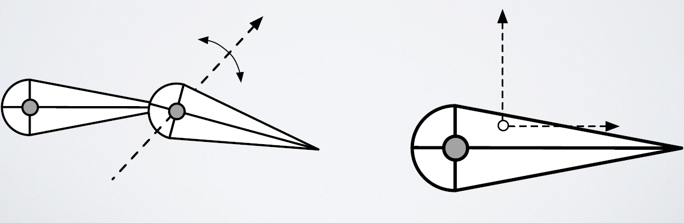
Ball Joints
Translate inboard point to local origin
Apply rotation about arbitrary axis
Translate origin to location of joint on outboard body

Slide 13
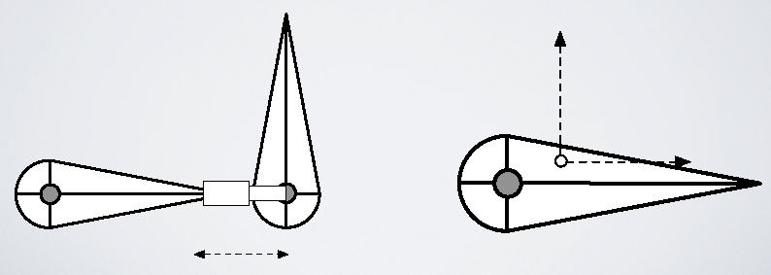
Prism Joint
Translate inboard joint to local origin
Translate along axis
Translate origin to location of joint on outboard

Slide 14
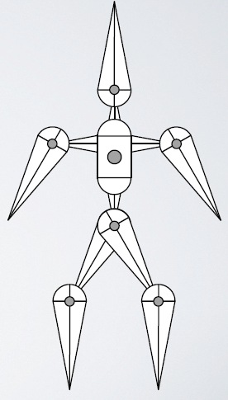
Forward Kinematics
Composite transformations up the hierarchy

Slide 15
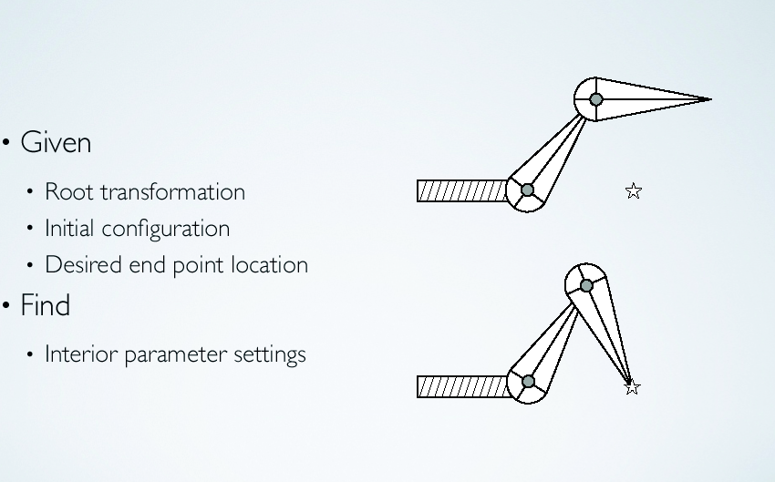
Inverse Kinematics

Slide 16
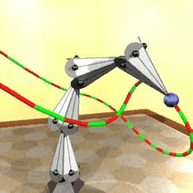
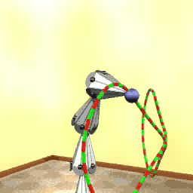
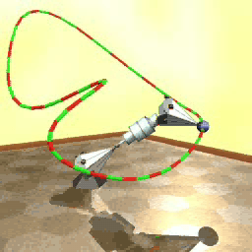
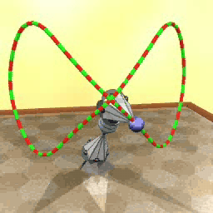
Inverse Kinematics
Egon Pasztor

Slide 17
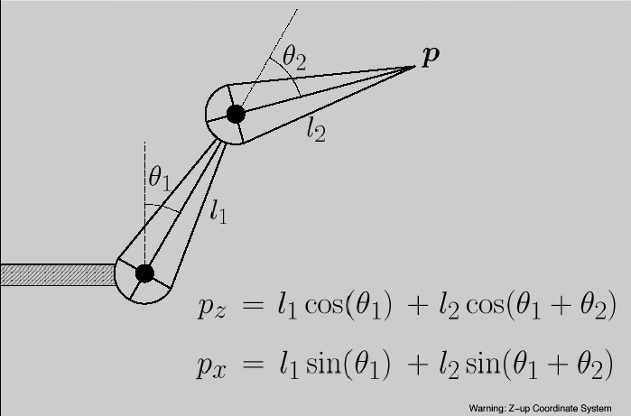
2 Segment Arm in 2D

Slide 18
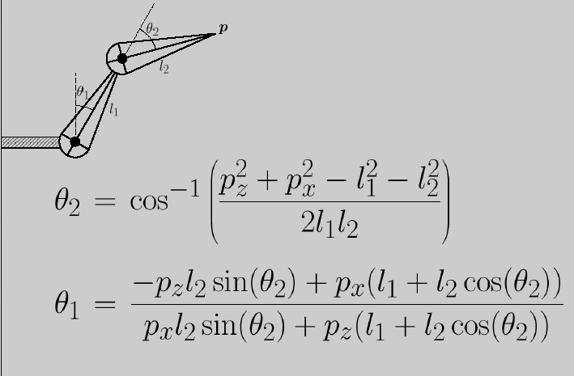
Direct IK
Analytically solve for parameters (not general)

Slide 19
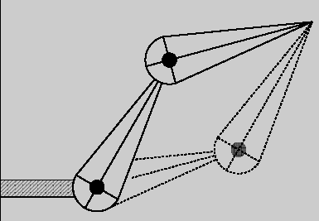
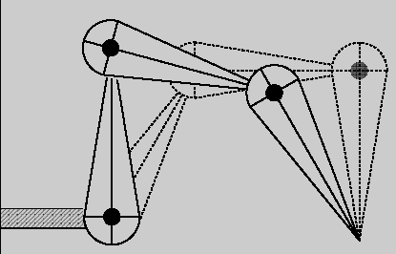
Difficult Issues
Multiple configurations distinct in config space
Or connected in config space

Slide 20
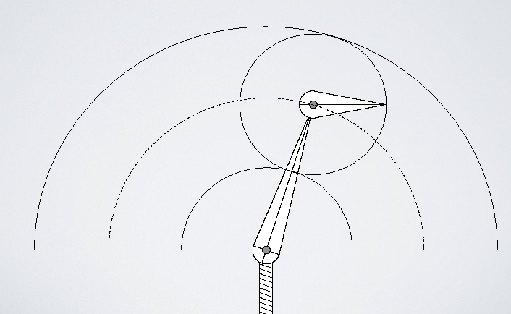
Infeasible Regions

Slide 21
Numerical Solution
Start in some initial config. (previous frame)
Define error metric (goal pos – current pos)
Compute Jacobian with respect to inputs
Use Newton’s or other method to iterate
General principle of goal optimization

Slide 22
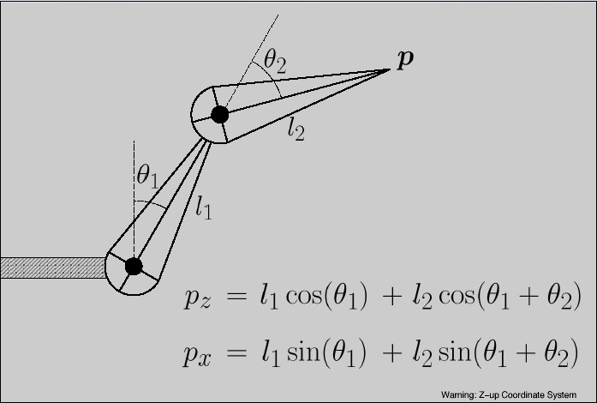
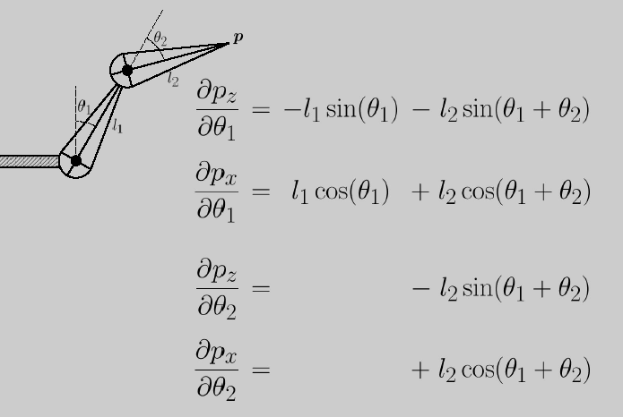
Back to 2 Segment Arm

Slide 23
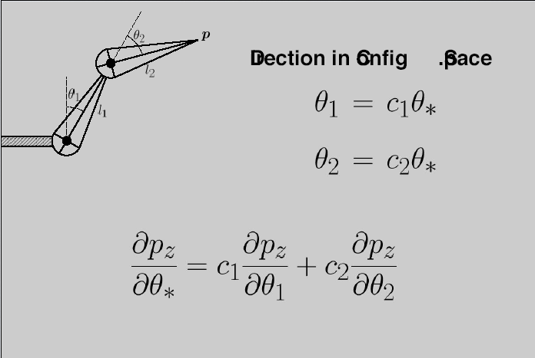
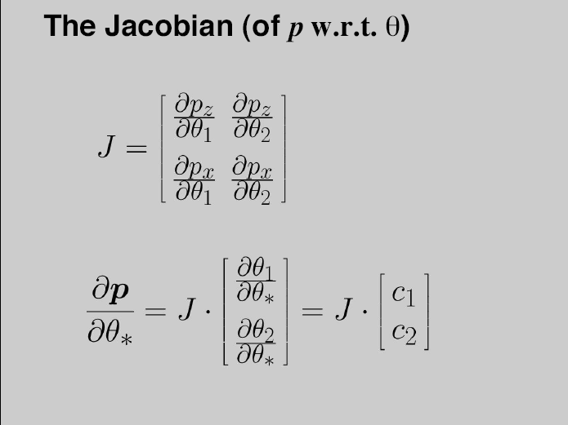
Jacobians and Configuration Space

Slide 24
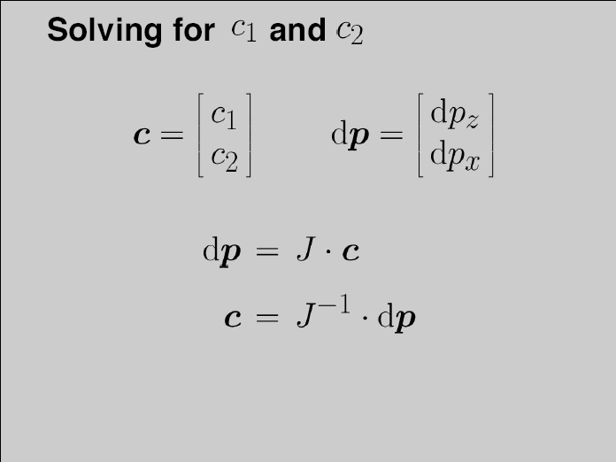
Solving for Joint Angles

Slide 25
Issues
Jacobian not always invertible
  Use an SVD and pseudo-inverse
Iterative approach, not direct
  The Jacobian is a linearization, changes
Practical implementation
  Analytic forms for prism, ball joints
  Composing transformations
  Or quick and dirty: finite differencing
  Cyclic coordinate descent (each DOF one at a time)

Slide 26
Prism and Ball Joints

Slide 27
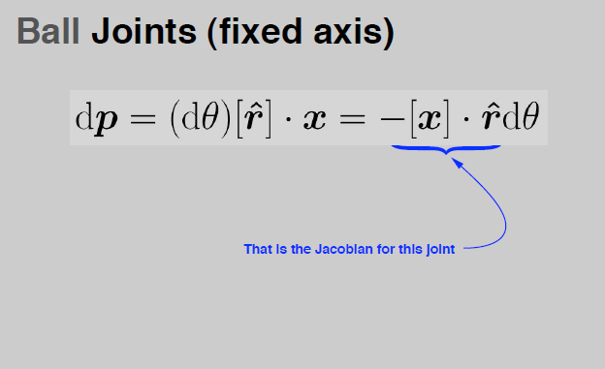
More on Ball Joints

Slide 28
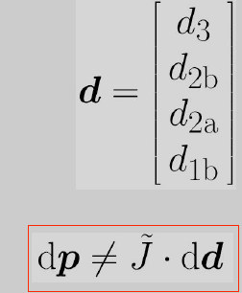
Multiple Links
IK requires Jacobian
  Need generic method for building one
Can’t just concatenate matrices

Slide 29
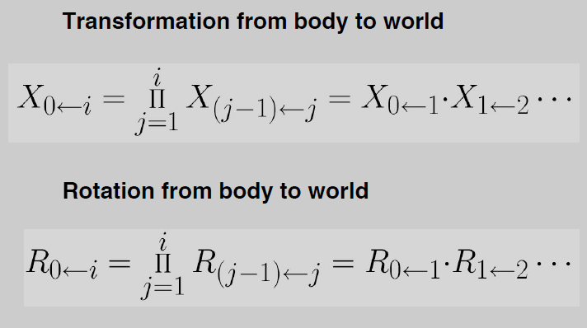
Composing Transformations

Slide 30
Inverse Kinematics: Final Form

Slide 31
A Cheap Alternative
Estimate Jacobian (or parts of it) w. finite diffs.
Cyclic coordinate descent
  Solve for each DOF one at a time
  Iterate till good enough / run out of time

Slide 32
More complex systems
More complex joints (prism and ball)
More links
Other criteria (center of mass or height)
Hard constraints (e.g., foot plants)
Unilateral constraints (e.g., joint limits)
Multiple criteria and multiple chains
Loops
Smoothness over time
  DOF determined by control points of curve (chain rule)

Slide 33
Practical Issues
How to pick from multiple solutions?
Robustness when no solutions
Contradictory solutions
Smooth interpolation
  Interpolation aware of constraints

Slide 34
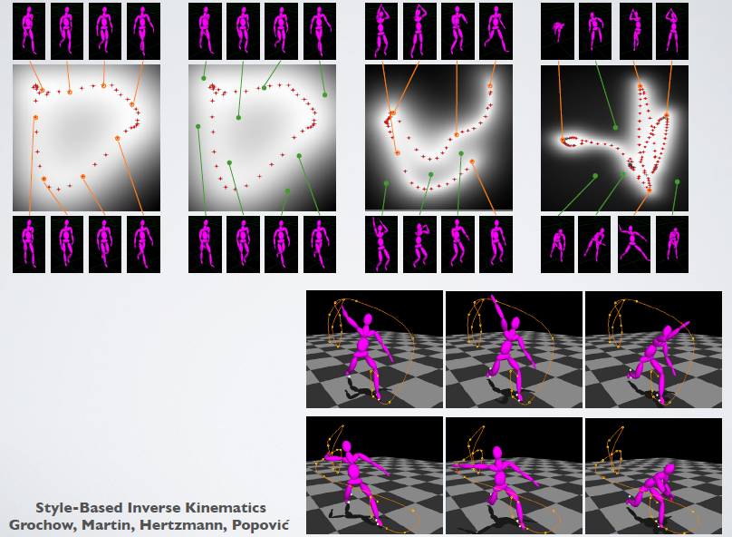
Prior on “good” configurations

