Slide 1
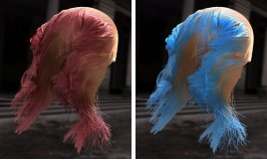

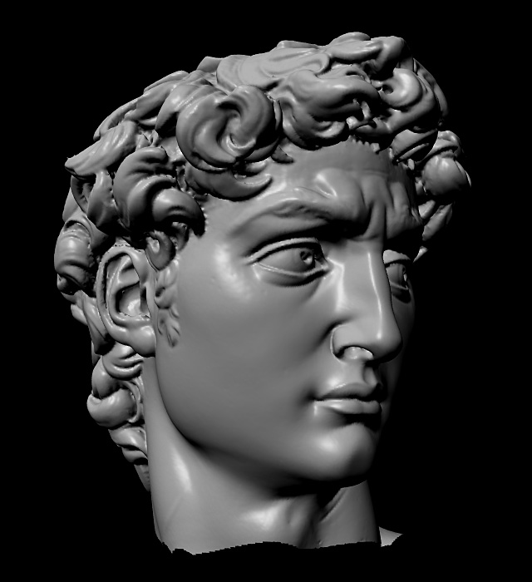
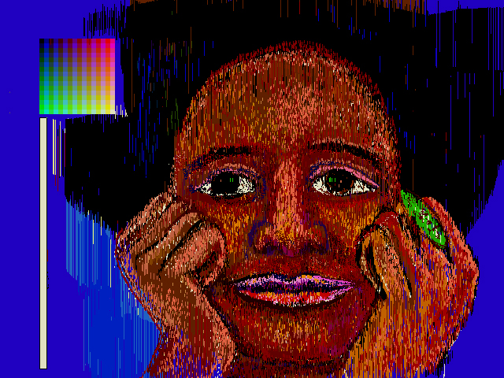
Advanced Computer Graphics
CSE 163 [Spring 2017], Lecture 17
Ravi Ramamoorthi
http://www.cs.ucsd.edu/~ravir

Slide 2
Motivation for Lecture
Image-Based Rendering major new idea in graphics in past 20 years
Many of the rendering methods, especially precomputed techniques borrow from it
And many methods use measured data
Also, images are an important source for rendering
Sampled data rapidly becoming popular

Slide 3
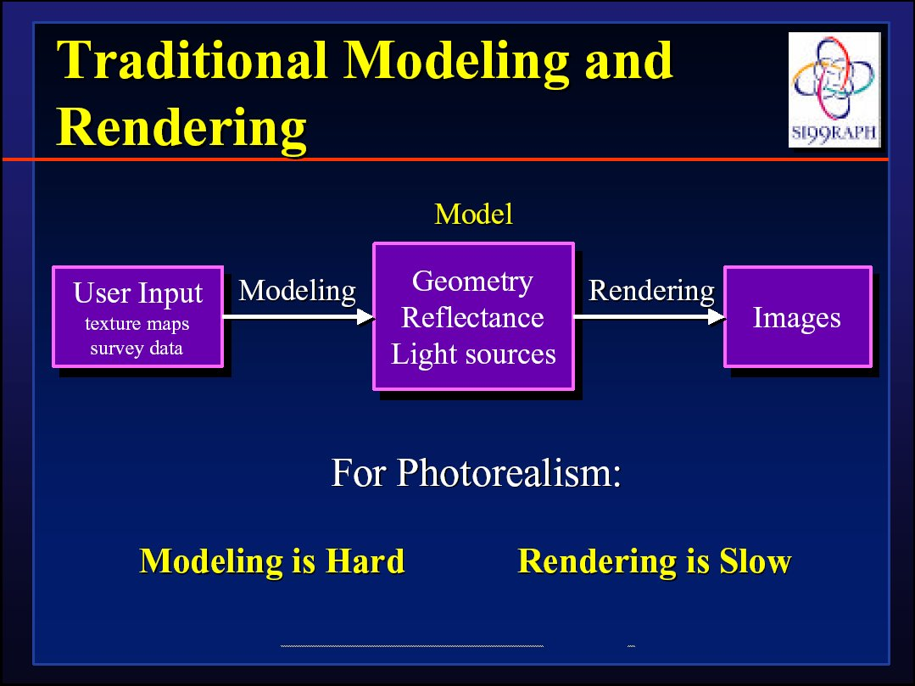
Next few slides courtesy Paul Debevec; SIGGRAPH 99 course notes

Slide 4
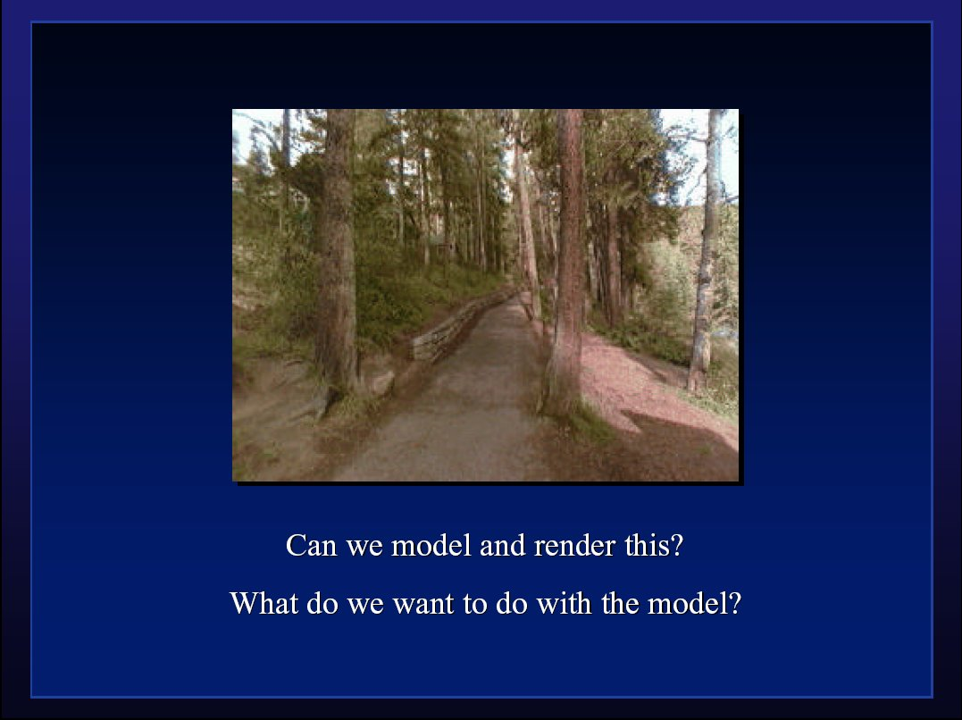

Slide 5
To Do
Assignment 3 milestone due Jun 3
  Send to both instructor and TA
  1-2 page PDF or website
  What you have done so far (at least one image)
  1-2 para proposal of what you hope to accomplish
  We may say ok or schedule time to meet, discuss
  Talk to us if any difficulty finding project
    Assignment gives some well specified, loose, other options; you can do something else too
Please fill out CAPE evaluations now
Videos for HW 2

Slide 6
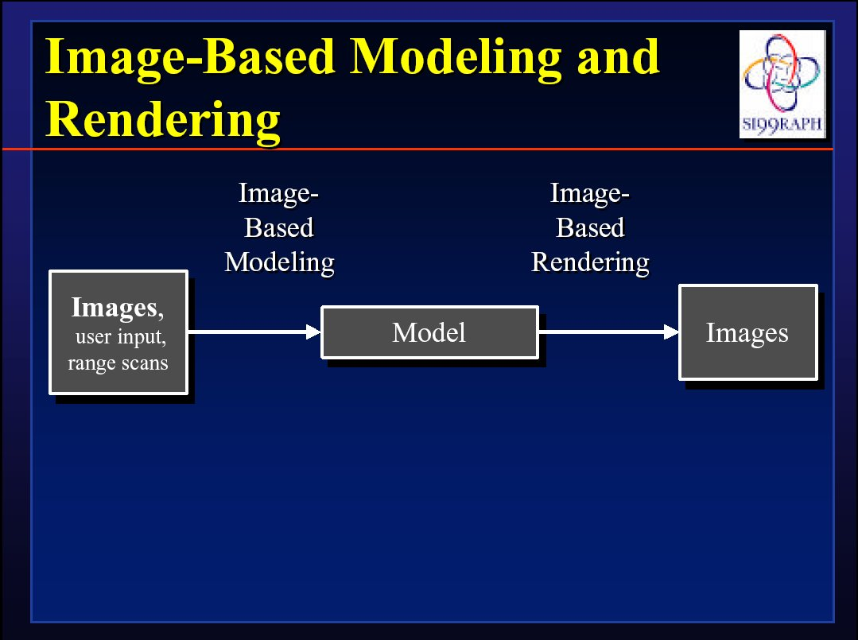

Slide 7
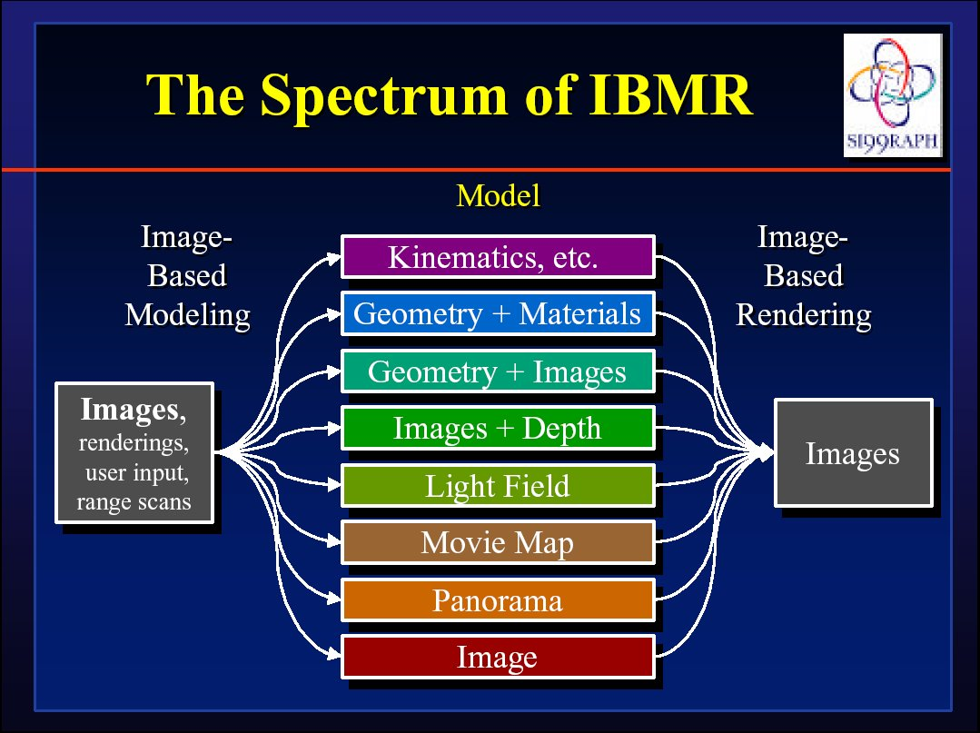

Slide 8
IBR: Pros and Cons
Advantages
  Easy to capture images: photorealistic by definition
  Simple, universal representation
  Often bypass geometry estimation?
  Independent of scene complexity?
Disadvantages
  WYSIWYG but also WYSIAYG
  Explosion of data as flexibility increased
  Often discards intrinsic structure of model?
Today, IBR-type methods also often used in synthetic rendering (e.g. real-time rendering PRT)
  General concept of data-driven graphics, appearance
  Also, data-driven geometry, animation, simulation
  Spawned light field cameras for image capture

Slide 9
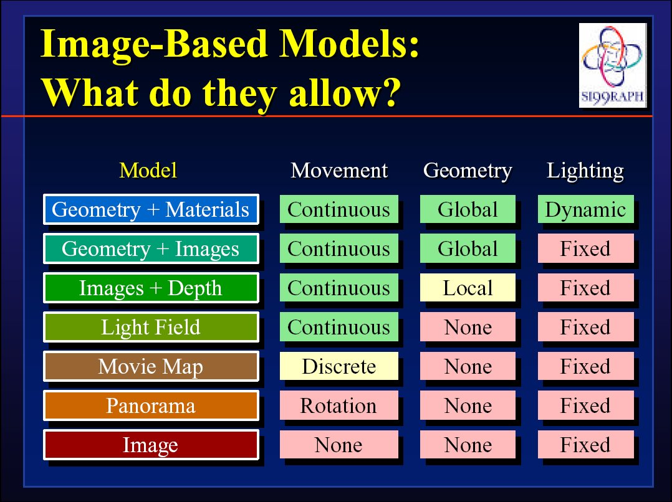

Slide 10
IBR: A brief history
Texture maps, bump maps, environment maps [70s]
Poggio MIT 90s: Faces, image-based analysis/synthesis
Mid-Late 90s
  Chen and Williams 93, View Interpolation [Images+depth]
  Chen 95 Quicktime VR [Images from many viewpoints]
  McMillan and Bishop 95 Plenoptic Modeling [Images w disparity]
  Gortler et al, Levoy and Hanrahan 96 Light Fields [4D]
  Shade et al. 98 Layered Depth Images [2.5D]
  Debevec et al. 00 Reflectance Field [4D]
  Inverse rendering (Marschner,Sato,Yu,Boivin,…)
Today: IBR hasn’t replaced conventional rendering, but has brought sampled and data-driven representations to graphics

Slide 11
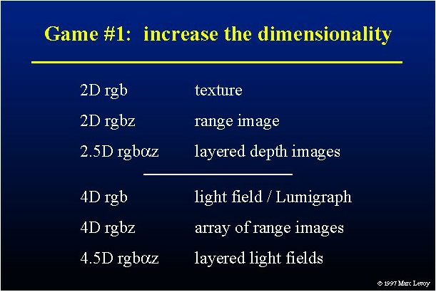

Slide 12
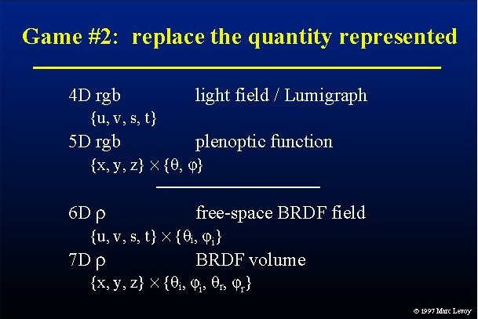

Slide 13
Outline
Overview of IBR
Basic approaches
  Image Warping
    [2D + depth. Requires correspondence/disparity]
  Light Fields [4D]
  Survey of some early work

Slide 14
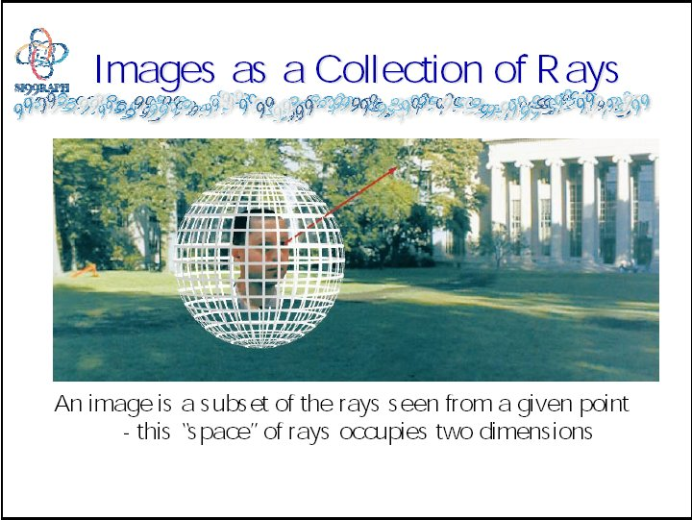
Warping slides courtesy Leonard McMillan, SIGGRAPH 99 course notes

Slide 15
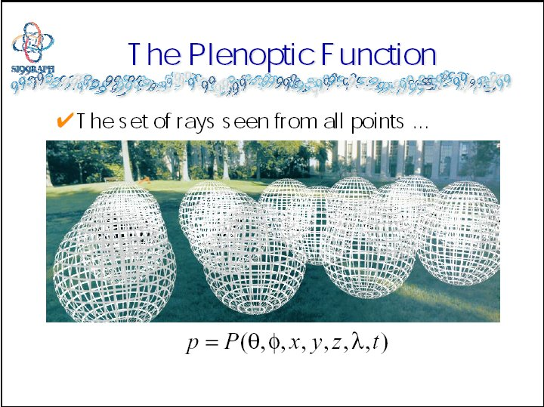

Slide 16
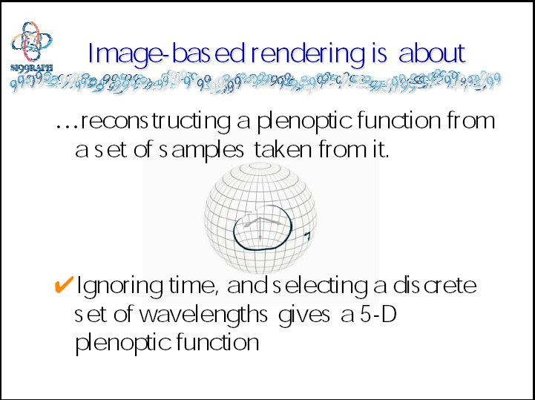

Slide 17
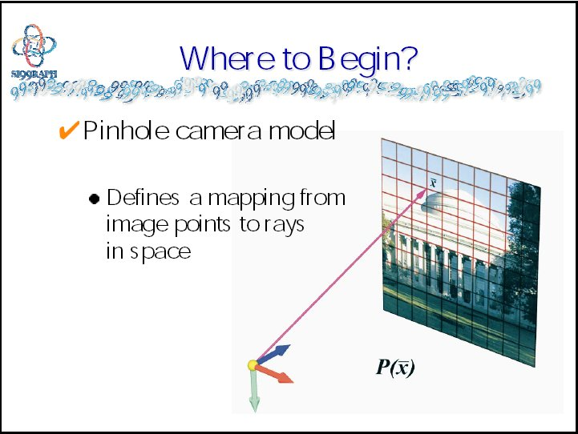

Slide 18
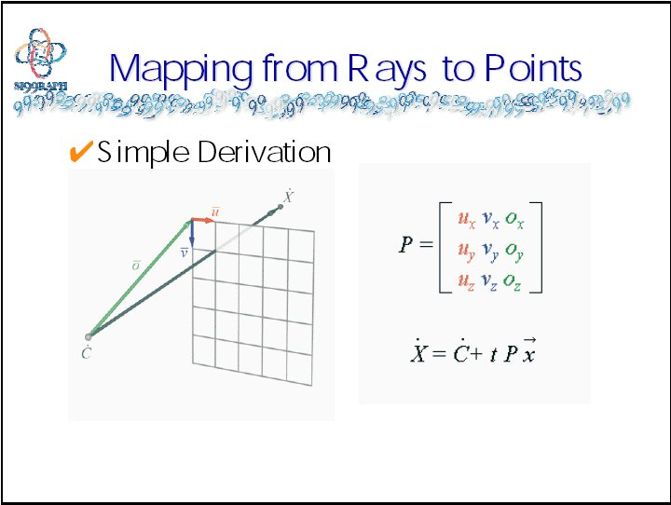

Slide 19
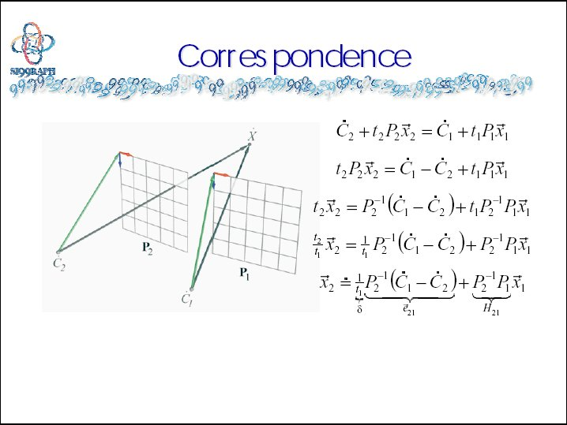

Slide 20
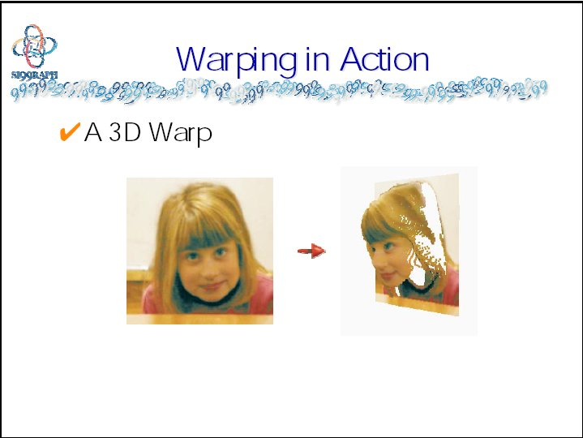

Slide 21
Demo: Lytro Perspective Shift
See demos at http://pictures.lytro.com/
Notice image is everywhere in focus
Only small motions, interpolate in aperture

Slide 22
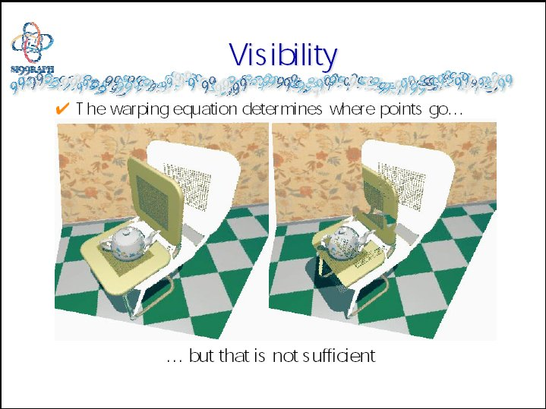

Slide 23
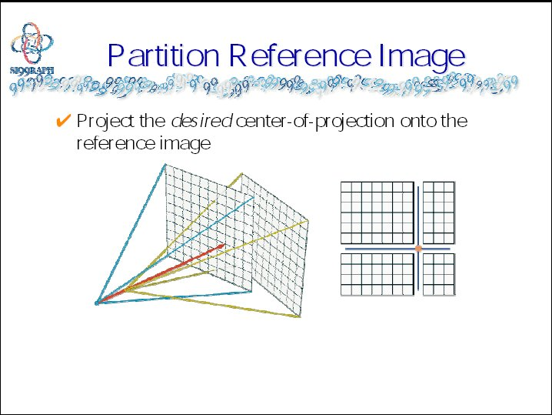

Slide 24
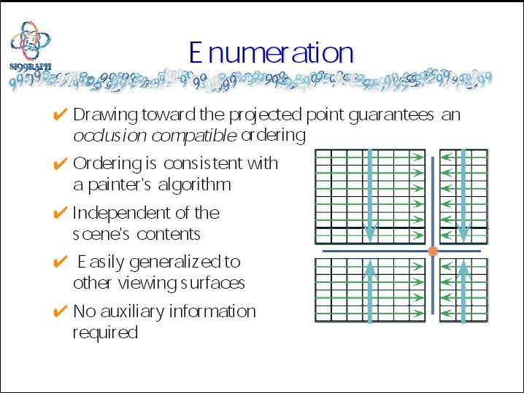

Slide 25
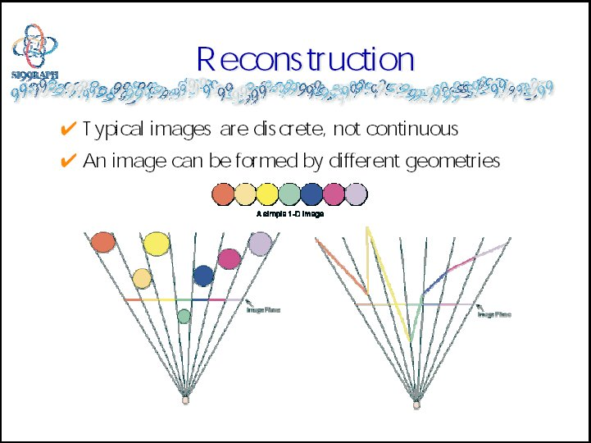

Slide 26
Outline
Overview of IBR
Basic approaches
  Image Warping
    [2D + depth. Requires correspondence/disparity]
  Light Fields [4D]
  Survey of some early work

Slide 27
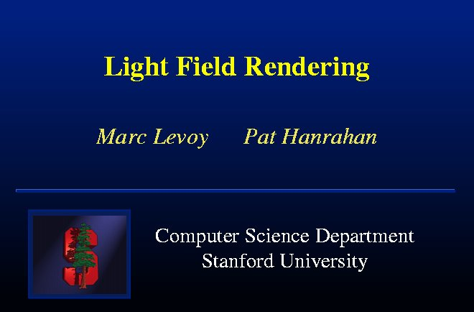

Slide 28
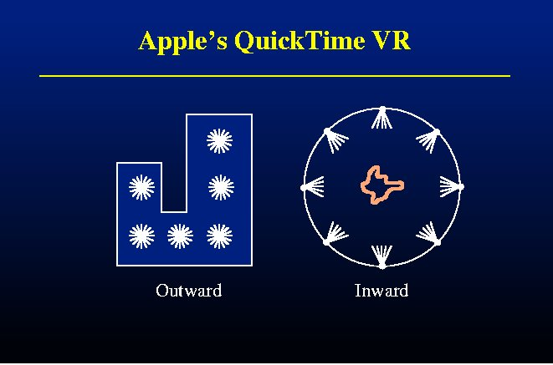

Slide 29
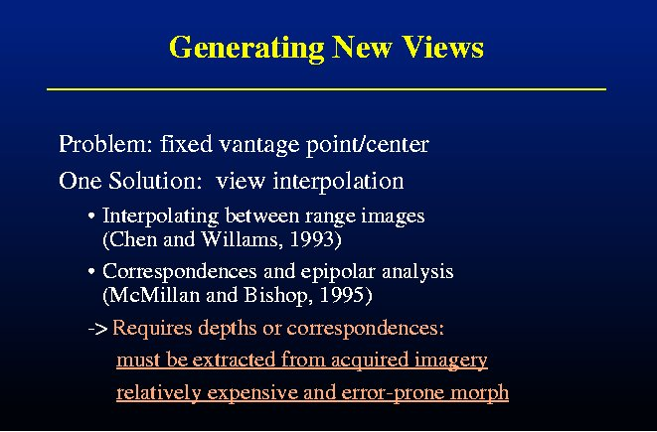

Slide 30
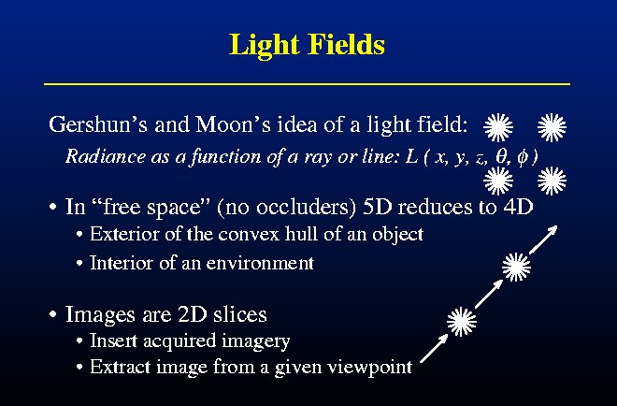

Slide 31
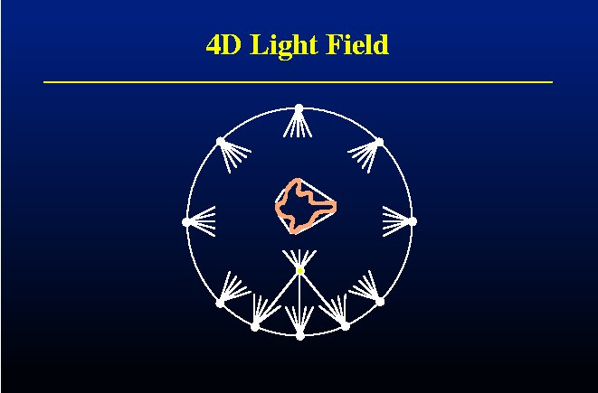

Slide 32
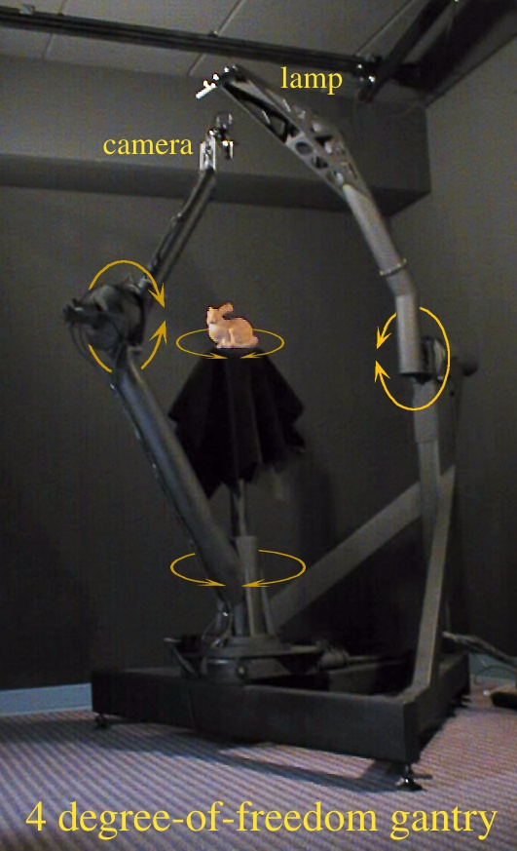
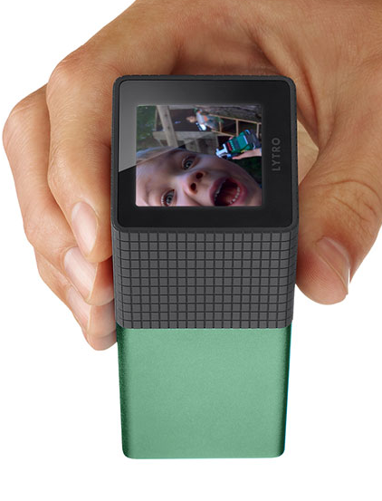
Lytro Camera

Slide 33
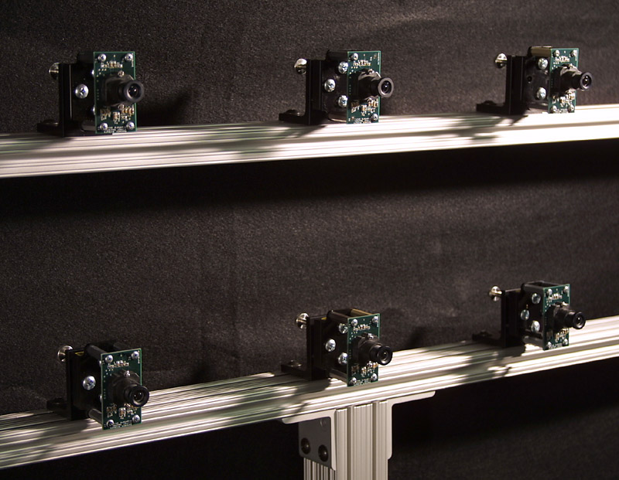

Slide 34
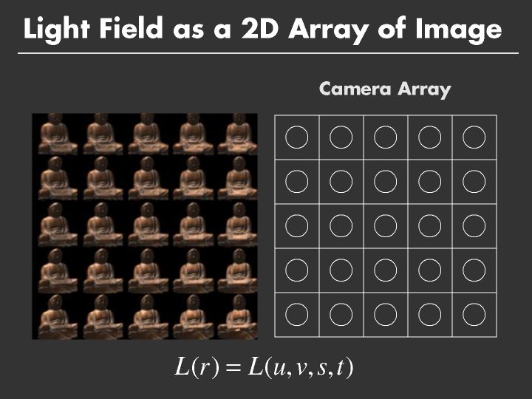

Slide 35
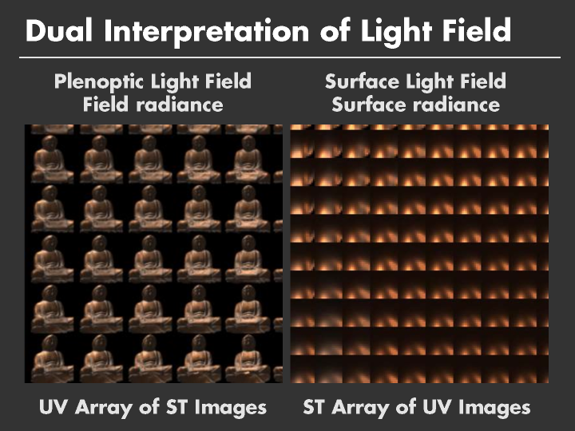

Slide 36
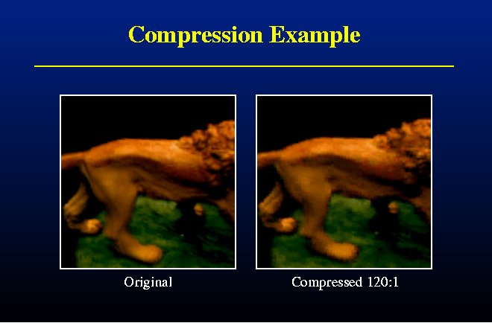

Slide 37
Outline
Overview of IBR
Basic approaches
  Image Warping
    [2D + depth. Requires correspondence/disparity]
  Light Fields [4D]
  Survey of some early work

Slide 38
Layered Depth Images [Shade 98]
Camera
Geometry
Slide from Agrawala, Ramamoorthi, Heirich, Moll, SIGGRAPH 2000
Notes:
(1:00)
First, let’s briefly consider Shade’s original formulation for the layered depth image.
To create an LDI, from a given camera location, we trace a ray thru each pixel, noting all intersections.
The LDI is just a list of layers for each pixel, with each fragment storing depth and color information.

Slide 39
Layered Depth Images [Shade 98]
LDI

Slide 40
Layered Depth Images [Shade 98]
LDI
(Depth, Color)

Slide 41
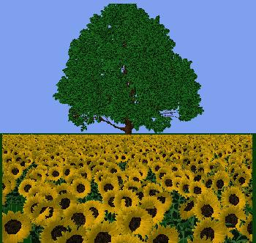

Slide 42
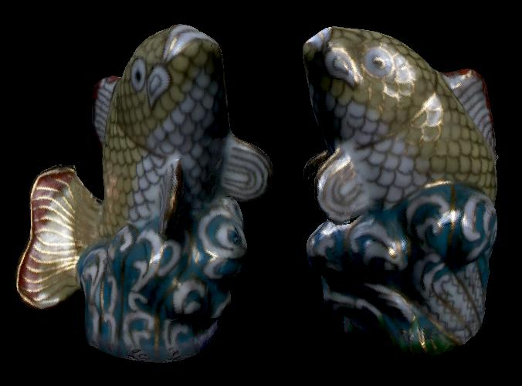
Surface Light Fields
Miller 98, Nishino 99, Wood 00
Reflected light field (lumisphere) on surface
Explicit geometry as against light fields. Easier compress

Slide 43
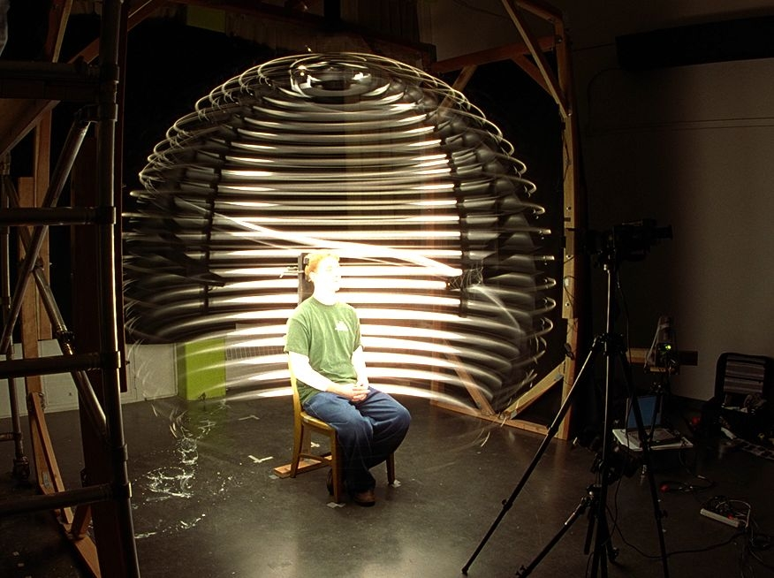
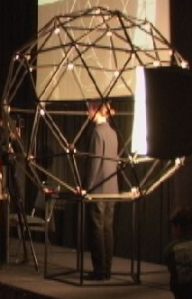
Acquiring Reflectance Field of Human Face [Debevec et al. SIGGRAPH 00]
Illuminate subject from many incident directions

Slide 44
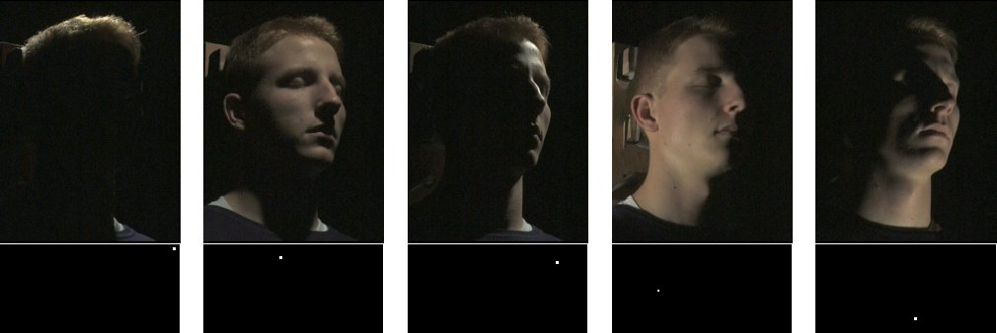
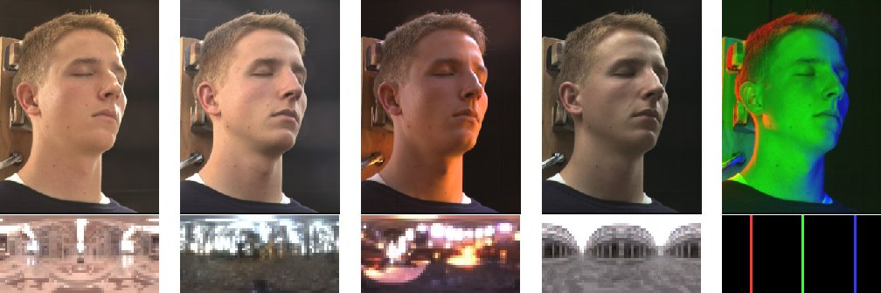
Example Images

Slide 45
Outline
Overview of IBR
Basic approaches
  Image Warping
    [2D + depth. Requires correspondence/disparity]
  Light Fields [4D]
  Survey of some recent work
    Sampled data representations

Slide 46
Conclusion (my views)
IBR initially spurred great excitement: revolutionize pipeline
But, IBR in pure form not really practical
  WYSIAYG
  Explosion as increase dimensions (8D transfer function)
  Good compression, flexibility needs at least implicit geometry/BRDF
Real future is sampled representations, data-driven method
  Acquire (synthetic or real) data
  Good representations for interpolation, fast rendering
  Much of visual appearance, graphics moving in this direction
Understand from Signal-Processing Viewpoint
  Sampling rates, reconstruction filters
  Factored representations, Fourier analysis
Light Fields fundamental in many ways, including imaging

