Slide 1
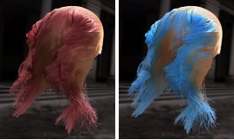

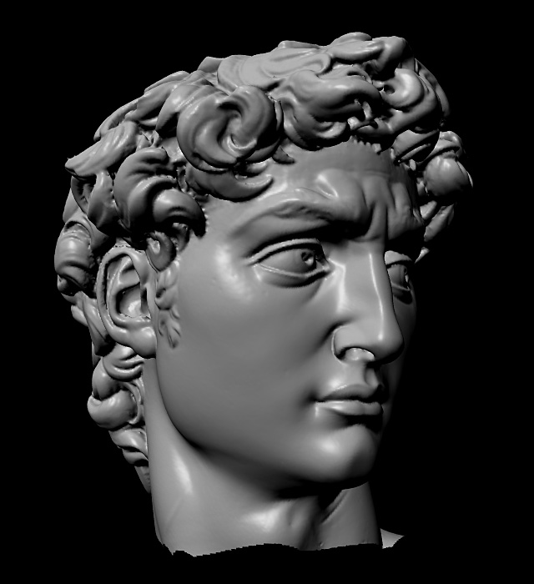
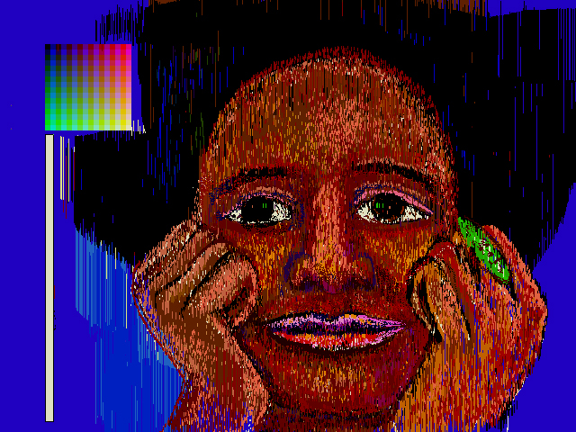
Advanced Computer Graphics
CSE 163 [Spring 2017], Lecture 16
Ravi Ramamoorthi
http://www.cs.ucsd.edu/~ravir

Slide 2
To Do
Assignment 3 milestone due Jun 3
  1-2 page PDF or website
  What you have done so far (at least one image)
  1-2 para proposal of what you hope to accomplish
  We may say ok or schedule time to meet, discuss
  Talk to us if any difficulty finding project
    Assignment gives some well specified, loose, other options; you can do something else too

Slide 3
Motivation
Next week: Image-Based Rendering. Use measured data (real photographs) and interpolate for realistic real-time
Why not apply to real-time rendering?
  Precompute (offline) some information (images) of interest
  Must assume something about scene is constant to do so
  Thereafter real-time rendering. Often accelerate hardware
Easier and harder than conventional IBR
  Easier because synthetic scenes give info re geometry, reflectance (but CG rendering often longer than nature)
  Harder because of more complex effects (lighting from all directions for instance, not just changing view)
Representations and Signal-Processing crucial

Slide 4
My General Philosophy
This general line of work is a large data management and signal-processing problem
Precompute high-dimensional complex data
Store efficiently (find right mathematical represent.)
Render in real-time
  Worry about systems issues like caching
  Good signal-processing: use only small amount of data but guarantee high fidelity
Many insights into structure of lighting, BRDFs, …
  Not just blind interpolation; signal processing

Slide 5

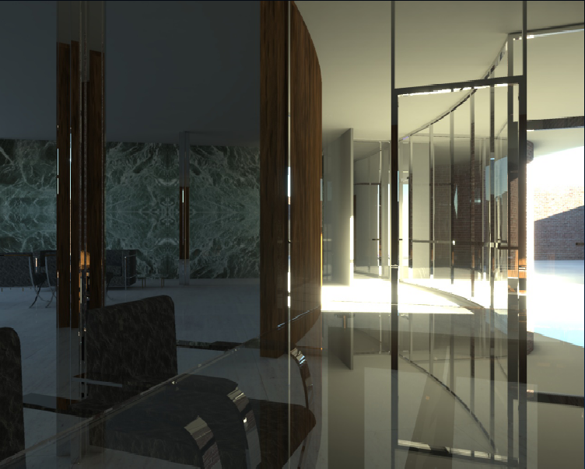
Precomputation-Based Relighting
Analyze precomputed images of scene
Synthesize relit images from precomputed data
Jensen 2000

Slide 6
Precomputation-Based Relighting
Analyze precomputed images of scene
Synthesize relit images from precomputed data
Jensen 2000

Slide 7
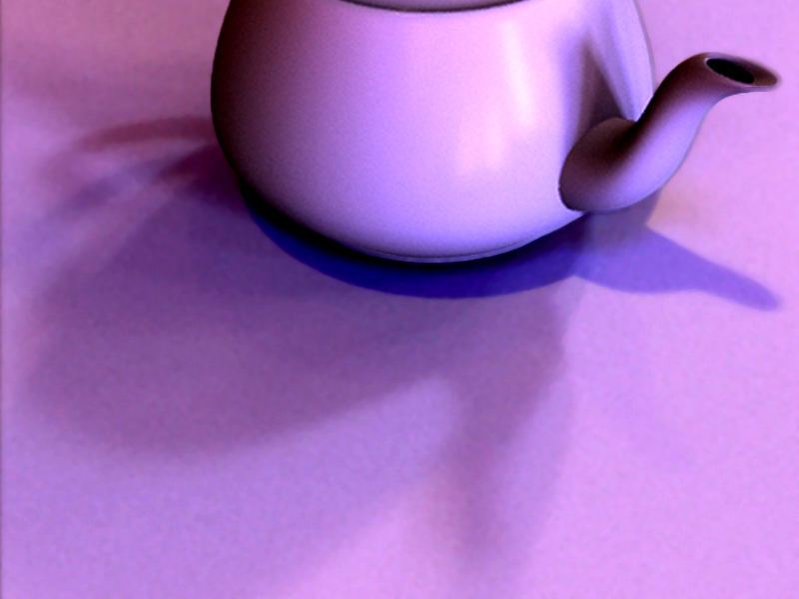
Assumptions
Static geometry
Precomputation
Real-Time Rendering (relight all-frequency effects)
  Exploit linearity of light transport for this
  Later, change viewpoint as well

Slide 8
Why is This Hard?
Plain graphics hardware supports only simple (point) lights, BRDFs (Phong) without any shadows
Shadow maps can handle point lights (hard shadows)
Environment maps complex lighting, BRDFs but no shadows
IBR can often do changing view, fixed lighting
How to do complex shadows in complex lighting?
With dynamically changing illumination and view?

Slide 9
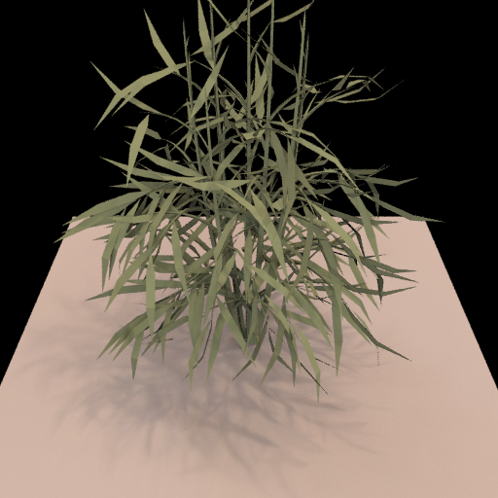
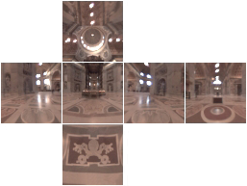
Relighting as a Matrix-Vector Multiply
Notes:
I’d first like to quickly review the concept of relighting as a matrix vector multiplication.

Slide 10
Relighting as a Matrix-Vector Multiply
Output Image
(Pixel Vector)
Input Lighting
(Cubemap Vector)
Precomputed Transport
Matrix
Notes:
The input to the multiplication is the lighting environment, here shown as an unfolded cubemap. The input vector contains a linearization of the cubemap pixels. The output of the multiplication is an image of the scene lit by the input environment. The output vector contains relit image pixels. We call the matrix that transforms from input lighting to output image the light-transport matrix.
TODO: Add change of environment, and corresponding update of the plant image.

Slide 11
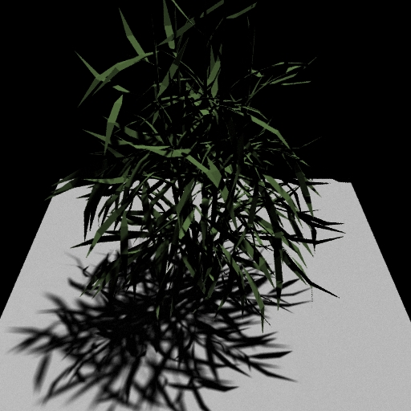

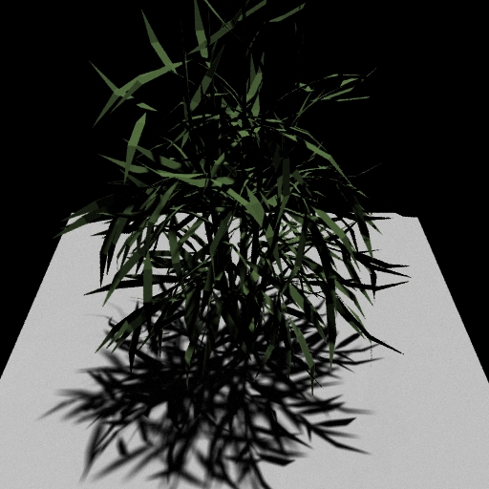
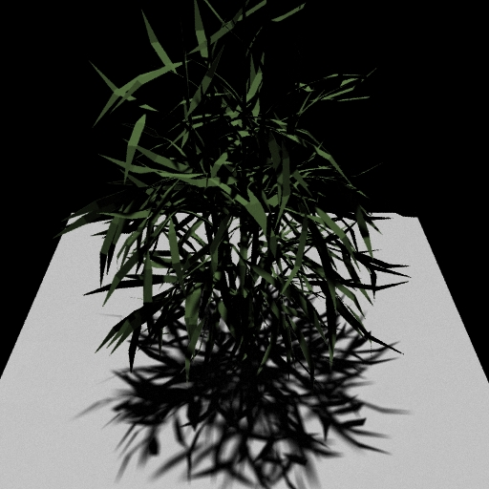
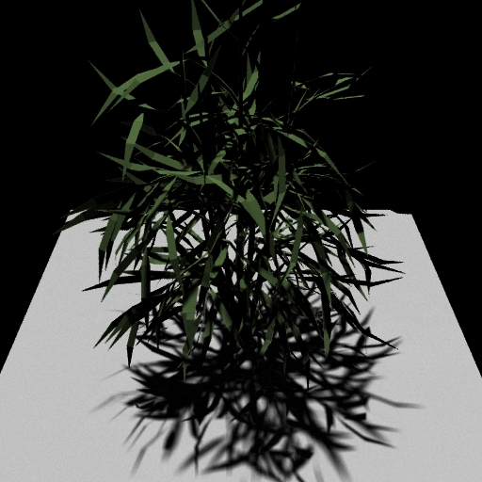
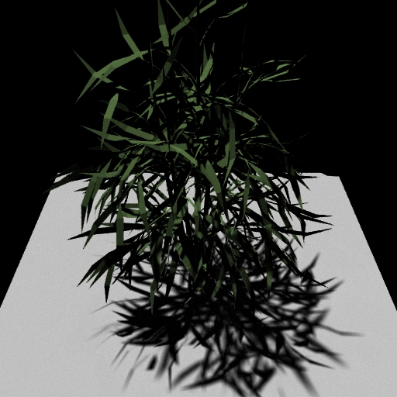
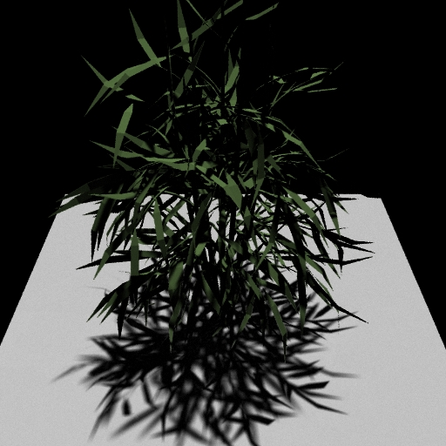
Matrix Columns (Images)
Notes:
The columns of the marix are just images of the scene lit by a single basis light.

Slide 12
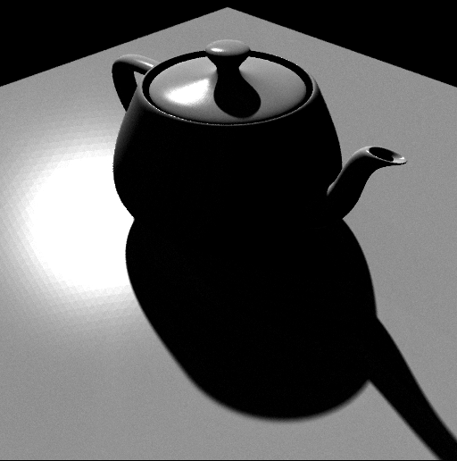
Precompute: Ray-Trace Image Cols
Notes:
Computing the columns is simple and flexible. We can just ray-trace images of the scene under each light. This means that we can handle any light transport effect that we can ray-trace, like glossy reflections and global illumination.

Slide 13
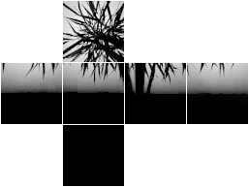
Precompute 2: Rasterize Matrix Rows
Notes:
Alternatively, we can compute the matrix rows. The rows tell us how energy is transported from the environment to a single output pixel. For example, if we consider the row for a pixel on the floor of the plant scene, we would see the silhouette of the plant blocking part of the sky.
To compute a row, we use graphics hardware to render a visibility hemicube at that point, read back the pixels and weight it by the reflection function.

Slide 14
Problem Definition
Matrix is Enormous
  512 x 512 pixel images
  6 x 64 x 64 cubemap environments
Full matrix-vector multiplication is intractable
  On the order of 10¹⁰ operations per frame
How to relight quickly?
Notes:
This brings us to our main problem with using high-resolution, all-frequency lighting. While the matrix formulation is simple mathematically, it’s intractable numerically. The matrix is enormous. We use 512 x 512 images, and cubemaps with 64 x 64 faces. That’s a matrix with a quarter of a million rows and over 24,000 columns. A full multiplication would use on the order of 10 billion operations per frame.
One thing we could do is reduce the dimension to achieve real-time rates; the original precomputed radiance transfer technique is so fast because it uses only 25 – 50 lights. But that blurs output image detail.
Our goal is to try to maintain the fidelity of high resolution light transport, but do it at interactive rates.

Slide 15
Outline
Motivation and Background
Compression methods
  Low frequency linear spherical harmonic approximation
  Factorization and PCA
  Local factorization and clustered PCA
  Non-linear wavelet approximation
Changing view as well as lighting
  Clustered PCA
  Factored BRDFs
  Triple Product Integrals

Slide 16
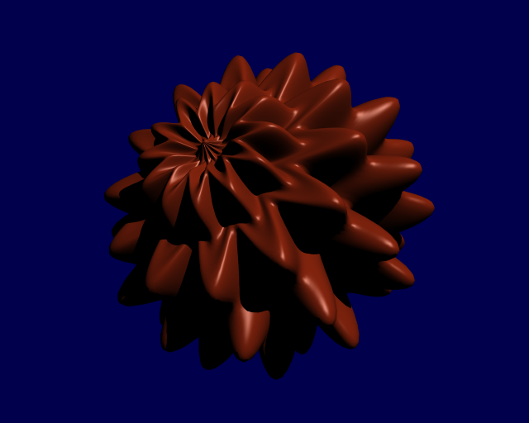
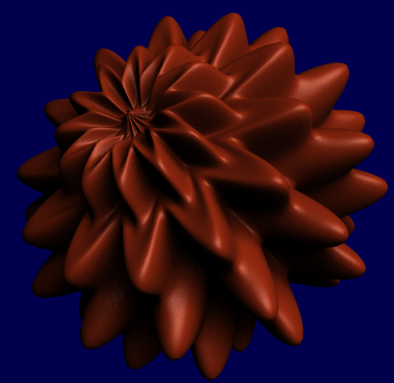
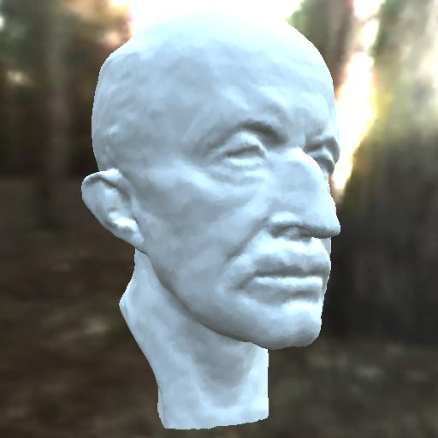
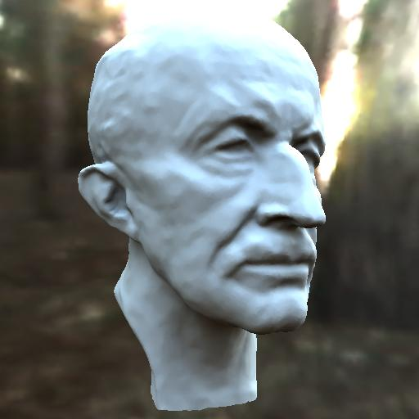
Precomputed Radiance Transfer
Better light integration and transport
  dynamic, area lights
  self-shadowing
  interreflections
For diffuse and
glossy surfaces
At real-time rates
Sloan et al. 02 (most cited rendering paper in last 15 years~1000, widely used in games, movie production: Spherical Harmonic Lighting)
point light
area light
area lighting,
no shadows
area lighting,
shadows
Notes:
We think there’s good reason to concentrate on this part of the lighting/transport complexity space.
We wanted to handle dynamic and large area lights, including their self-shadowing and interreflection effects.
Area lights can add a sense of realism that is difficult to obtain with point lights – in the top row we have a displacement mapped sphere illuminated with a point light (casting hard shadows) and an area light (casting soft shadows.) The object shape’s is more effectively conveyed with soft shadows.
Shadows also add much more realism than area lighting without shadows.
In the bottom row we have a bust of the max planc head rendered on the left using ravi’s technique from last year (no shadows) and on the right using our technique. Though both are lit by an entire environment, the shadowed image on the right looks more realistic.
We wanted to achieve these effects for both diffuse and glossy surfaces at real-time rendering rates.

Slide 17
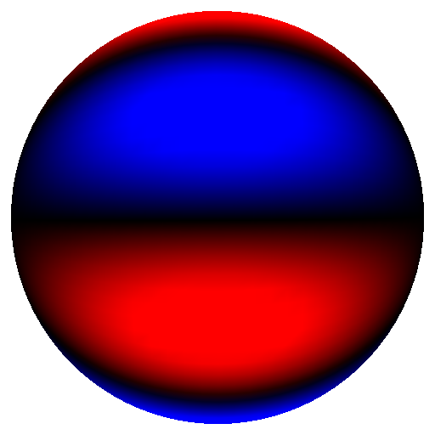
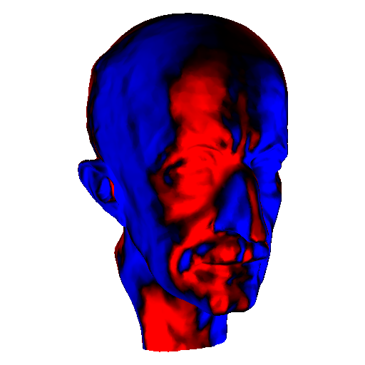
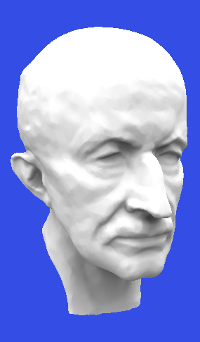
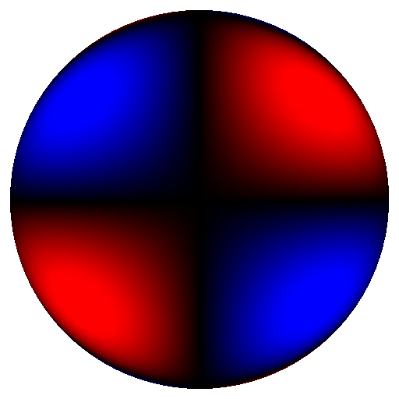
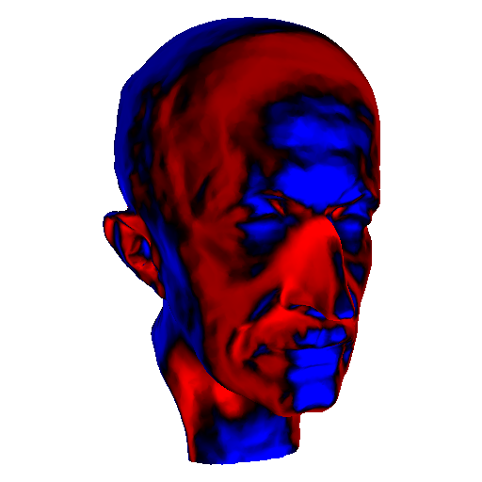
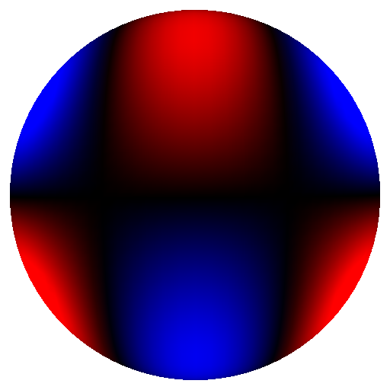
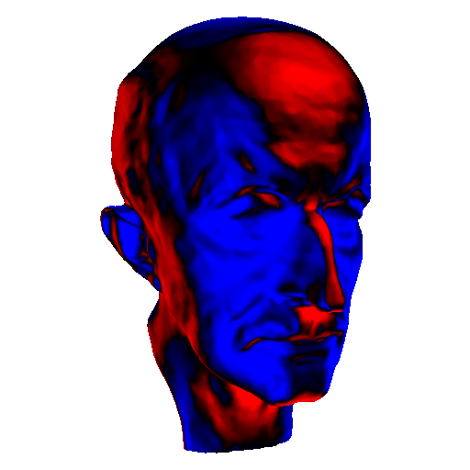
Precomputation: Spherical Harmonics
.
.
.
Basis 16
Basis 17
illuminate
result
Basis 18
.
.
.
Notes:
This slide illustrates the precomputation for direct lighting. Each image on the right is generated by placing the head model into a lighting environment that simply consists of the corresponding basis function (SH basis in this case illustrated on the left.) This just requires rendering software that can deal with negative lights.
The result is a spatialy varying set of transfer coefficients shown on the right.
To reconstruct reflected radiance just compute a linear combination of the transfer coefficient images scaled by the corresponding coefficient for the lighting environment.

Slide 18
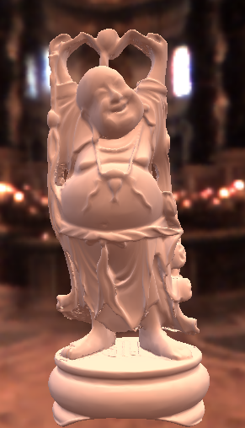
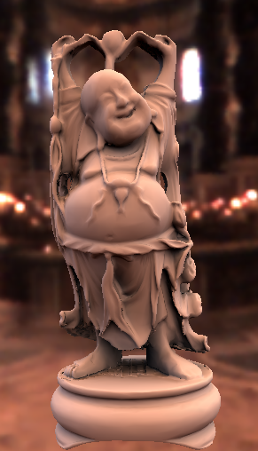
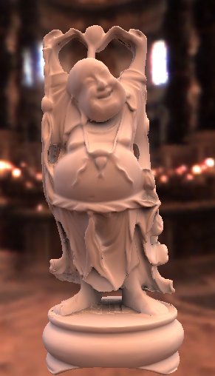
Diffuse Transfer Results
No Shadows/Inter Shadows Shadows+Inter
Notes:
This set of images shows the buddha model lit in the same lighting environment, without shadows, with shadows and with shadows and inter reflections.

Slide 19
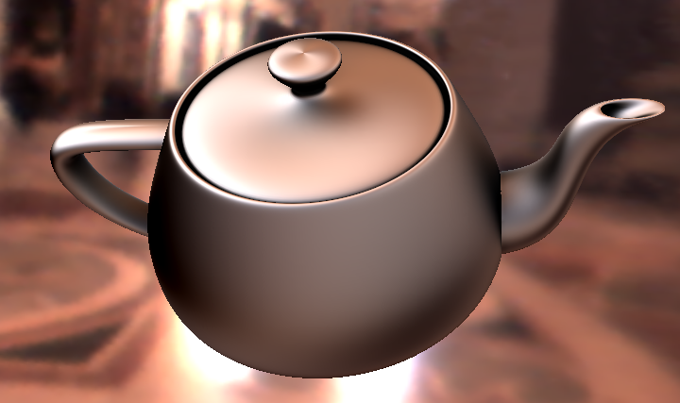
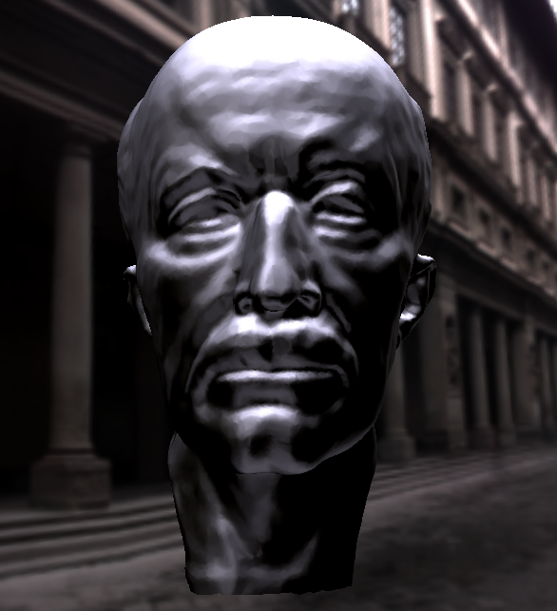
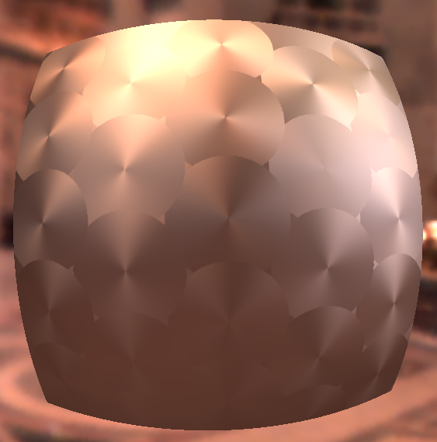
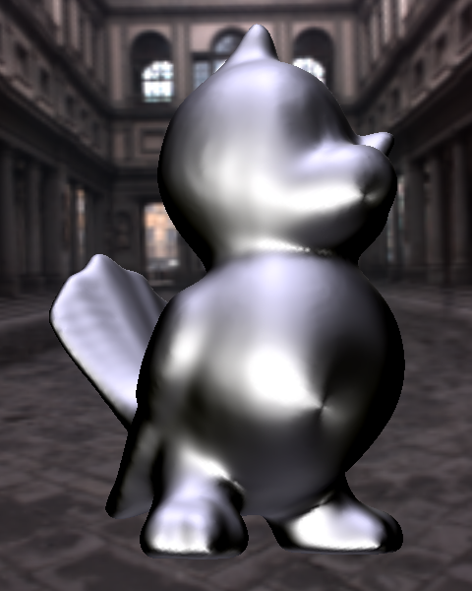
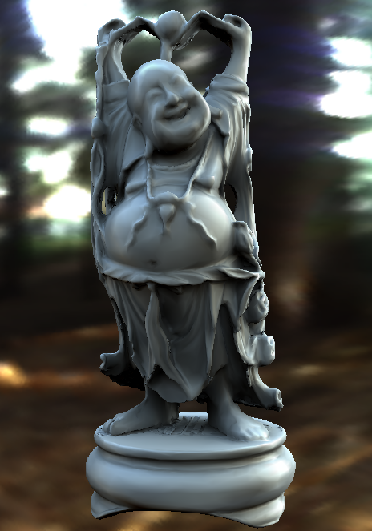
Arbitrary BRDF Results
Anisotropic BRDFs
Other BRDFs
Spatially Varying
Notes:
Here are a few results. On the left you can see renderings with anisotropic BRDFs, in the middle renderings with the Ashikhmin-Shirley BRDF and with measured vinyl. On the right you can see spatially varying BRDFs. All of these examples can be rendered at interactive rates.

Slide 20
Relighting as a Matrix-Vector Multiply
Notes:
I’d first like to quickly review the concept of relighting as a matrix vector multiplication.

Slide 21
Idea of Compression
The vector is projected onto low-frequency components (say 25). Size greatly reduced.
Hence, only 25 matrix columns
But each pixel still treated separately (still have 300000 matrix rows for 512 x 512 image)
Actually, for each pixel, dot product of matrix row (25 elems) and lighting vector (25 elems) in hardware
Good technique (common in games, movies) but useful only for broad low-frequency lighting

Slide 22
Outline
Motivation and Background
Compression methods
  Low frequency linear spherical harmonic approximation
  Factorization and PCA
  Local factorization and clustered PCA
  Non-linear wavelet approximation
Changing view as well as lighting
  Clustered PCA
  Factored BRDFs
  Triple Product Integrals

Slide 23
PCA or SVD factorization
SVD:
I^{j}
=
E^{j}
x
S^{j}
x
p x n
p x p
p x n
C^{jT}
diagonal matrix
(singular values)
n x n
Applying Rank b:
I^{j}

p x n
x
x
E^{j}
S^{j}
C^{jT}
p x b
b x b
b x n
Absorbing S^{j} values into C^{iT}:
I^{j}

p x n
x
E^{j}
L^{j}
p x b
b x n

Slide 24
Idea of Compression
Represent matrix (rather than light vector) compactly
Can be (and is) combined with low frequency vector
Useful in broad contexts.
  BRDF factorization for real-time rendering (reduce 4D BRDF to 2D texture maps) McCool et al. 01 etc
  Surface Light field factorization for real-time rendering (4D to 2D maps) Chen et al. 02, Nishino et al. 01
  Factorization of Orientation Light field for complex lighting and BRDFs (4D to 2D) Latta et al. 02
Not too useful for general precomput. relighting
  Transport matrix not low-dimensional!!

Slide 25
Local or Clustered PCA
Exploit local coherence (in say 16x16 pixel blocks)
  Idea: light transport is locally low-dimensional. Why?
  Even though globally complex
  See Mahajan et al. 07 for theoretical analysis
Original idea: Each triangle separately
  Example: Surface Light Fields 3D subspace works well
  Vague analysis of size of triangles
  Instead of triangle, 16x16 image blocks [Nayar et al. 04]
Clustered PCA [Sloan et al. 2003]
  Combines two widely used compression techniques: Vector Quantization or VQ and Principal Component Analysis
  For complex geometry, no need for parameterization / topology

Slide 26
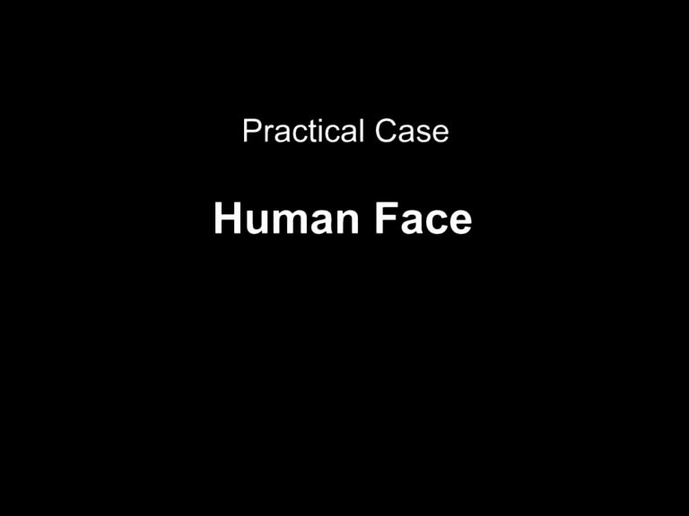
Demo (block PCA relighting)

Slide 27
Outline
Motivation and Background
Compression methods
  Low frequency linear spherical harmonic approximation
  Factorization and PCA
  Local factorization and clustered PCA
  Non-linear wavelet approximation
Changing view as well as lighting
  Clustered PCA
  Factored BRDFs
  Triple Product Integrals

Slide 28
Sparse Matrix-Vector Multiplication
Choose data representations with mostly zeroes
Vector: Use non-linear wavelet approximation
on lighting
Matrix: Wavelet-encode transport rows
Notes:
Our solution is to compress the computation by choosing data representations with mostly zeroes for both the lighting vector and the matrix. We then implement relighting as a sparse matrix-vector multiplication. I’m going to tell about each of these sources of compression. The lighting compression is dominant – it’s the title of our paper – so let’s talk about that first.

Slide 29
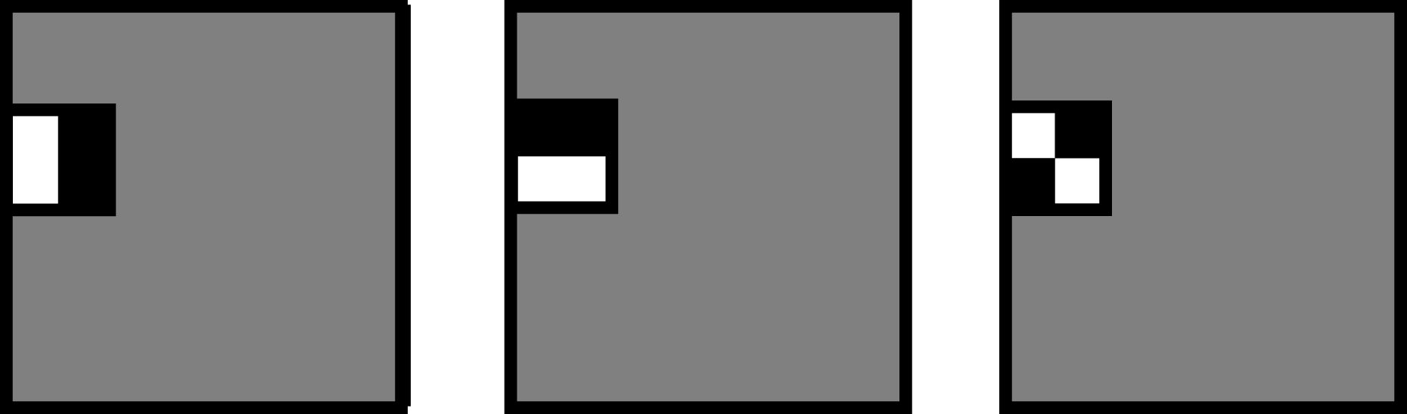
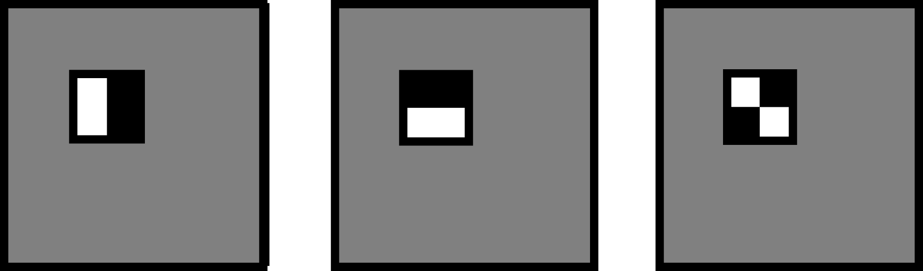


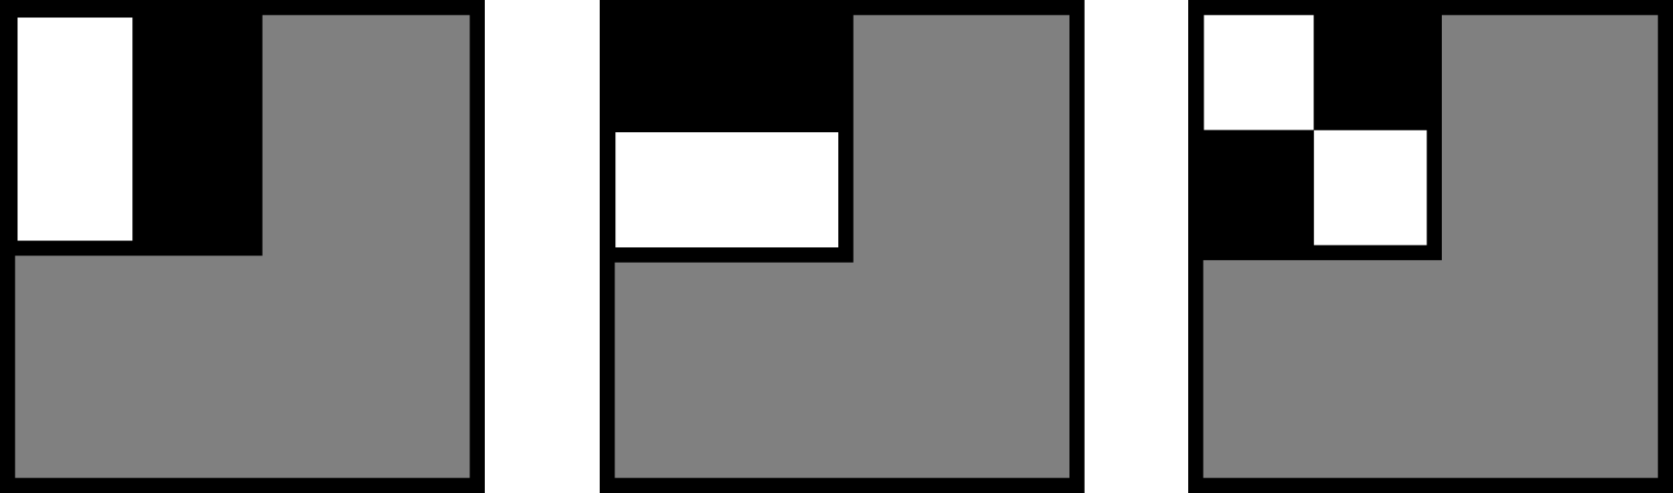

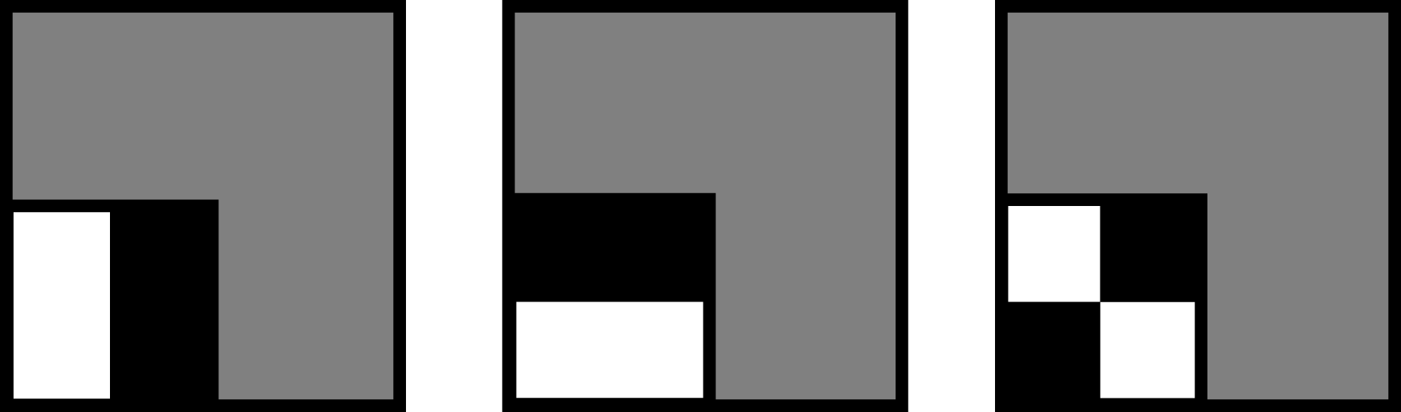

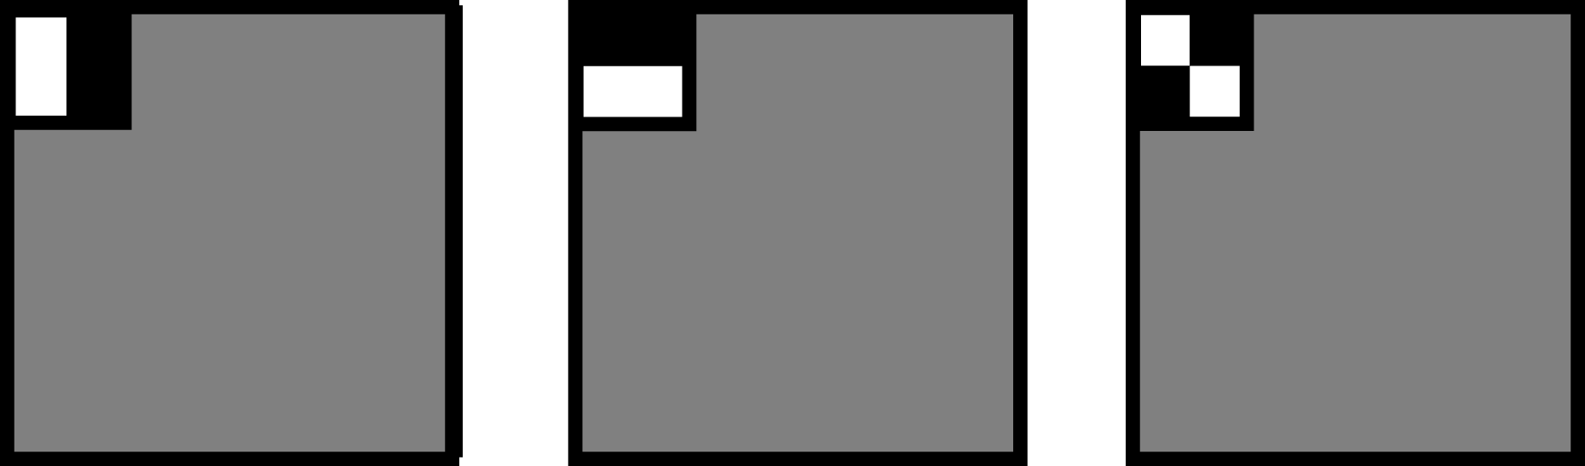



Haar Wavelet Basis
Notes:
I just want to give a quick visual review of the 2D Haar basis.
The Haar basis starts with three mother wavelets, shown here for horizontal, vertical and diagonal differencing. White is positive and black is negative.
The Haar basis is a subdivision series based on quartering these mother wavelets and replicating them in all positions. In these pictures gray is zero.
The next level of subdivision quarters the functions again, and here are a few of basis functions at that level.
Of course this subdivision continues for higher order basis expansions. We typically use 6 to 8 subdivision levels.

Slide 30
Non-linear Wavelet Approximation
Wavelets provide dual space / frequency locality
  Large wavelets capture low frequency area lighting
  Small wavelets capture high frequency compact features
Non-linear Approximation
  Use a dynamic set of approximating functions (depends on each frame’s lighting)
  By contrast, linear approx. uses fixed set of basis functions (like 25 lowest frequency spherical harmonics)
  We choose 10’s - 100’s from a basis of 24,576 wavelets
Notes:
Another you might have is whether we need a wavelet basis? Why not non-linear spherical harmonics, or why not just the brightest pixels in the cubemap?
Wavelet bases are good approximating spaces for relighting because they contain functions of all different sizes and positions. Some are as small as a single cubemap pixel; others cover essentially the whole environment. The large wavelets can capture low-frequency features. And the small wavelets can capture compact, high-frequency features. In signal processing terms, a wavelet basis provides energy localization in both frequency and space.
In contrast, spherical harmonics localize well in frequency but not in space. A point light would need many harmonics to be approximated well. Conversely, a pixel basis localizes well in space but not in frequency. A large area light needs many pixels to resolve it well.
So that’s why we choose a wavelet basis.

Slide 31
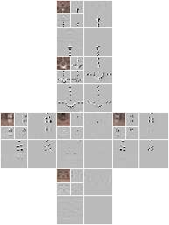
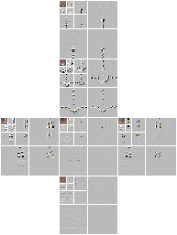
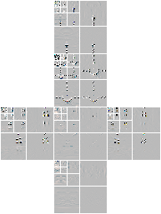
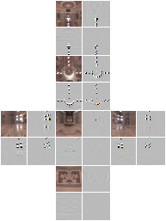
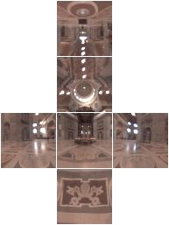
Non-linear Wavelet Light Approximation
Wavelet Transform
Notes:
What is non-linear wavelet approximation? Well, we take the input lighting cubemap, and wavelet transform each face. I’m not going to review wavelet transforms, but basically this consists of recursively averaging down each face and storing the differences between the averaged image and original. This gives us a vector of wavelet transformed coefficients. The wavelet transform turns coherence in the environment into small coefficients – so the majority of these L coefficients are now close to zero.

Slide 32
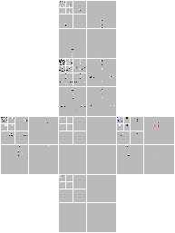
Non-linear Wavelet Light Approximation
Non-linear
Approximation
Retain 0.1% – 1% terms
Notes:
The next step is non-linear approximation, where we choose some coefficients to keep, and discard the others – we make them zero. We use a very aggressive, lossy approximation, where we keep only a hundredth or a thousandth of the coefficients.

Slide 33


Error in Lighting: St Peter’s Basilica
Sph. Harmonics
Relative L² Error (%)
Non-linear Wavelets
Approximation Terms
Ng, Ramamoorthi, Hanrahan 03
Notes:
This graph shows the relative error in the lighting approximation of St Peter’s as we increase the number of approximation terms. As we increase the number of terms, the error decreases to zero. The top, dashed curve is for linear spherical harmonics, the bottom is for non-linear wavelets. Note that the horizontal scale is on a log plot, so the separation between the two curves means that non-linear wavelets converge about two orders of magnitude more quickly.

Slide 34

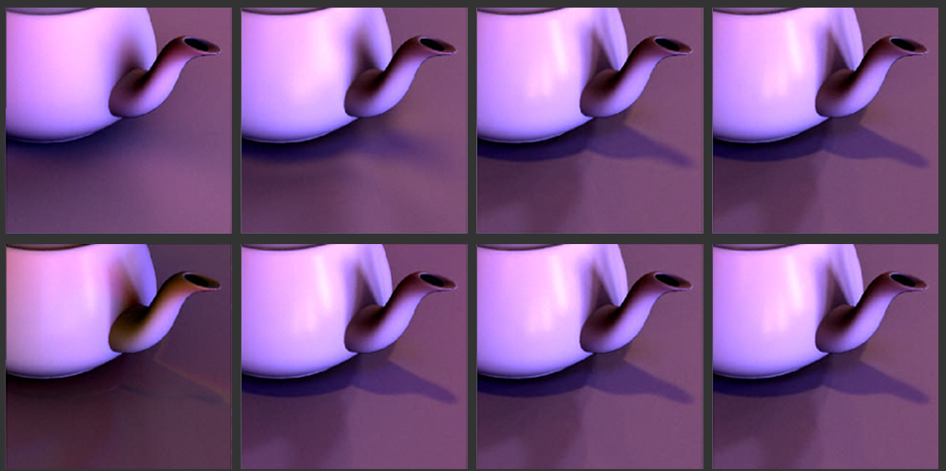
Output Image Comparison
Top: Linear Spherical Harmonic Approximation
Bottom: Non-linear Wavelet Approximation
25
200
2,000
20,000
Notes:
And here is the visual comparison. Note that 200 wavelets resolve essentially all image details. 200 harmonics still blur the reflection of the window. And 2000 harmonics still blur the tip of the shadow under the teapot.

Slide 35

Video

Slide 36
Outline
Motivation and Background
Compression methods
  Low frequency linear spherical harmonic approximation
  Factorization and PCA
  Local factorization and clustered PCA
  Non-linear wavelet approximation
Changing view as well as lighting
  Clustered PCA
  Factored BRDFs
  Triple Product Integrals

Slide 37
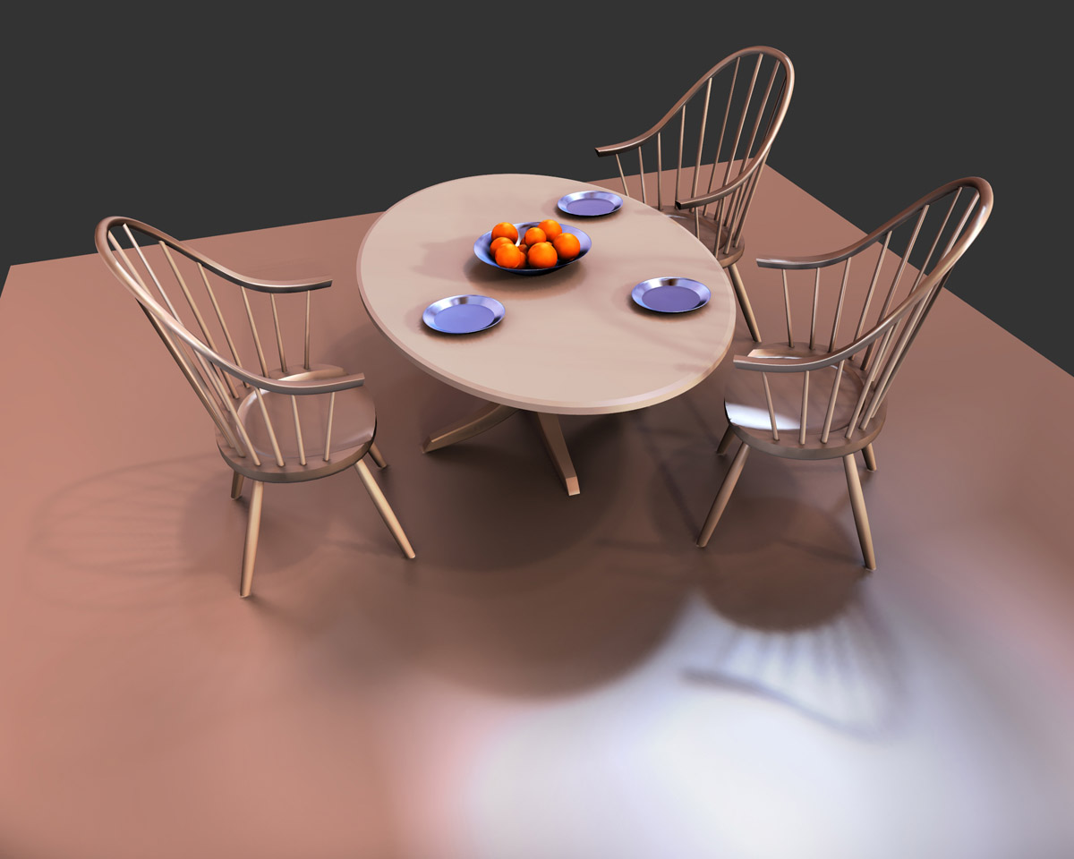
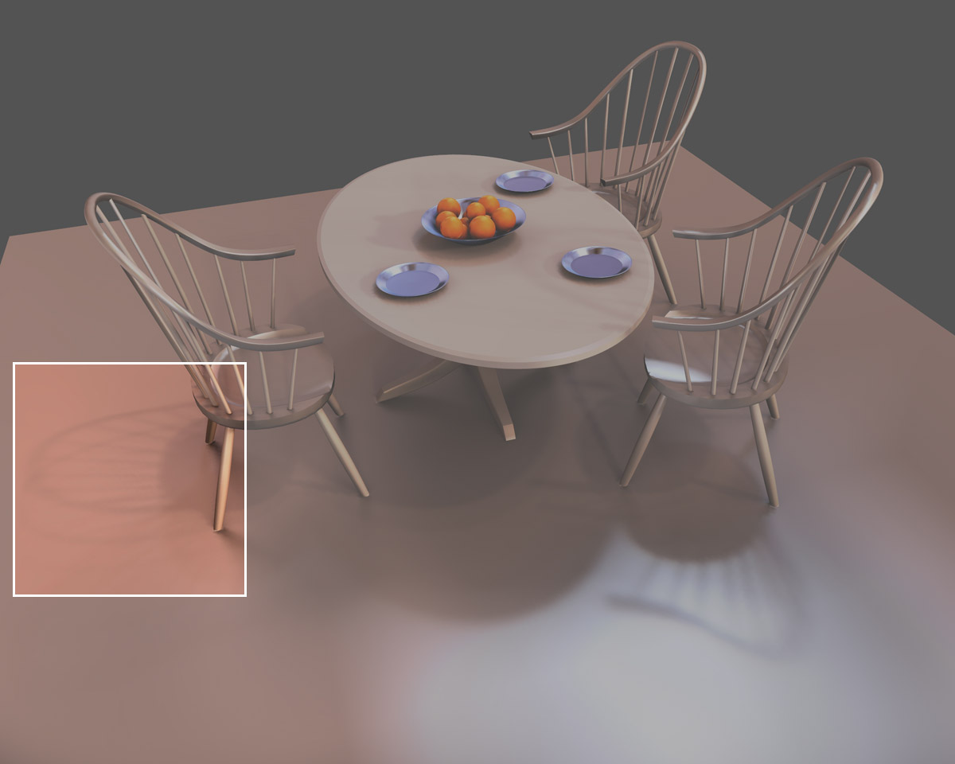
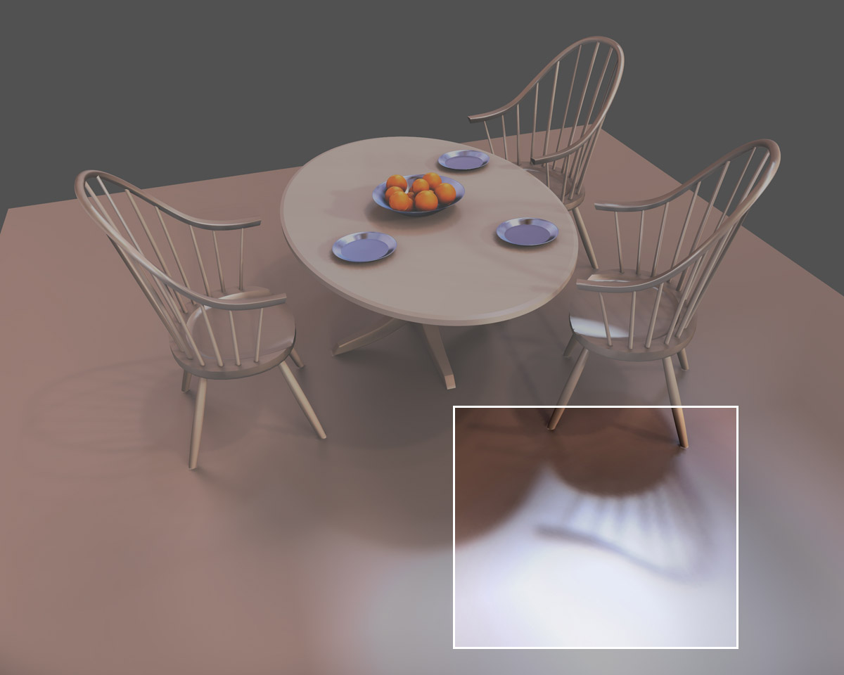



Changing Only The View
Notes:
Here are a pair of views changing just the camera as in the photos. Note that the diffuse shadows here on the floor stay fixed – they’re caused by a bright light scattering equally in all directions. They don’t change with the viewpoint.
In contrast, these glossy shadows evolve dramatically with change in viewpoint. On the left the specular lobe intersects essentially one window, and on the right it intersects parts of three windows.
These images were rendered without texture to emphasize the lighting details.

Slide 38

Problem Characterization
6D Precomputation Space
Distant Lighting (2D)
View (2D)
Rigid Geometry (2D)
With ~ 100 samples per dimension
  ~ 10¹² samples total!! : Intractable computation, rendering
Notes:
So what we’ve seen is that the transport function is 6 dimensional, because it varies over the hemisphere of incoming lighting directions, the hemisphere of viewing directions, and the surface position.
In all-frequency relighting, we need at least 100 samples per dimension, typically, so that means the 6D space uses 10^12 samples – a terasample. That’s much too much data to precompute, store or relight with.

Slide 39
Clustered PCA
Use low-frequency light and view variation (Order 4 spherical harmonic = 25 for both; total = 25*25=625)
625 element vector for each vertex
Apply CPCA directly (Sloan et al. 2003)
Does not easily scale to high frequencies
  Really cubic complexity (number of vertices, illumination directions or harmonics, and view directions or harmonics)
Practical real-time method on GPU

Slide 40
Factored BRDFs
Sloan et al. 04, Wang et al. 04: All-frequency effects
Combines lots of things: BRDF factorization, CPCA, nonlinear approx. with wavelets
Idea: Factor BRDF to depend on incident, outgoing
  Incident part handled with view-independent relighting
  Then linearly combine based on outgoing factor
Effectively, break problem into a few subproblems that can be solved view-independently and added up
  Can apply nonlinear wavelet approx. to each subproblem
  And CPCA to the matrices for further compression

Slide 41
Factored BRDFs: Critique
Simple, reasonably practical method
Problem: Non-optimal factorization, few terms
  Can only handle less glossy materials
  Accuracy not properly investigated [Mahajan et al 08]
Very nice synthesis of many existing ideas
Comparison to triple product integrals
  Not as deep or cool, but simpler and real-time
  Limits BRDF fidelity, glossiness much more
  In a sense, they are different types of factorizations

Slide 42
Outline
Motivation and Background
Compression methods
  Low frequency linear spherical harmonic approximation
  Factorization and PCA
  Local factorization and clustered PCA
  Non-linear wavelet approximation
Changing view as well as lighting
  Clustered PCA
  Factored BRDFs
  Triple Product Integrals

Slide 43



Factorization Approach
6D Transport
=
~ 10¹² samples
*
4D Visibility
4D BRDF
~ 10⁸ samples
~ 10⁸ samples
Notes:
The approach we propose in this paper is a bit different. For direct illumination, the 6D transport operator is exactly given by the product of the 4D visibility, which tells us where we can see the sky and where we’re blocked, and the 4D BRDF. So instead of using 10^12 samples, in factored form we need 10^8 samples.

Slide 44




Triple Product Integral Relighting
Notes:
The tricky part is that where we had two functions before to multiply and integrate, we now have…

Slide 45




Relit Images (3-5 sec/frame)
Notes:
Using this factored algorithm we can produce images of this 300,000 vertex scene in 3-5 seconds. The cubemaps faces here are 64x64.

Slide 46

Triple Product Integrals
Notes:
This equation is for calculating the color of a single vertex. B is the final color of the vertex, and as I mentioned it’s just the integral of the lighting, L, the visibility, V and the BRDF, p. We fold the cosine term into the BRDF.
The derivation is quite standard as with previous techniques, where we expand each of the three functions in a basis, where psi_i is the i’th basis function. If we re-order the terms, we see that we end up with a sum of all possible triples of basis coefficients, weighted by this integral of the i’th, j’th and k’th basis functions. It’s important to note that these integrals are constants --- once we choose the basis, these integrals are fixed.
We call these integrals “tripling coefficients”, and denote C_ijk as the integral of the i’th, j’th and k’th basis function.

Slide 47



Basis Requirements
Need few non-zero “tripling” coefficients
Need sparse basis coefficients
Notes:
So, looking at this equation, what do we need from a basis to compute the triple product integral efficiently?
Well, first we need the tripling coefficients to be sparse – that is for most of them to be zero.
Second, we need the basis to be able to represent our functions, the lighting, visibility and BRDF, with very few coefficients.
If we have both of these things, then most of the terms in the triple sum are zero, and relighting will be efficient.
Let’s take a look at how many non-zero tripling coefficients there are in various bases.

Slide 48
1. Number of Non-Zero Tripling Coefficients
Basis Choice | Number Non-Zero
General (e.g. PCA) | O (N ³)
Pixels | O (N)
Fourier Series | O (N ²)
Sph. Harmonics | O (N ^{5 / 2})
Haar Wavelets | O (N log N)
Notes:
Here we’re assuming that we look at basis expansions involving the first N basis functions, and ask how many of the N^3 possible triples have a non-zero integral.
The first thing to note is that in an arbitrary basis, say PCA, there’s no reason that the product of three basis functions should integrate to zero, so in general order N^3 tripling coefficients are non-zero. That’s the worst case.
The best case is the pixel basis, with piece-wise constant pixels. Since no two pixels overlap, the only way a tripling coefficient is non-zero is if all three basis functions are chosen to be the same pixel. So that means that there are only a linear number of non-zero C_ijk.
In the paper we analyze frequency-based spaces in some detail, like Fourier series and spherical harmonics. We show that they are significantly worse than pixels, with a quadratic or worse number of non-zero coefficients. This makes them unusable for this kind of technique, and I’m going to ignore them for the rest of the talk.
The last case to note is that the Haar wavelet basis has a log-linear number of non-zero terms, which is at least competitive with pixels. In fact, pixels may seem superior at this point.

Slide 49


2. Sparsity in Light Approx.
Pixels
Relative L² Error (%)
Wavelets
Approximation Terms
Notes:
This graph shows the relative error in lighting approximation as we increase the number of basis coefficients. The dashed curve is for pixels, the solid one for wavelets. Note that the horizontal scale is on a log plot, so the separation between the two curves means that for equal accuracy we can use three orders fewer wavelets than pixels. The reason for this is that the environment is an outdoor scene, where every sky pixel must be stored for accuracy. A small number of large wavelet functions can cover this sky region well.

Slide 50
Summary of Wavelet Results
Derive direct O(N log N) triple product algorithm
Dynamic programming can eliminate log N term
Final complexity linear in number of retained basis coefficients

Slide 51



Broader Computational Relevance
Clebsch-Gordan triple product series for spherical harmonics in quantum mechanics (but not focused on computation)
Essentially no previous work graphics, applied math
Same machinery applies to basic operation: multiplication
  Signal multiplication for audio, image compositing,….
  Compressed signals/videos (e.g. wavelets JPEG 2000)
=
*

Slide 52
Summary
Really a big data compression and signal-processing problem
Apply many standard methods
  PCA, wavelet, spherical harmonic, factor compression
And invent new ones
  VQPCA, wavelet triple products
Guided by and gives insights into properties of illumination, reflectance, visibility
  How many terms enough? How much sparsity?

Slide 53
Subsequent Work
My survey linked from website (lecture only covers 2002-2004)
Varied lighting/view. What about dynamic scenes, BRDFs
  Much subsequent work [Zhou et al. 05, Ben-Artzi et al. 06]. But still limited for dynamic scenes
Must work on GPU to be practical
Sampling on object geometry remains a challenge
Near-Field Lighting has had some work, remains a challenge
Applications to lighting design, direct to indirect transfer
New basis functions and theory
Newer methods do not require precompute, various GPU tricks
So far, low-frequency spherical harmonics used in games, all-frequency techniques have had limited applicability

