Slide 1
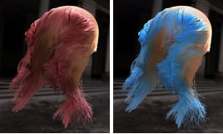

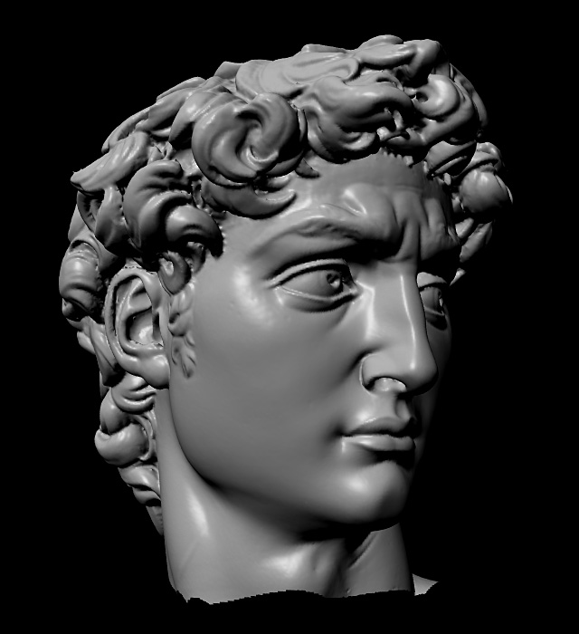
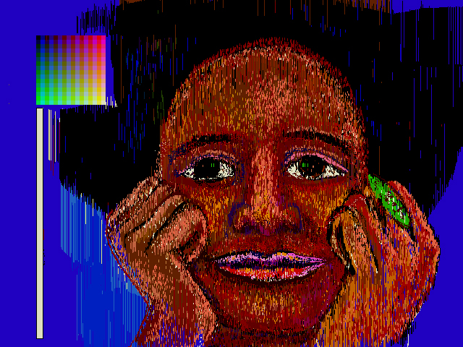
Advanced Computer Graphics
CSE 163 [Spring 2017], Lecture 1
Ravi Ramamoorthi
http://www.cs.ucsd.edu/~ravir

Slide 2
Goals
Systems: Write fairly complex programs for image processing, mesh algorithms, image synthesis
Theory: Understand mathematical aspects and algorithms underlying modern 3D graphics
This course is a continuation of CSE 167, Introduction to Computer Graphics. It fills some gaps, provides a more advanced thorough overview

Slide 3
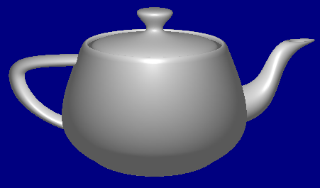
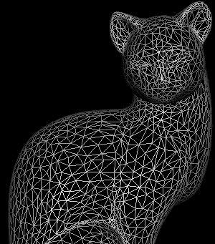
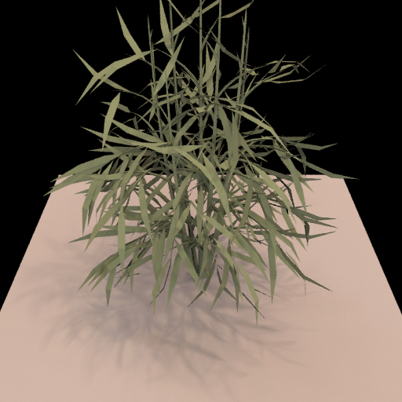
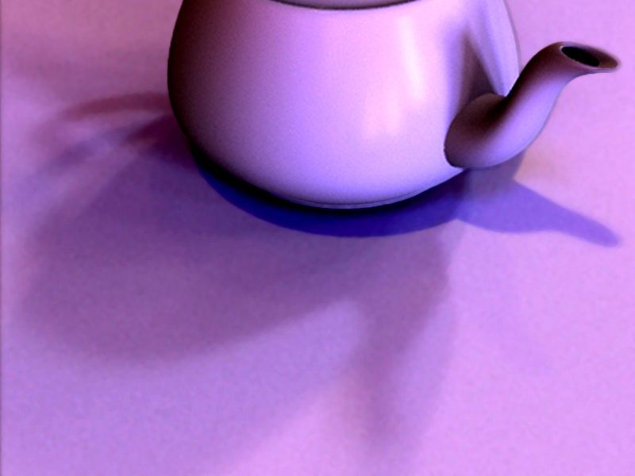
Course Outline
3D Graphics Pipeline
Rendering
(Creating, shading images from geometry, lighting, materials)
Modeling
(Creating 3D Geometry)

Slide 4
Course Outline
3D Graphics Pipeline
Rendering
(Creating, shading images from geometry, lighting, materials)
Modeling
(Creating 3D Geometry)
Unit 1: Foundations of Signal and Image Processing
Understanding the way 2D images are formed and displayed, the important concepts and algorithms, and to build an image processing utility like Photoshop
Weeks 1 – 3. Assignment 1

Slide 5
Course Outline
3D Graphics Pipeline
Rendering
(Creating, shading images from geometry, lighting, materials)
Modeling
(Creating 3D Geometry)
Unit 1: Foundations of Signal and Image Processing
Understanding the way 2D images are formed and displayed, the important concepts and algorithms, and to build an image processing utility like Photoshop
Weeks 1 – 3. Assignment 1
Unit 2: Meshes, Modeling
Weeks 3 – 5. Assignment 2

Slide 6
Course Outline
3D Graphics Pipeline
Rendering
(Creating, shading images from geometry, lighting, materials)
Modeling
(Creating 3D Geometry)
Unit 1: Foundations of Signal and Image Processing
Understanding the way 2D images are formed and displayed, the important concepts and algorithms, and to build an image processing utility like Photoshop
Weeks 1 – 3. Assignment 1
Unit 3: Advanced Rendering
Weeks 6 – 7, 8-9. (Final Project)
Unit 2: Meshes, Modeling
Weeks 3 – 5. Assignment 2
Unit 4: Animation, Imaging
Weeks 7-8, 9-10. (Final Project)

Slide 7
Overview
CSE 163, Advanced Computer Graphics
  Prerequisite: Done well in CSE 167 or equivalent elsewhere
    Strong interest in computer graphics
  Advanced undergraduates, MS, PhD all welcome
  Should count for relevant graphics/vision concentrations
Advanced topics in image processing, geometry, rendering, animation following on from CSE 167
Intended as a one quarter self-contained follow on
  If you take only one advanced graphics course, full coverage
  But can (encouraged) to take 163,168,190(VR) together
No significant overlap with CSE 165,168,169,190 VR
  Image processing, meshes new material
  Rendering coverage is real-time, image-based, not in 168

Slide 8
Overview
Regular lecture class but less rigid than CSE 167
  Advanced course, encourage class participation
But also need more independence, self discipline
  Grading entirely based on 3 large programming projects
  Can be done individually (same requirements) or group of 2
  Given 3-4 weeks, no extensions/late days. Turn in what you have. Need to START EARLY and work steadily.
  Minimal handholding, skeleton code, no feedback servers
Homeworks usually turned in by creating website
  Link to URL to submit + zip of code (new: upload TritonEd)
  Do not modify website after due date
  May schedule demos
Encourage you to take other CS 16x, 2xx in graphics

Slide 9
Overview
Workload: Challenging course: Lots of fun, rewarding but may involve significant work However, given 3-4 weeks/project; work steadily
Most will get high grades. Assume did well in 167, here to have fun learn more graphics
Final project open ended (some detailed options)
More flexibility on pass-fail (graduate students)
  Must still do one (of two) regular assignment
  Final project can be waived given research etc.
Please see website for more details, assignments

Slide 10
Administrivia
Web: http://viscomp.ucsd.edu/classes/cse163/sp17/163.html
Lectures MWF 3:00-3:50pm in Center 216
  Lectures were designed for Tue/Thu. Fri may be short
E-mail instructor directly for questions, meetings …
  ravir@cs.ucsd.edu
  Off. hours after class till 4:30pm on M/W in EBU3B, 4118
Teaching Assistants: Jiyang Yu, Jingwen Wang, tutor: Jessica Tran. See website for office hours, e-mail for other times
Piazza newsgroup: please sign up [note spr 2017] (piazza.com/ucsd/spring2017/cse163)
No books. Lecture slides online, reading as needed
  http://viscomp.ucsd.edu/classes/cse163/sp17/readings

Slide 11
To Do
Look at website
Various policies etc. for course. Send me e-mail if confused
Skim assignments if you want. All are ready
Assignment 1, due Apr 28. Start working on it immediately (START EARLY). For today, make sure download/compile
Find partners for assignment 1 and possibly later (can switch partners or switch individual/group of two between assignments if you want). Tell instructor/TA if need help
Questions?

Slide 12

History
Brief history of significant developments in field
End with a video showcasing graphics
  Similar to start of CSE 167 for those who took with me
The term Computer Graphics was coined by William Fetter of Boeing in 1960
First graphic system in mid 1950s USAF SAGE radar data (developed MIT)

Slide 13
2D Graphics
Many of the standard operations you’re used to:
  Text
  Graphical User Interfaces (Windows, MacOS, ..)
  Image processing and paint programs (Photoshop, …)
  Drawing and presentation (Powerpoint, …)

Slide 14
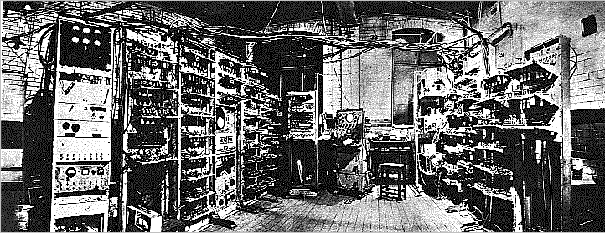
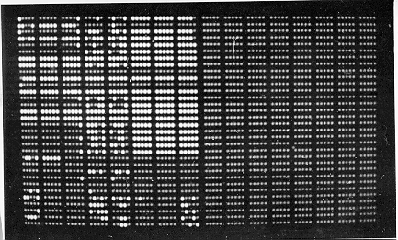
How far we’ve come: TEXT
Manchester Mark I
Display

Slide 15
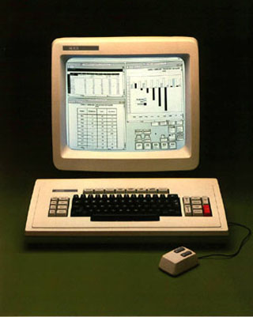
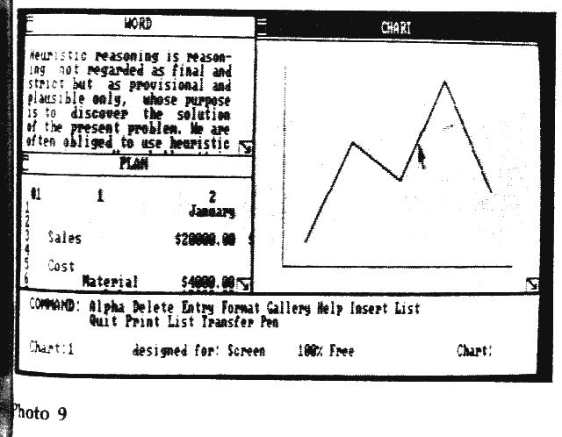
From Text to GUIs
Invented at PARC circa 1975. Used in the Apple Macintosh, and now prevalent everywhere.
Xerox Star
Windows 1.0

Slide 16
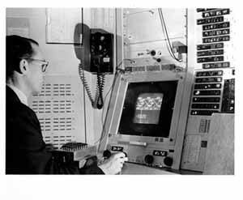
Drawing: Sketchpad (1963)
Sketchpad (Sutherland, MIT 1963)
First interactive graphics system (VIDEO)
Many of concepts for drawing in current systems
  Pop up menus
  Constraint-based drawing
  Hierarchical Modeling

Slide 17
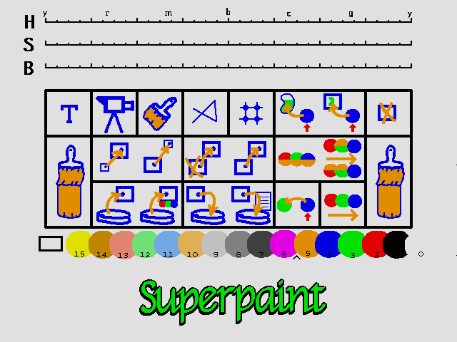
Paint Systems
SuperPaint system: Richard Shoup, Alvy Ray Smith (PARC, 1973-79)
Nowadays, image processing programs like Photoshop can draw, paint, edit, etc.

Slide 18
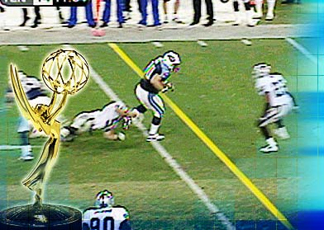
Image Processing
Digitally alter images, crop, scale, composite
Add or remove objects
Sports broadcasts for TV (combine 2D and 3D processing)

Slide 19
Relevance to Course
In 167, didn’t focus on 2D
But relevant broadly (not just for 2D), since ultimately 3D scene displayed as 2D image
In 163, we cover image processing and many photoshop functions [assign. 1 to write a mini-version]

Slide 20
Geometry
Spline curves, surfaces: 70^{s} – 80^{s}
Utah teapot: Famous 3D model
More recently: Triangle meshes often acquired from real objects

Slide 21

Progressive Mesh Simplification

Slide 22
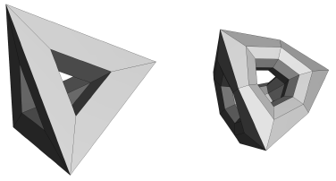
Subdivision Surfaces
Coarse mesh + subdivision rule
  Smooth surface = limit of sequence of refinements
Video

Slide 23
Relevance to Course
Unit 2 is about mesh processing algs.
Will learn to represent, work with meshes
Do mesh simplification, progressive meshes for assignment 2

Slide 24
Rendering and Appearance
Core area in computer graphics
Efficiently and easily create visual appearance
Long history (1960s to current time): Variety of old and new topics
From basic visibility and shading, to global illumination, to image-based rendering, to data-driven appearance and light fields
Many links to physics, math, computer science
We focus on real-time, image-based (no overlap with 168 that focuses on basic offline rendering)

Slide 25
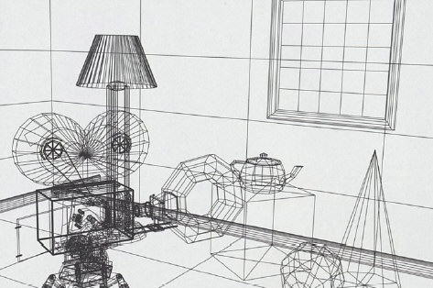
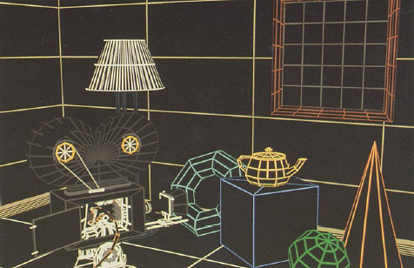
Rendering: 1960s (visibility)
  Roberts (1963), Appel (1967) - hidden-line algorithms
  Warnock (1969), Watkins (1970) - hidden-surface
  Sutherland (1974) - visibility = sorting
Images from FvDFH, Pixar’s Shutterbug
Slide ideas for history of Rendering courtesy Marc Levoy
Notes:
1970s
illustrations taken from FvDFH

Slide 26
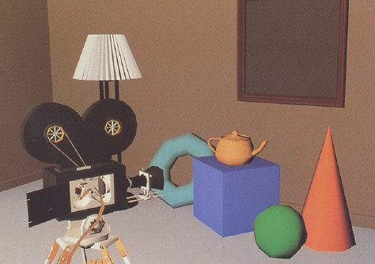
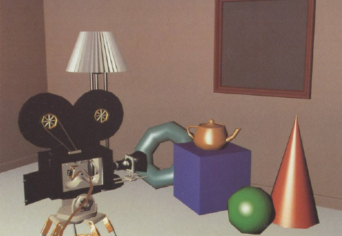
Rendering: 1970s (lighting)
1970s - raster graphics
  Gouraud (1971) - diffuse lighting, Phong (1974) - specular lighting
  Blinn (1974) - curved surfaces, texture
  Catmull (1974) - Z-buffer hidden-surface algorithm
Notes:
1970s
illustrations taken from FvDFH

Slide 27
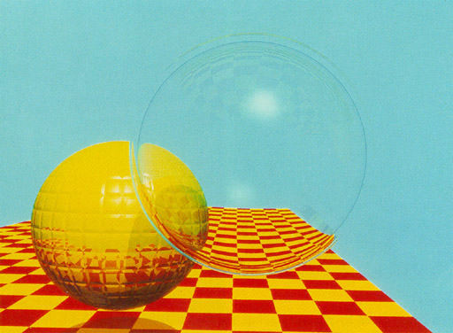
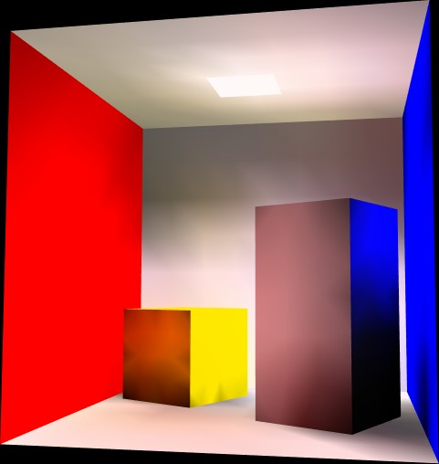
Rendering (1980s, 90s: Global Illumination)
early 1980s - global illumination
  Whitted (1980) - ray tracing
  Goral, Torrance et al. (1984) radiosity
  Kajiya (1986) - the rendering equation
  This is basically what 168 covers
Notes:
1980s
illustrations taken from Siggraph proceedings
global illumination
ray tracing = Monte Carlo evaluation of the rendering equation
radiosity = finite element evaluation of the rendering equation

Slide 28
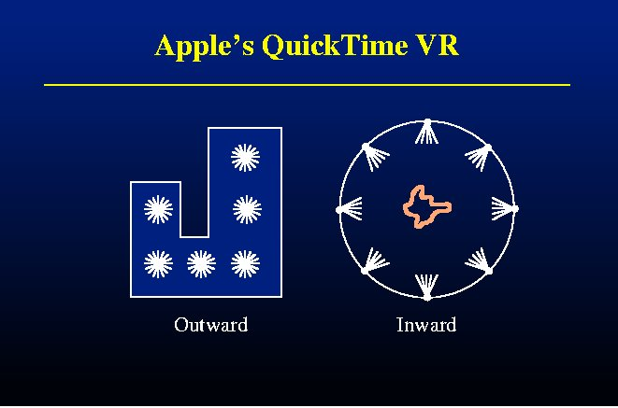
Image-Based Rendering

Slide 29
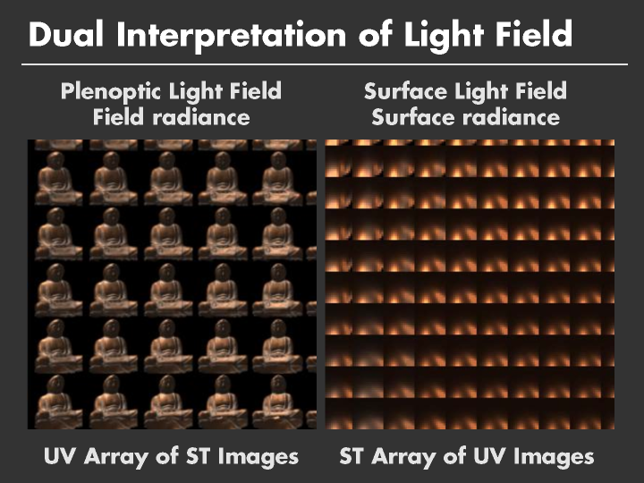

Slide 30
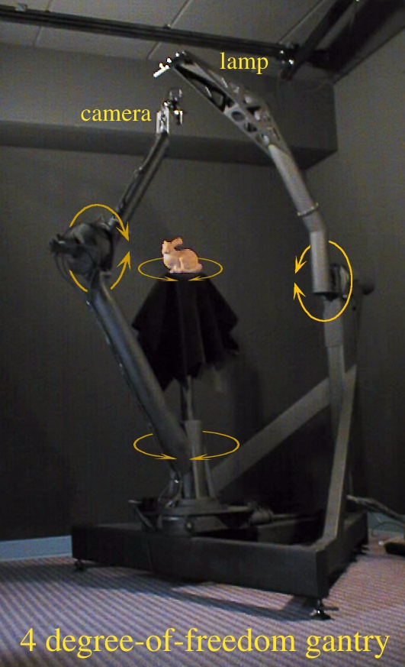
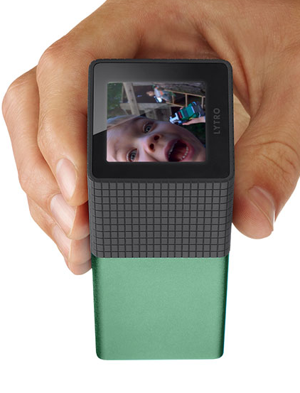
Lytro Light Field Camera
Demo refocus, perspective

Slide 31
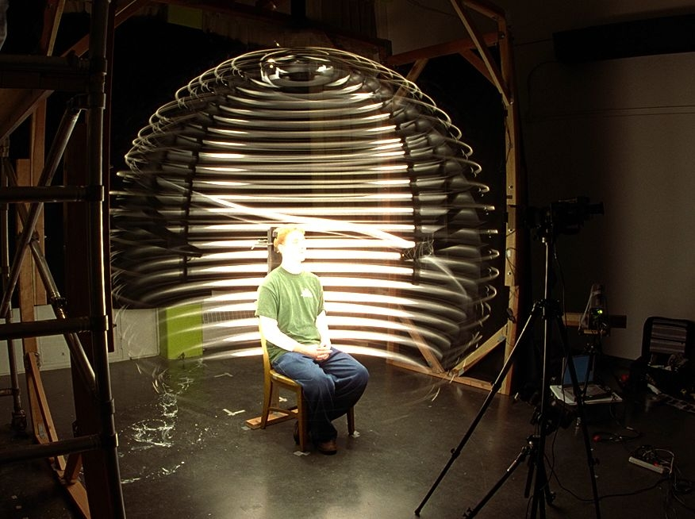
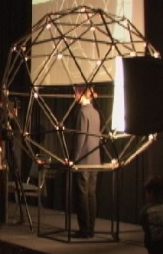
Acquiring Reflectance Field of Human Face [Debevec et al. SIGGRAPH 00]
Illuminate subject from many incident directions

Slide 32
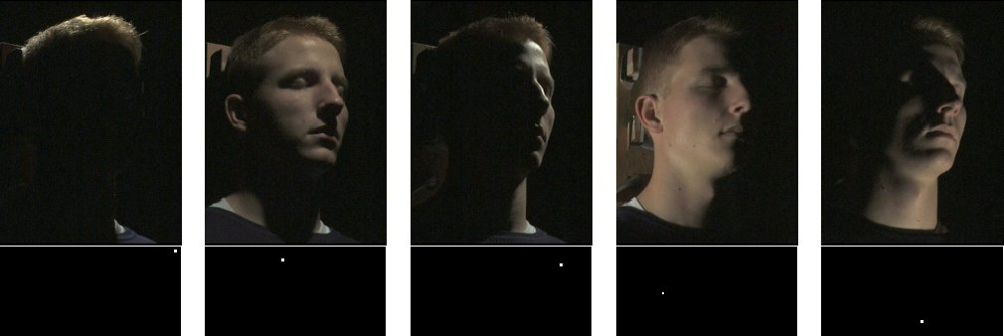
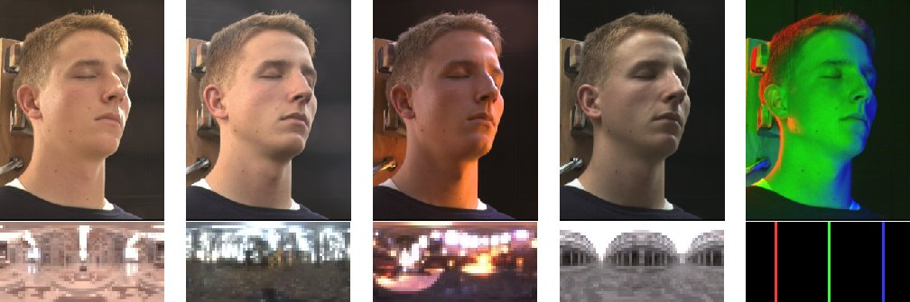
Example Images
Images from Debevec et al. 00

Slide 33
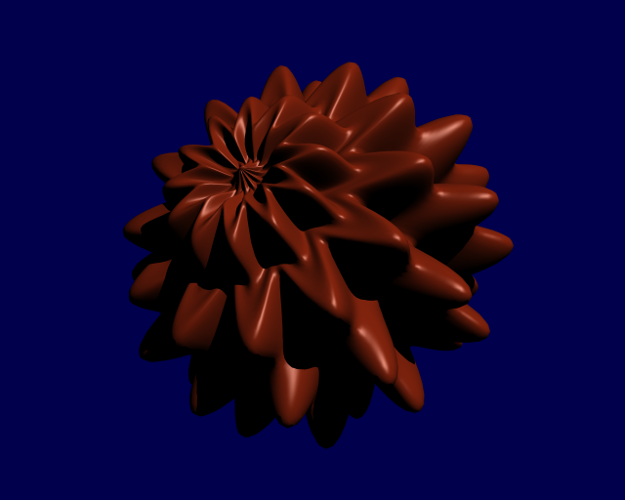
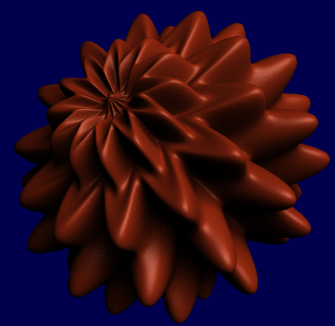
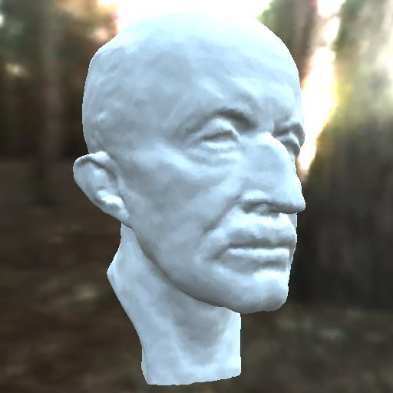
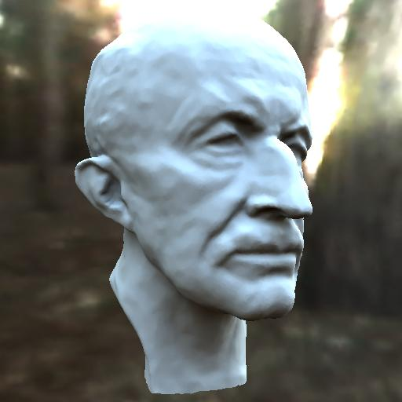
Precomputed Radiance Transfer
Better light integration and transport
  dynamic, area lights
  self-shadowing
  interreflections
For diffuse and
glossy surfaces
At real-time rates
Sloan et al. 02
point light
area light
area lighting,
no shadows
area lighting,
shadows
Notes:
We think there’s good reason to concentrate on this part of the lighting/transport complexity space.
We wanted to handle dynamic and large area lights, including their self-shadowing and interreflection effects.
Area lights can add a sense of realism that is difficult to obtain with point lights – in the top row we have a displacement mapped sphere illuminated with a point light (casting hard shadows) and an area light (casting soft shadows.) The object shape’s is more effectively conveyed with soft shadows.
Shadows also add much more realism than area lighting without shadows.
In the bottom row we have a bust of the max planc head rendered on the left using ravi’s technique from last year (no shadows) and on the right using our technique. Though both are lit by an entire environment, the shadowed image on the right looks more realistic.
We wanted to achieve these effects for both diffuse and glossy surfaces at real-time rendering rates.

Slide 34
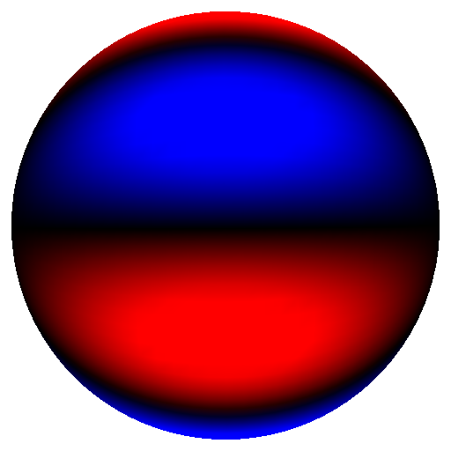
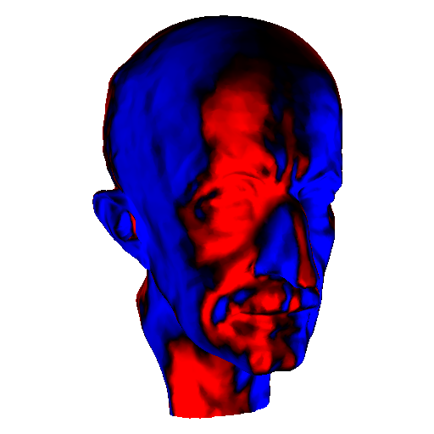
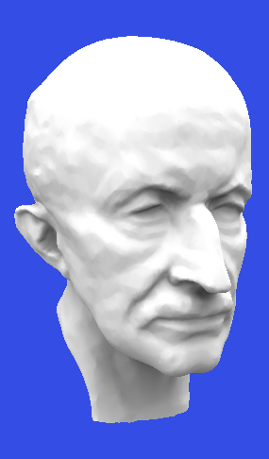

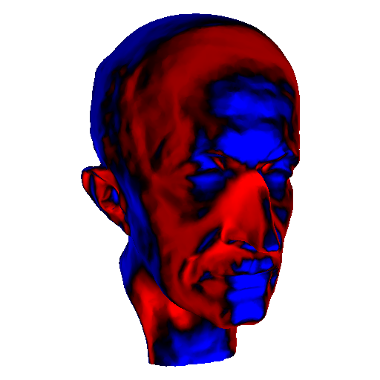
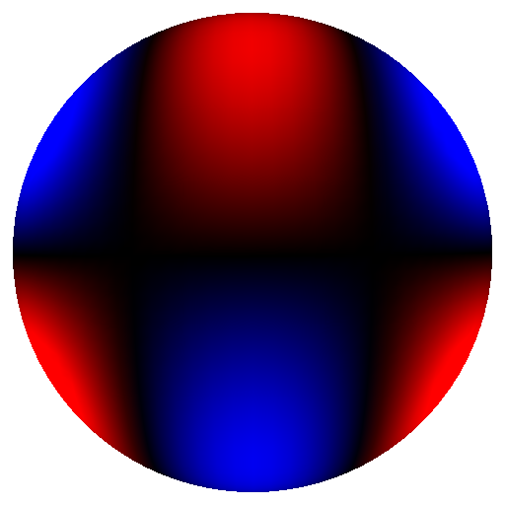
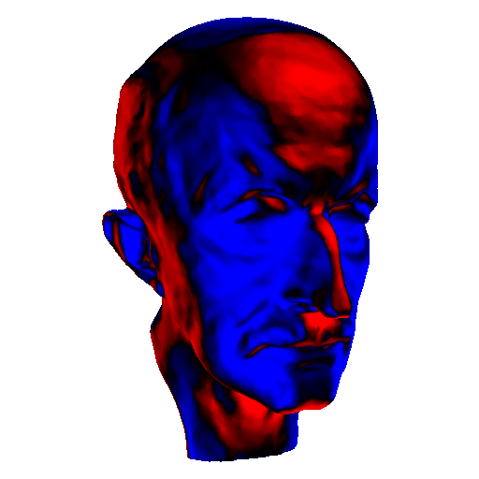
Precomputation: Spherical Harmonics
.
.
.
Basis 16
Basis 17
illuminate
result
Basis 18
.
.
.
Notes:
This slide illustrates the precomputation for direct lighting. Each image on the right is generated by placing the head model into a lighting environment that simply consists of the corresponding basis function (SH basis in this case illustrated on the left.) This just requires rendering software that can deal with negative lights.
The result is a spatialy varying set of transfer coefficients shown on the right.
To reconstruct reflected radiance just compute a linear combination of the transfer coefficient images scaled by the corresponding coefficient for the lighting environment.

Slide 35
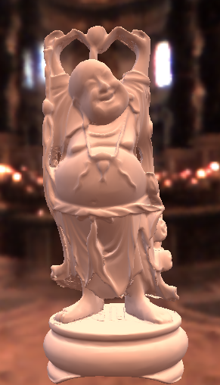
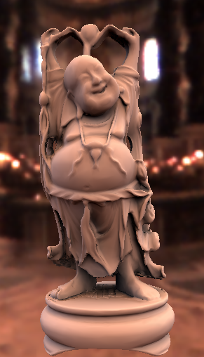
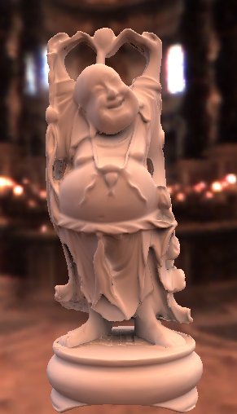
Diffuse Transfer Results
No Shadows/Inter Shadows Shadows+Inter
Notes:
This set of images shows the buddha model lit in the same lighting environment, without shadows, with shadows and with shadows and inter reflections.

Slide 36
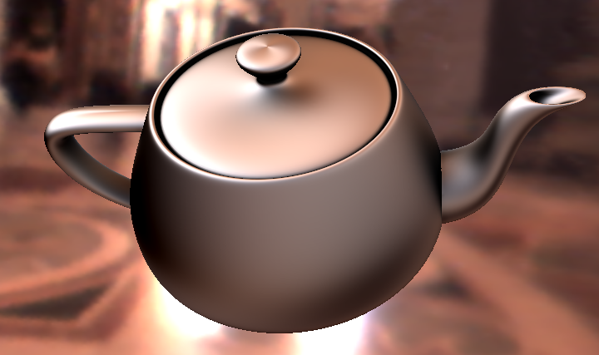
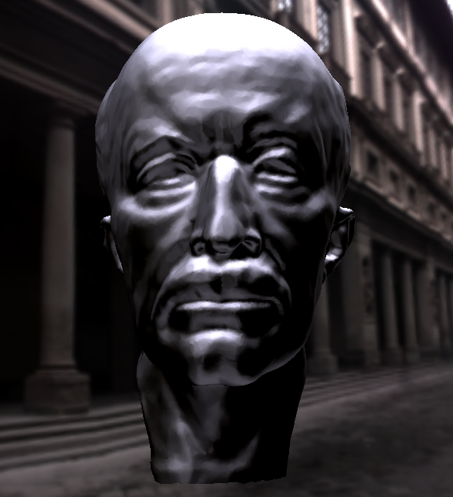
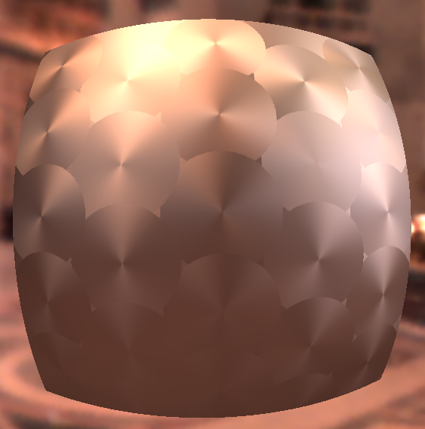
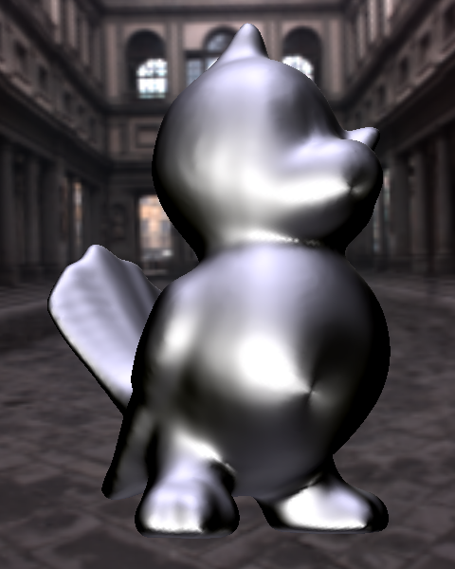
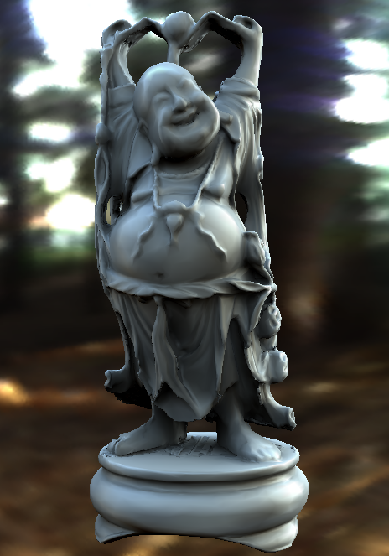
Arbitrary BRDF Results
Anisotropic BRDFs
Other BRDFs
Spatially Varying
Notes:
Here are a few results. On the left you can see renderings with anisotropic BRDFs, in the middle renderings with the Ashikhmin-Shirley BRDF and with measured vinyl. On the right you can see spatially varying BRDFs. All of these examples can be rendered at interactive rates.

Slide 37
Imaging
Processing of images important part of graphics
Especially in context of photography: Combine photos, manipulate images
Computational photography. Examples flash/no-flash, fluttered shutter, new light field cameras
Community and Internet photo collections
Basic ideas like HDR and Texture Synthesis

Slide 38
High Dynamic Range
Photographs at multiple exposures
Combine and tonemap
From Wikipedia. Debevec and Malik 97

Slide 39
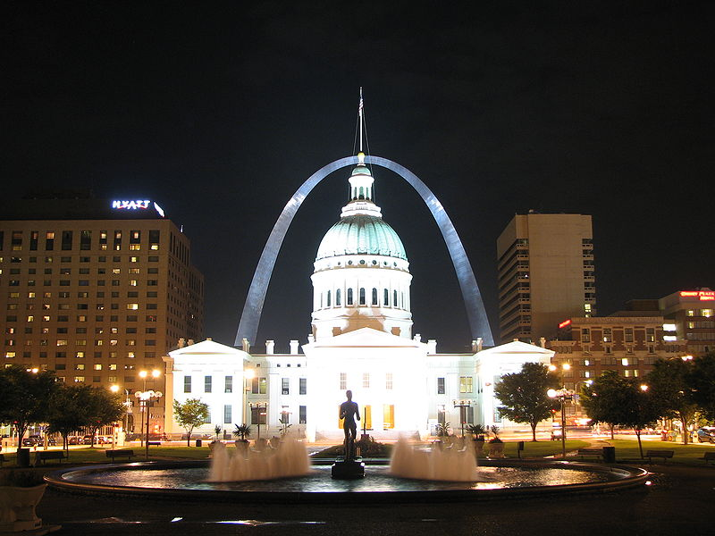
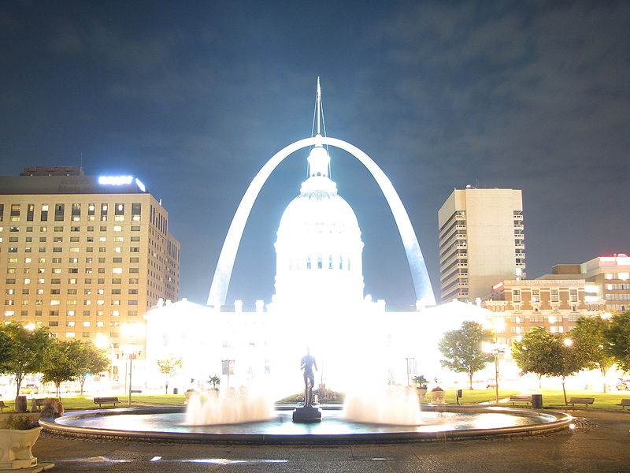
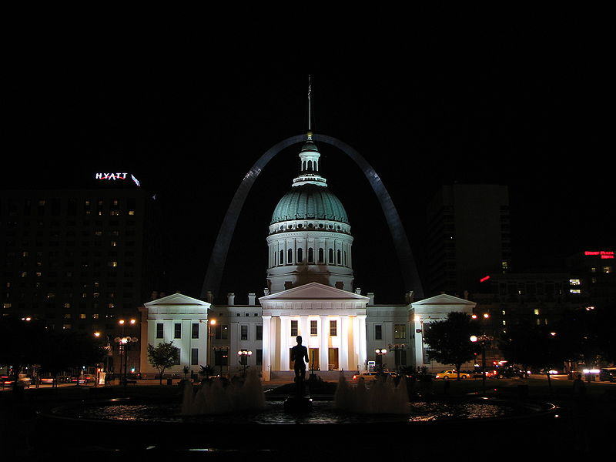

Multiple Photographs

Slide 40

Combined and Tonemapped

Slide 41

Texture Synthesis
From small image to larger (keep texture)
Novel idea: Copy image patches (quilting)
Efros and Leung 99, Efros and Freeman 01. This example from Wikipedia

Slide 42
History of Computer Animation
10 min clip from video on history of animation
http://www.youtube.com/watch?v=LzZwiLUVaKg
Covers sketchpad, animation, basic modeling, rendering
A synopsis of what this course is about
(watch offline if short on time)

Slide 43
Summary
Graphics is Modeling/Geometry, Rendering, Animation/Simulation, Imaging and much more
Course looks at all of these. One stop follow on to CSE 167, no overlap with 165, 168 or 169
3 programming assignments (groups of 2)
  Image Processing
  Progressive Meshes
  Project (eg Real-Time / Image-Based Rendering)

